Slide 1
Every Small Town Could Use One:
Brownfield Locations and a Regional Landbank
Dr. Victoria Livingston
Prairie Hills Resource Conservation & Development

Slide 2
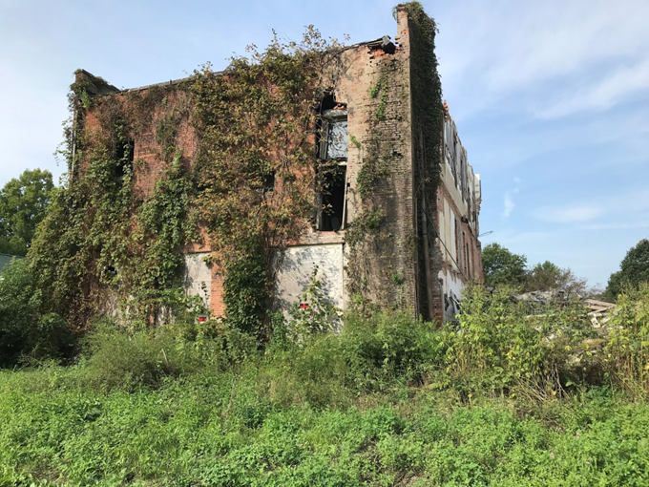
Overview
Introduction to Prairie Hills RC&D
Brownfield definitions & process
Land Bank process
Community Redevelopment
Community Engagement
Examples from our program
Funding opportunities
Final thoughts & questions

Slide 3
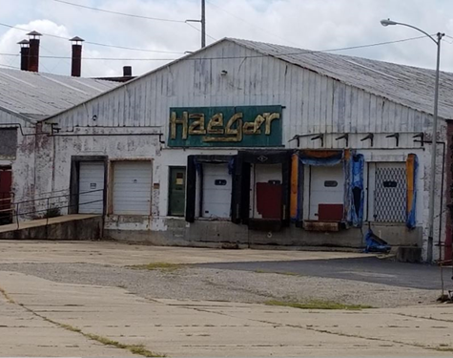

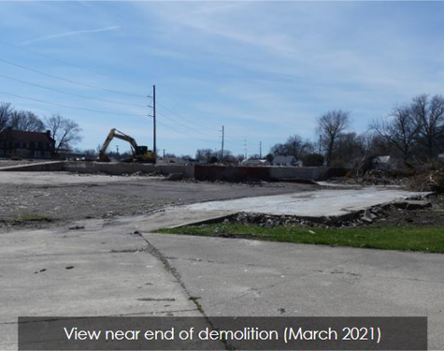
PHRCD
Originally formed through RCD program.
Registered 501(c)3 non-profit
Today we have several divisions:
Prairie Land Conservancy
Small Business Loan program
Fiscal Sponsorship Program
Macomb Farmers market
Community Redevelopment &
Brownfield Revitalization program
Prairie Hills Land Bank Authority

Slide 4
Brownfield Team
US EPA
IL EPA
Stantec Environmental Consultants
eProperty Innovations – Land Bank Consultant
Illinois Institute for Rural Affairs
Prairie Hills Resource Conservation & Development
Fulton County
Knox County
McDonough County
Warren County
Hancock County
Notes:
Hired Stantec to write and submit an EPA Brownfield Community Wide Assessment (CWA) grant, and then opted for a Revolving Loan Fund (RLF) grant
Currently preparing for our next round of CWA grant

Slide 5
Definitions
“Brownfields are real property, the expansion, redevelopment, or reuse of which may be complicated by the presence or potential presence of a hazardous substance, pollutant, or contaminant.” -EPA
This is a broad definition – because potential substances and sources are varied.

Slide 6
Definitions
Greenfields are properties that have never been developed.
They are currently open space or agricultural.
The development restrictions are much smaller.

Slide 7
Brownfield Varieties
Brownfields come in 2 flavors:
Petroleum sites are usually former gas stations, auto shops or car dealers.
Hazardous substances are often manufacturing or industrial sites, commercial buildings, salvage yards. In many cases, they’re public buildings like schools.
- Biggest concerns are asbestos and lead.

Slide 8
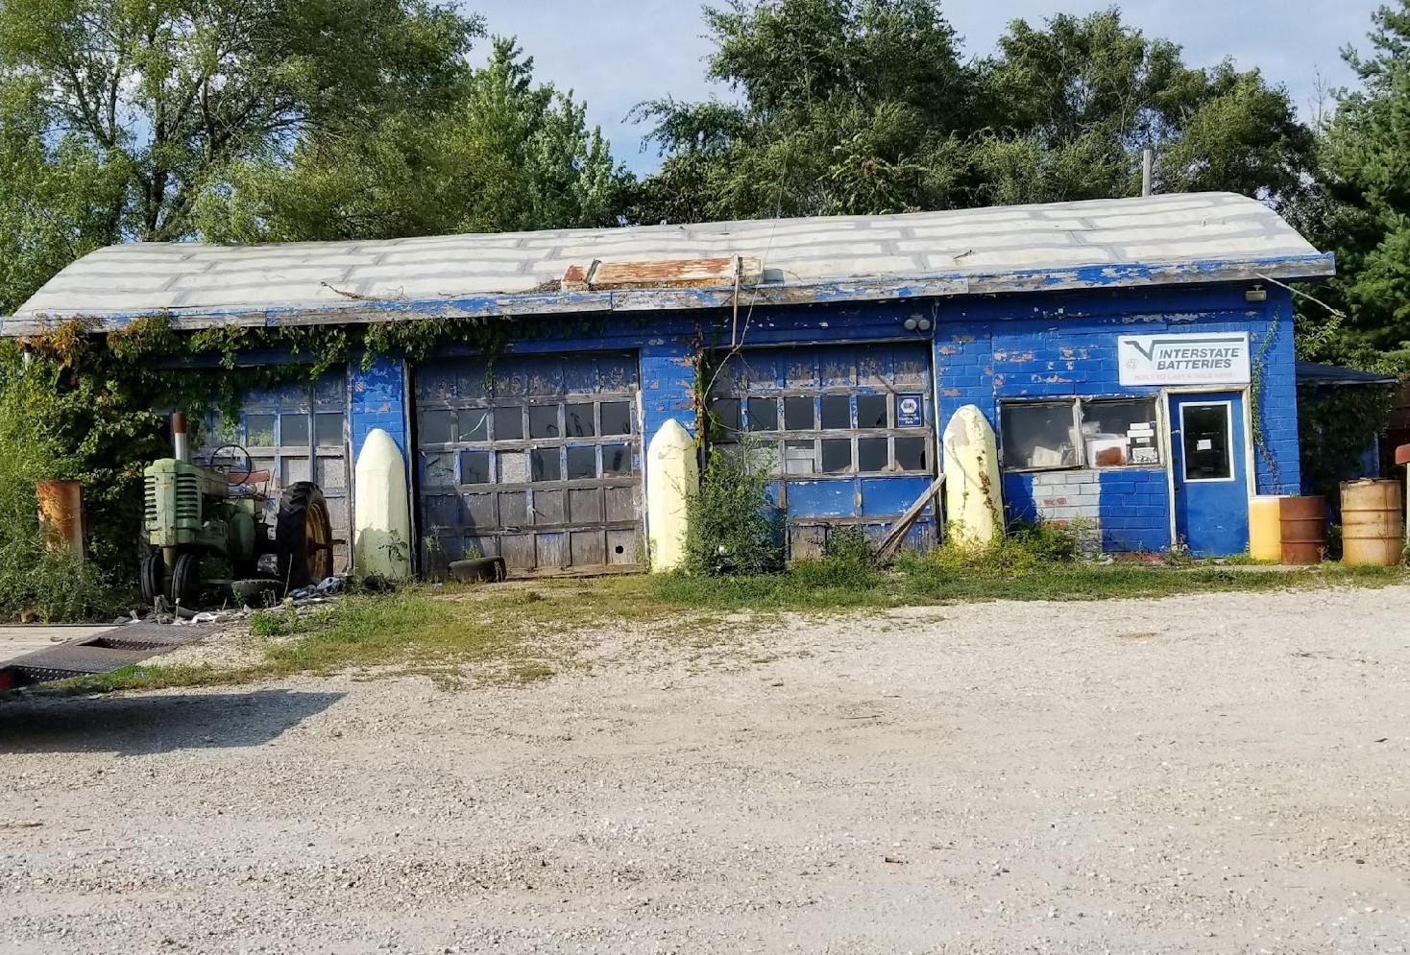
Brownfield Varieties
Notes:
Okay, quiz time. Think of the communities you spend your time in – living, working, shopping, wherever – do you see properties like these? How many of you can think of 3 places like this, off the top of your head? 5? 8? 12? More than 12??
Literally all of us have something like this. Chances are really good they qualify for at least a phase I assessment to determine safety of the building and the community.
Top left –
Top right – Farmington
Bottom – Abingdon main st

Slide 9
Our Brownfield Story
Selected for an US EPA Brownfield Community Wide Assessment grant in 2018.
Additional grant dollars awarded in 2022, and most recently in 2025.
Started to notice some trends across this project, not only in properties, but in circumstances and property owners.

Slide 10
Brownfield Owners
Vacant landowners are often hard to find.
Out of state speculators are even more complicated.
Local owners may not be receptive to change.
Properties owned by multiple people come with relationship challenges.
Some grants specify municipal or non-profit ownership for eligibility.

Slide 11
Let’s Form a Landbank!
As a potential solution, we decided to explore land banking.
My first question was “What’s a Land Bank?”
It’s an additional set of tools to address vacant or distressed properties.
Functions like a “repair station” – land is held by the land bank for a set period of time and then is passed back into productive use.

Slide 12
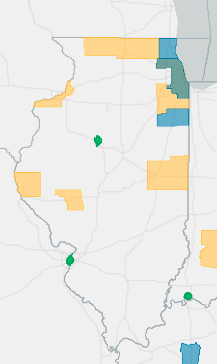
Illinois Land Banks
Currently 10 landbanks in the state.
We’re new enough we haven’t
made the map yet.

Slide 13
Illinois Landbanks
Even within IL, they vary in form and function.
Some are held within a single city – Peoria or the Quad Cities.
Some are more regional like Central Illinois or ourselves.
Two Rivers has members in 2 different counties that are not adjacent.

Slide 14
Series of Steps
To begin, we talked to a US EPA Brownfield Technical Assistance provider.
For our region, it’s Kansas State University.
They connected us with an Illinois based company who worked with multiple landbanks across the state.

Slide 15
Series of Steps
Meet our Consultant, Brian.
Meet with local groups who may be interested in joining.
Draft an Intergovernmental Agreement.
Adopt IGA via resolution and form the LB.

Slide 16
Identifying Potential Partners
Landbanks are open to municipalities, county boards and economic development agencies.
When starting our LB, we decided to include a 5-county region, totaling 150,000 people.
  Had identified plenty of BF opportunities in those 5 counties.
  Wanted to take a regional approach.
  Economically this area isn’t moving in a lot of places – limiting our members too much could make the economy of a LB more challenging.

Slide 17
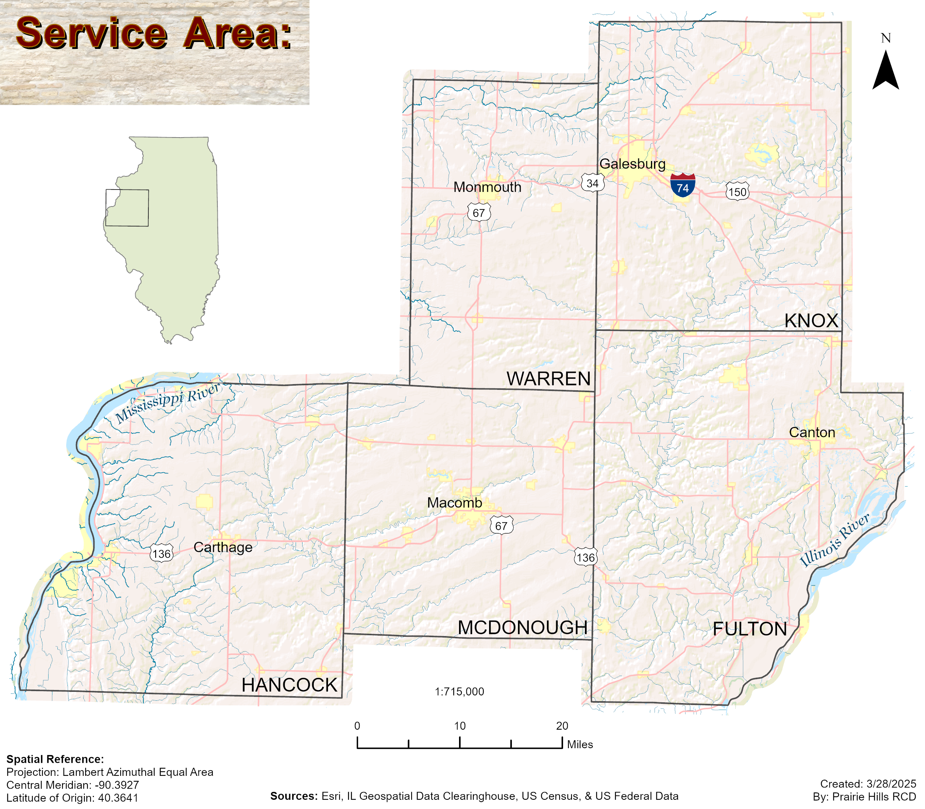

Slide 18
Community Meetings
We started with a 2-day tour of the region.
Met with city council members, mayors, county board members, economic development directors, anyone who expressed interest in hearing about the opportunity.
Continued for the next few months to meet with committees, councils, and boards.
Held a monthly information meeting to answer questions and provide information.
Assembled an informational packet.

Slide 19
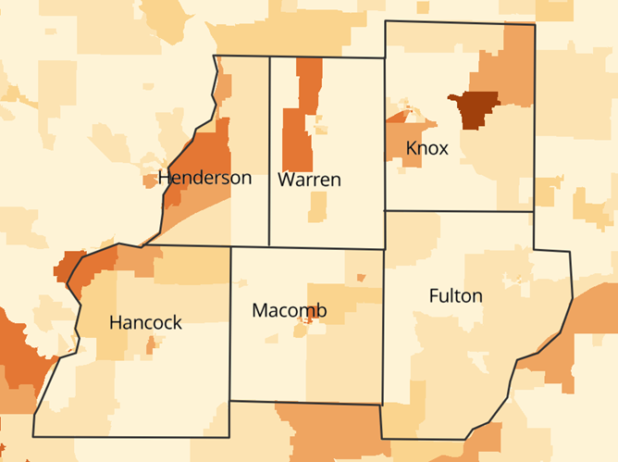

Slide 20
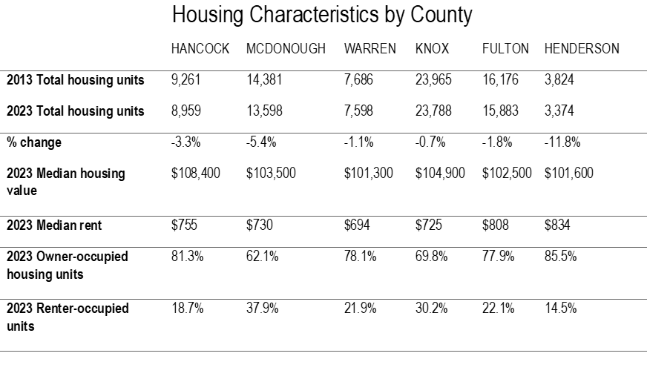

Slide 21
Land Bank Funding Model
Currently we do not have state level legislation or funding for landbanks.
Still need starting funds.
Decided to ask member communities for an annual per capita membership fee of $3.
Provides stable annual income for operations.

Slide 22
Land Bank Funding Model
Illinois Housing Development Authority (IHDA) tends to look favorably on landbanks.
There are TA grant pools to offer:
Legal services
Regional planning
Data collection

Slide 23
Community Redevelopment
Several plus sides to this sort of development.
Revitalize current corridors and entry points to the city.
Bring focus back to the heart of the city instead of greenfield or new construction.
Reduction in blighted properties raises values for others.
Reduces loss of historical places.

Slide 24
Community Engagement
These types of conversations happen best face to face.
Meeting with rural city or village administrations.
Take a walk around the downtown or the main street through town with the city representative.
Some will have specific properties in mind, and will know the history.
Sometimes, new opportunities come up that they didn’t think about.

Slide 25
Community Engagement
Through our brownfield program, we’re able to offer technical assistance and reuse planning support.
We can connect a community with a city planning firm.
They complete the market analysis, draws up the plans and gives the city a tangible goal to take to the developer.
To small communities with few staff, this is huge.

Slide 26
Pairing the Right Programs
Combining our brownfield resources with the capability of the landbank is a great asset.
The brownfield grant program can pay for many requirements to work on these properties.
The landbank can hold title on properties while they work through the brownfield process.

Slide 27
Phase I ESA Reports
First step in determining what could be on the property.
Starts with historical look at land use, neighboring land use.
Reviews land title records, fire insurance maps, aerial photos, etc.
Looking for any uses that include use, storage, treatments, disposal or generation of hazardous substances, petroleum products and wastewater.
Essentially looking for possible problems before getting into the site.
Notes:
Environmental Site Assessment

Slide 28
Phase I ESA Reports
Phase I investigations may include site visits.
Helpful for identifying things like above ground storage tanks or potentially harmful building materials.
Phase I reports are needed for real estate transactions, so providing this service often makes the sale more attractive.
Phase I reports will also indicate if a Phase II report is needed.
Notes:
Environmental Site Assessment

Slide 29
Phase II ESA Reports
Can include things like hazardous material surveys, soil testing, water testing, air testing, property conditions, building material testing, etc.
Not always needed, and often don’t look exactly the same.
Reflection of what was found during the Phase I report.
From here, the owner should have a solid idea of what is needed.

Slide 30
ABCA
Analysis of Brownfield Cleanup Alternatives.
Helpful when determining what actually needs to be done.
Sometimes full-scale remediation is unnecessary.
If the intended property use would contain the contamination.
If removing the contamination would expose the property to larger levels of contamination.
If the less expensive option isn’t the best option.

Slide 31
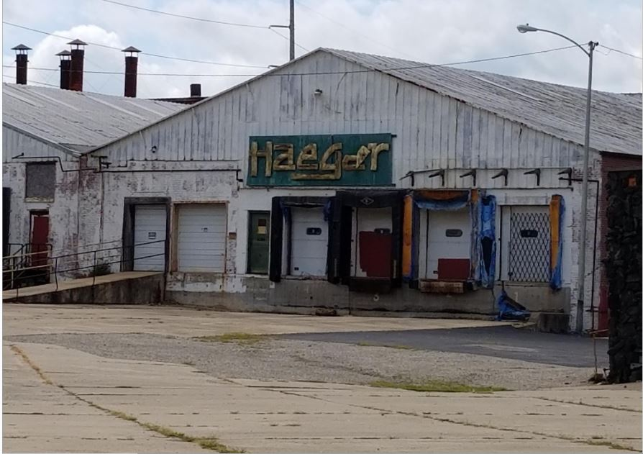
Examples from Our Program

Slide 32
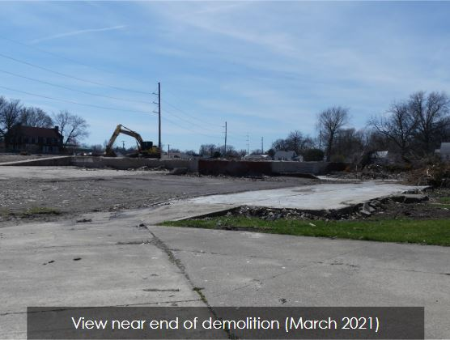
Examples from Our Program

Slide 33
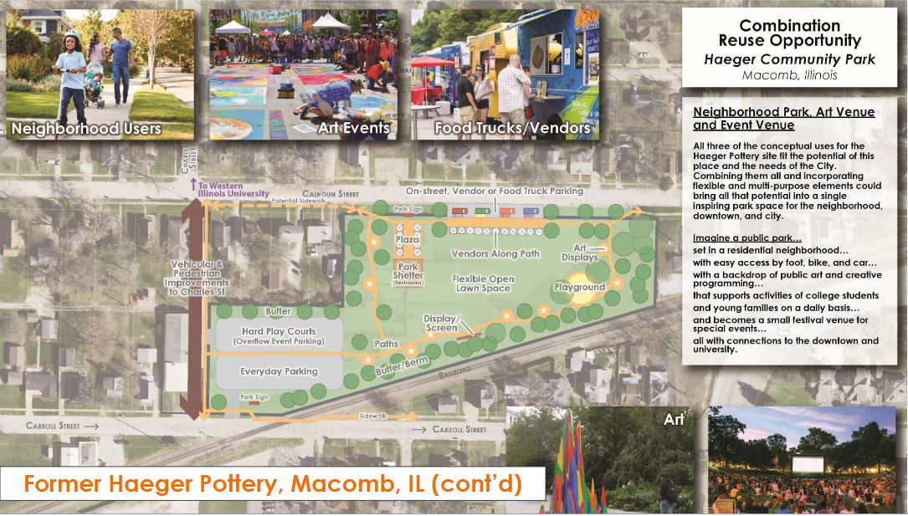
Examples from Our Program

Slide 34
Examples from Our Program
This site is the first property coming into our landbank.
Originally thought of as a great community meeting space and farmers market location.
Thoughts are moving in a different direction, and now we’re looking to remediate to city park conditions.
  Applying for an EPA clean up grant to help remove contaminated soils.
  Intend to build playground area, shelter house, native pollinator habitat and more.
  Want something the community can be proud of, to potentially help draw new families into vacant housing in the area.

Slide 35
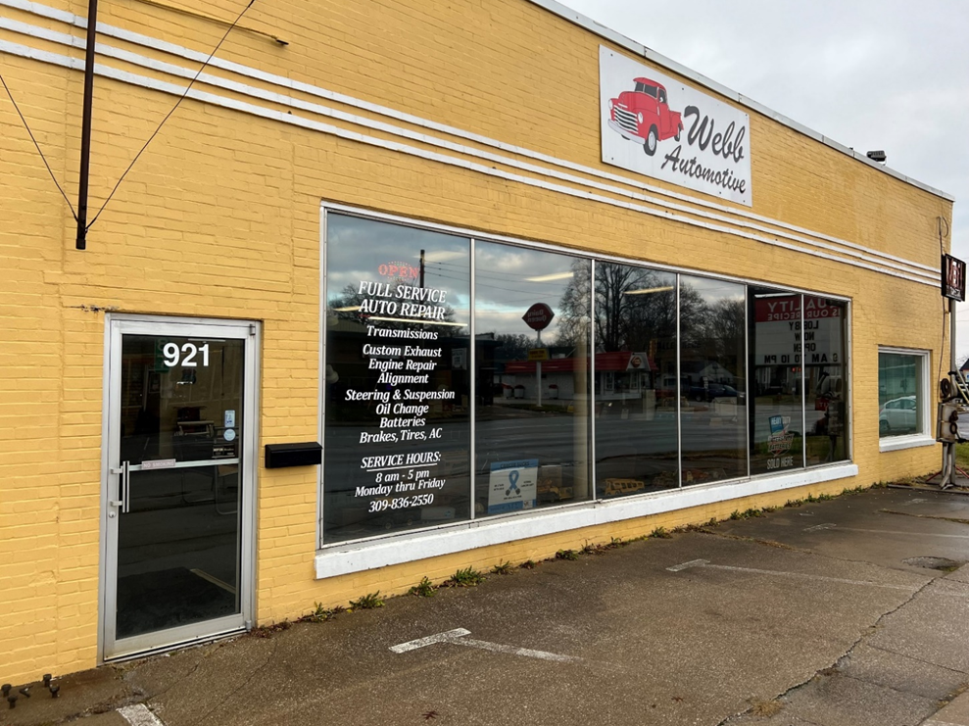
Examples from Our Program
Notes:
Webb automotive – Macomb

Slide 36

Former gas station (circa 1942-1982)
Auto repair facility (circa 1942-2023)
Bulk fuel storage facility (circa 1942-1981)
Adjacent site to east also used as a gas station and bulk fuel storage facility
Phase I ESA completed (April 2023)
Sampling and Analysis Plan completed (June 2023)
Phase II ESA completed (November 2023)

Slide 37
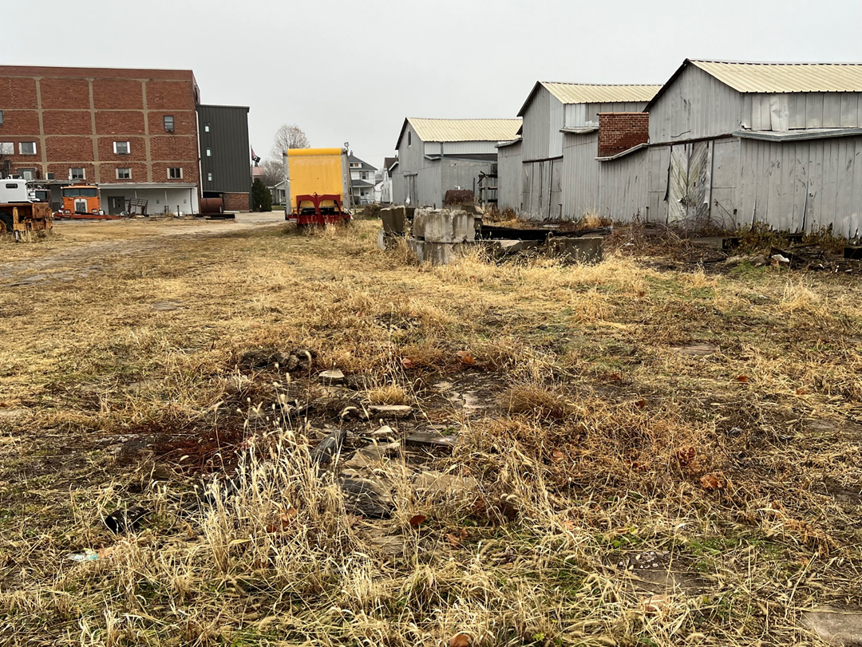
Examples from Our Program
Notes:
Munson property – Monmouth

Slide 38
3-parcel 4-acre former industrial site
Historic use by the Wier and Monmouth Plow Companies (1871-1920)
Subsequent use for warehouse and distribution, pottery manufacturing, and truck company
Phase I ESA completed (June 2023)
Sampling and Analysis Plan approved by EPA (November 2023)
Phase II ESA completed (June 2024)

Slide 39
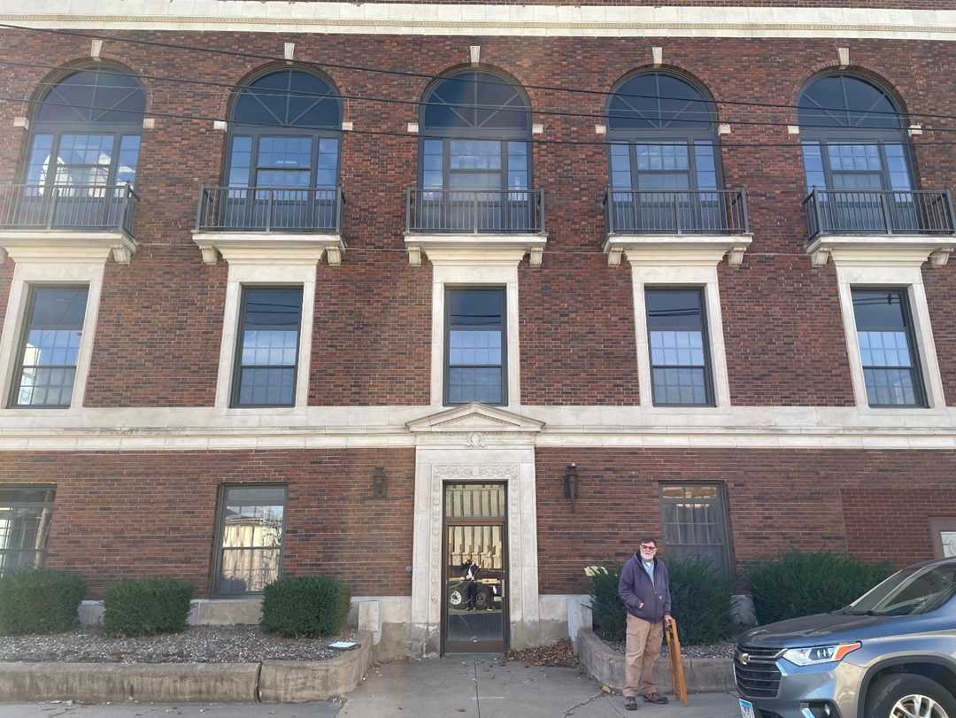
Examples from Our Program
Notes:
Former City Hall – Monmouth

Slide 40
0.2-acre site with 3-story brick building constructed in 1915
Initially developed prior to 1886
Primary historic use as a jail and city hall, until the City Hall moved to its current location in 2000.
Purchased by Warren County for use for offices and storage.
Phase I ESA completed (January 2024)
Building sold back to the city

Slide 41
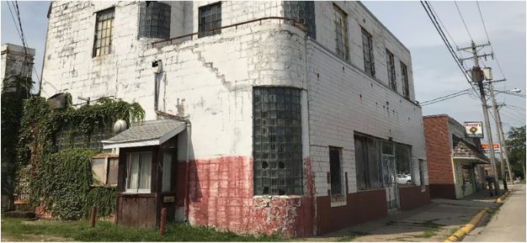
Examples from Our Program
Notes:
Maple City Dairy in Monmouth

Slide 42
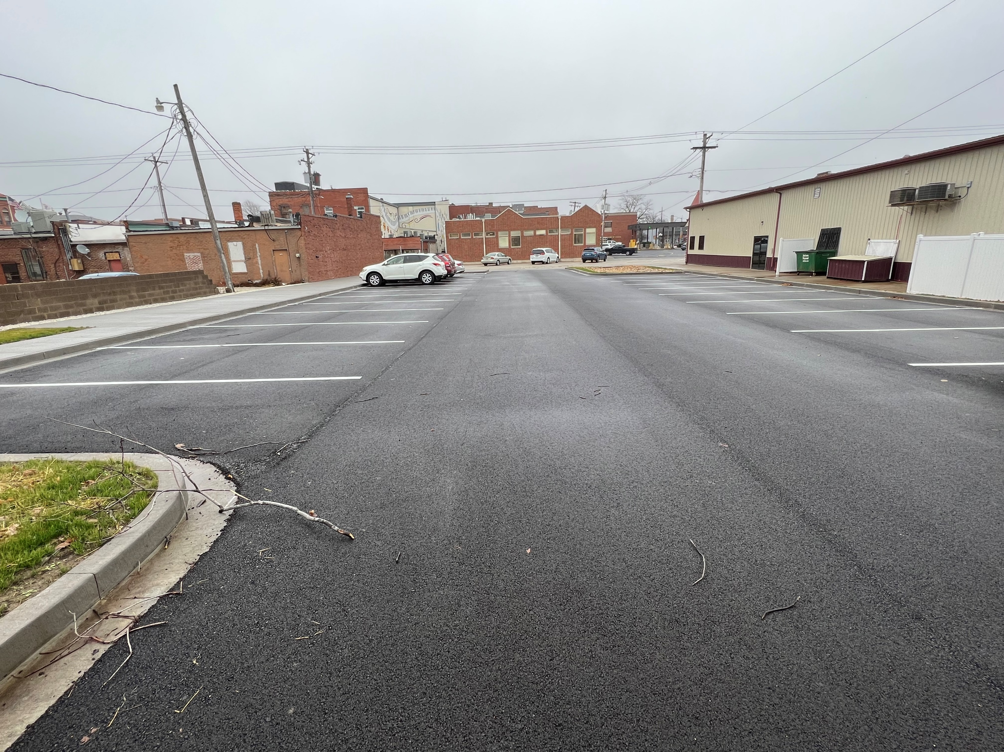
Examples from Our Program

Slide 43
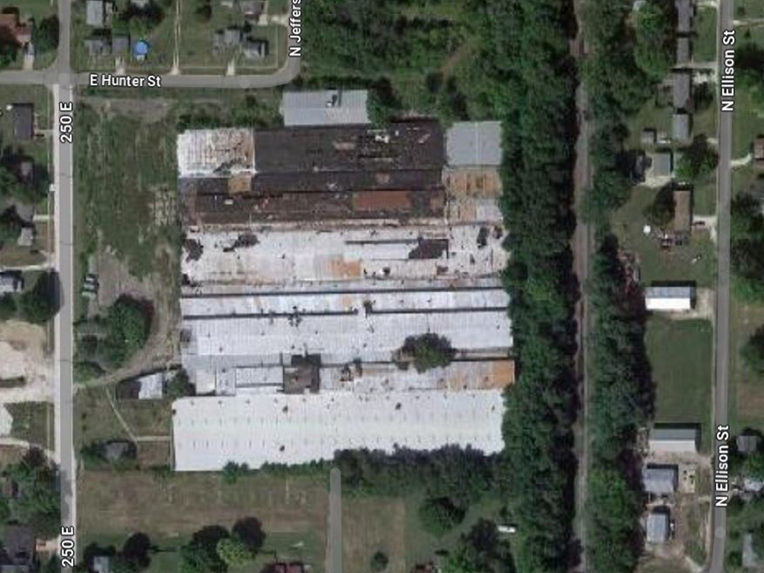
Examples from Our Program
Notes:
Briggs - Abingdon

Slide 44

4 parcels totaling >20 acres
~375,000 former manufacturing plant dating to 1920s used to manufacture plumbing fixtures until closed in 2000 after purchased by S. American company.
Sitting vacant with building slowly deteriorating since 2000.
Phase I ESA in progress

Slide 45
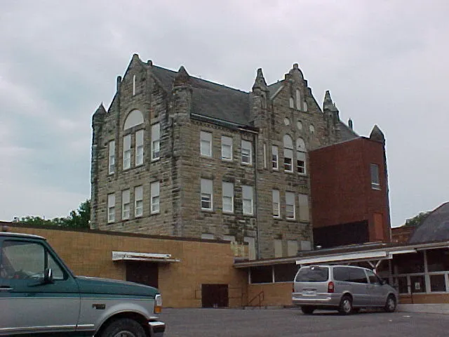
Examples from Our Program
Notes:
Dallas City school, built in 1895 (castle part anyway)

Slide 46

Old high school from 1890’s
1.97 acres, centrally located on the main highway
Complicated history of absentee landowners
Finally have access agreement
EPA Approval (July 2024)

Slide 47
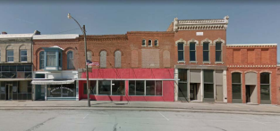
Examples from Our Program
Notes:
Main St, LaHarpe IL

Slide 48
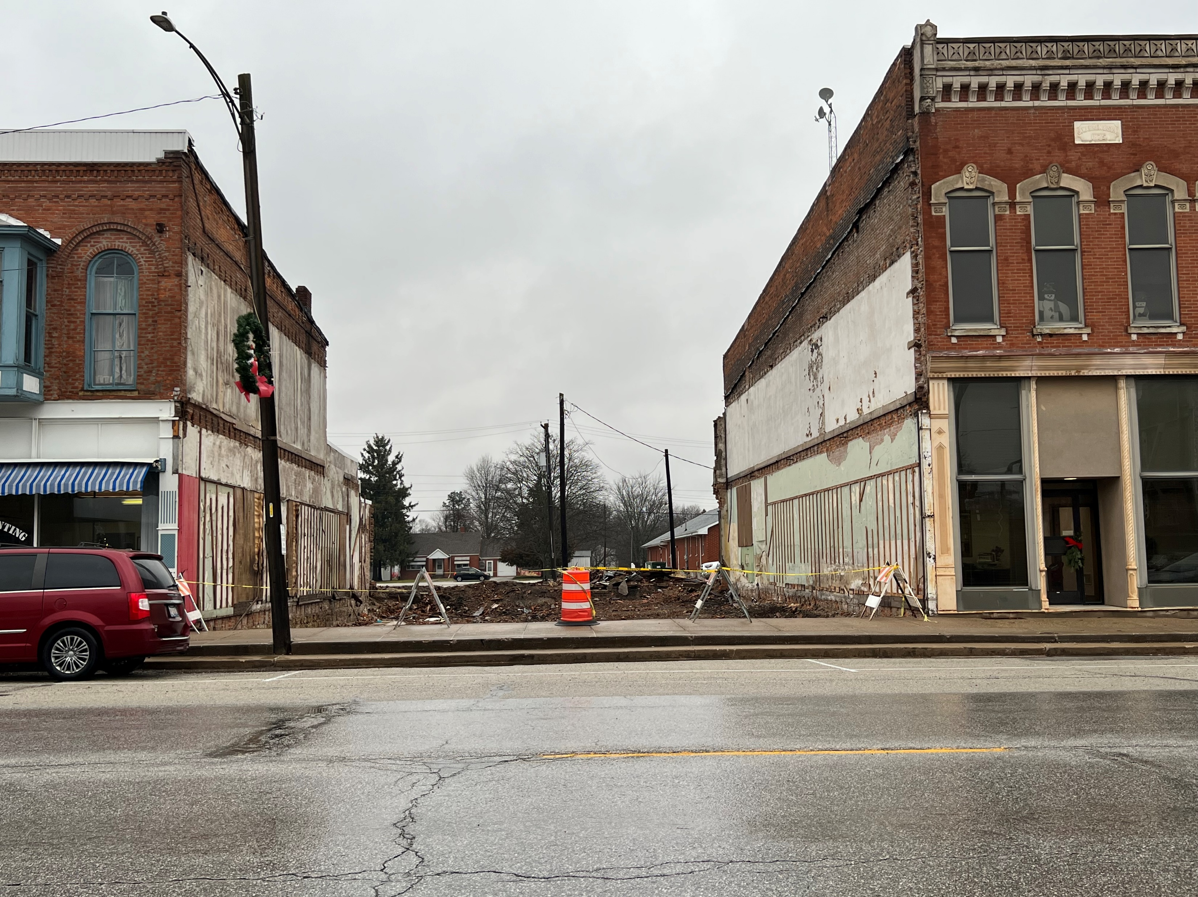
Examples from Our Program
Notes:
Main St, LaHarpe IL

Slide 49
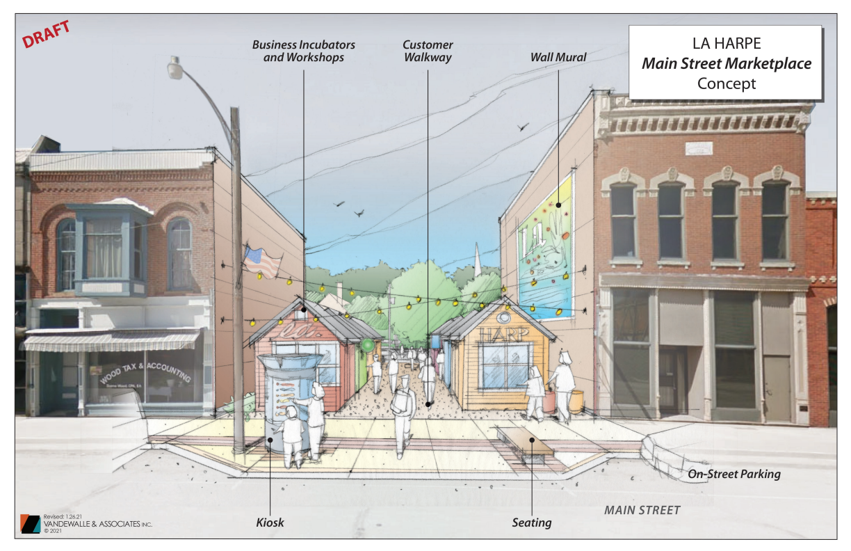
Examples from Our Program

Slide 50
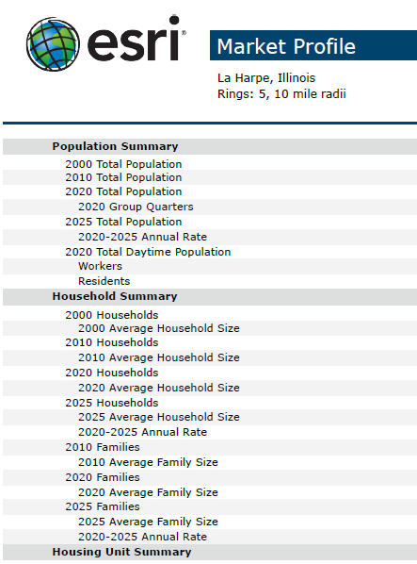
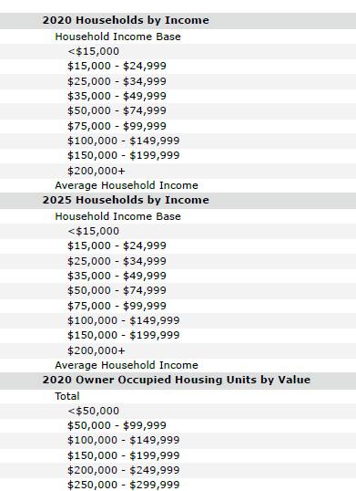

Slide 51
EPA Funding
US EPA is providing huge levels of funding right now:
- Community Wide Assessment
Clean up
Revolving Loan Funds
Technical Assistance

Slide 52
EPA Funding
EPA process:
- RFQ – Request for Qualifications.
- Review RFQ’s and select environmental firm.
They (can) write your grant for you.
Upon success of the grant, they should be helping to administer that grant.
This process takes ~12 months to complete.

Slide 53
Additional Funding Sources
Illinois Housing Development Authority (IHDA) grants are expected to see another round of funding.
Community Development partners – who’s working in your region right now?
Local Governments – several options for funding, including TIF districts. Some creative options such as video gambling revenue.

Slide 54
Questions?
Feel free to contact me:
Dr Victoria Livingston
Prairie Hills RC&D
321 W University
Macomb, Illinois 61455
Director@PrairieHillsRCD.org
309-833-4747
PrairieHillsRCD.org
PrairieLandConservancy.org

