Slide 1
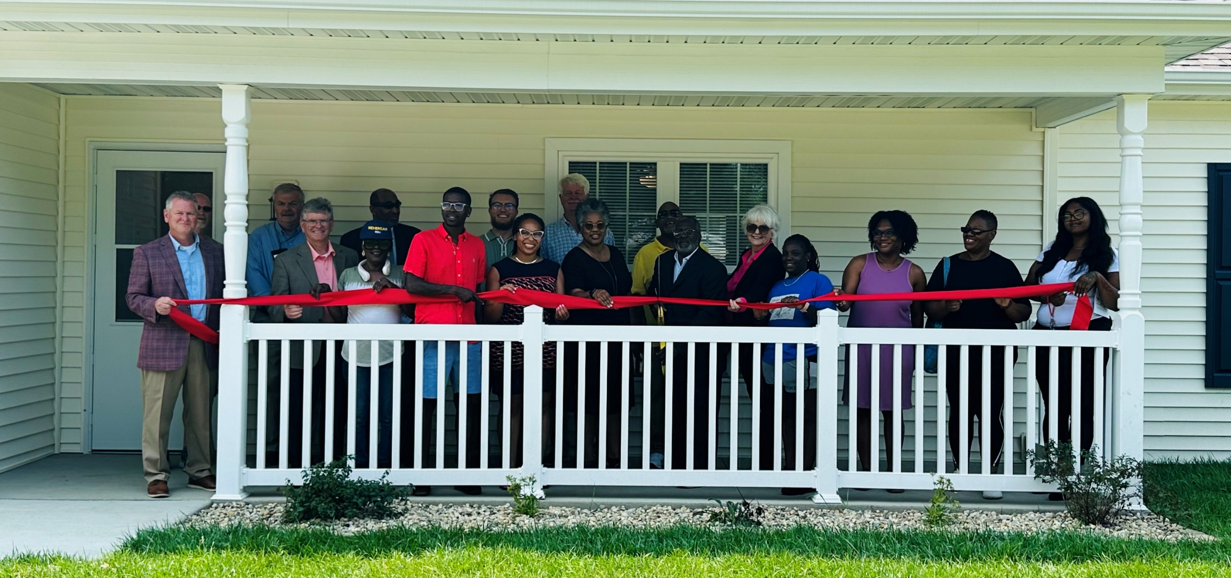
The Illinois Housing Development Authority
Resources for Development, Local Market Analysis, and Planning Support
Kristopher Walton
Community Revitalization Planner
Strategic Planning & Reporting

Slide 2
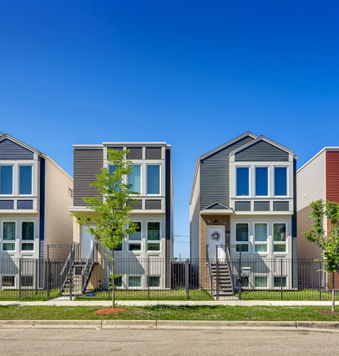
About Housing Finance Agencies (HFAs)
HFAs are state-chartered authorities established to meet the affordable housing needs of their residents.
Most are independent entities that do not use taxpayer dollars to support their operations, but administer publicly funded programs to support rental development, affordable homeownership, special needs housing, community revitalization, and more.
Every year, HFAs help 250,000+ renters and homeowners across the United States.

Slide 3
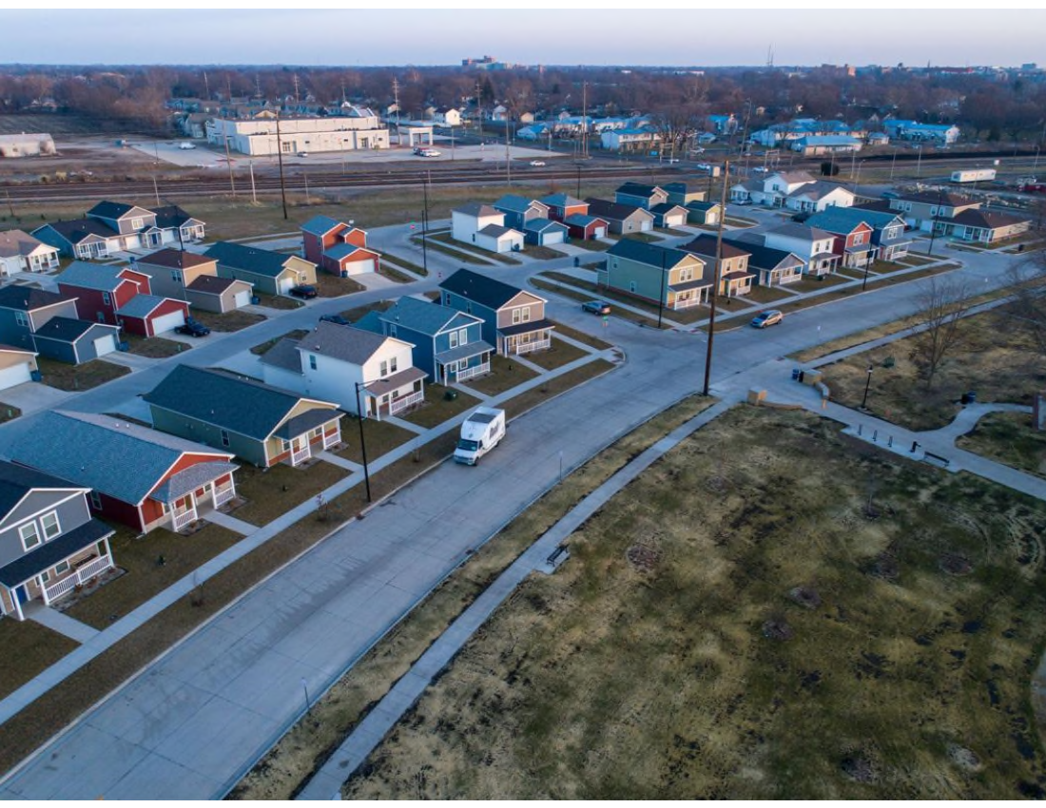
About the Illinois Housing Development Authority (IHDA)
IHDA is an independent bonding authority created in 1967 with a mission to finance the creation and preservation of affordable housing.
IHDA’s programs help families, older adults, and others find quality housing that meets their needs.
IHDA programs are funded with tax-exempt bonds, Low-Income Housing Tax Credits, and other affordable housing programs.
More than $29 billion in state, federal, and leveraged affordable housing financing since 1967.
Bristol Place, Champaign

Slide 4




IHDA’s Services
Multifamily Financing
IHDA provides financing and tax incentives to developers who build affordable and mixed-income rental communities.
Affordable Homeownership
IHDA provides mortgage financing, down payment assistance, housing counseling, and home repair programs to make homeownership affordable and sustainable.
Community Revitalization & Planning
IHDA provides technical assistance and grants that help local governments address local housing needs and plan for the future.

Slide 5
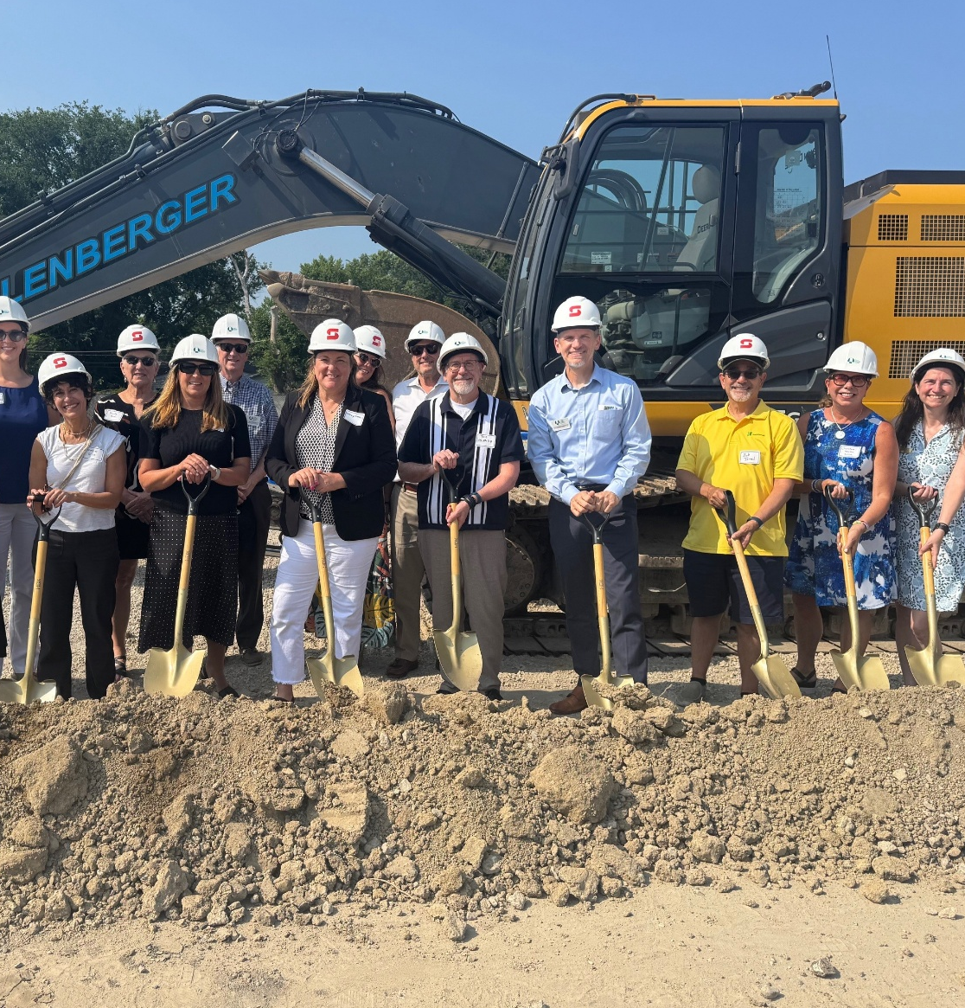
Multifamily Financing
IHDA awards loans, grants, and tax credits to rental housing developers that offer affordable rents to families, veterans, seniors, and persons with special needs.
Developments generally serve households earning less than 60% of the area median income ($61,980 for a household of three in Springfield).
Current IHDA portfolio consists of 110,200 units/1,971 developments.
Poupard Place, Northbrook

Slide 6
Resources for Development
Low-Income Housing Tax Credits (4% and 9%)
Illinois Affordable Housing Tax Credits (Donation Tax Credit)
First Mortgage Loan Products (Construction and Permanent)
Taxable and Tax-Exempt Bond Financing
Illinois Affordable Housing Trust Fund
HOME Investment Partnerships Program
National Housing Trust Fund
IHDA/HUD/Federal Financing Bank/US Treasury Mortgage

Slide 7

Affordable Homeownership
IHDA helps income-eligible homebuyers with down payment and closing cost assistance. Assistance can be:
  Up to $6,000 Forgiven over 10 years.
  Up to $7,500 Deferred until a sale, refinance, or payoff.
  Up to $10,000 Repaid interest free over 10 years.
Programs serve income eligible borrowers statewide (income less than $126,720 in Sangamon County).
Homeownership counseling is required.
Available through a network of 160+ mortgage lenders.
Tonnette Johnson, Chicago

Slide 8





Multifamily Financing
Affordable Homeownership
Home Rehab & Repair
Community Revitalization
2020 – 2024
IHDA Impact on Illinois
19,345 units created/preserved
248 developments funded
$7.1 billion in total development costs
34,466 homebuyers
$5.7 billion in mortgage volume
$249.5 million in down payment assistance
4,705 vacant homes maintained or demolished
600 homes repaired/modified
$48.3 million in revitalization grants
20 planning partnerships
in central and southern Illinois.

Slide 9
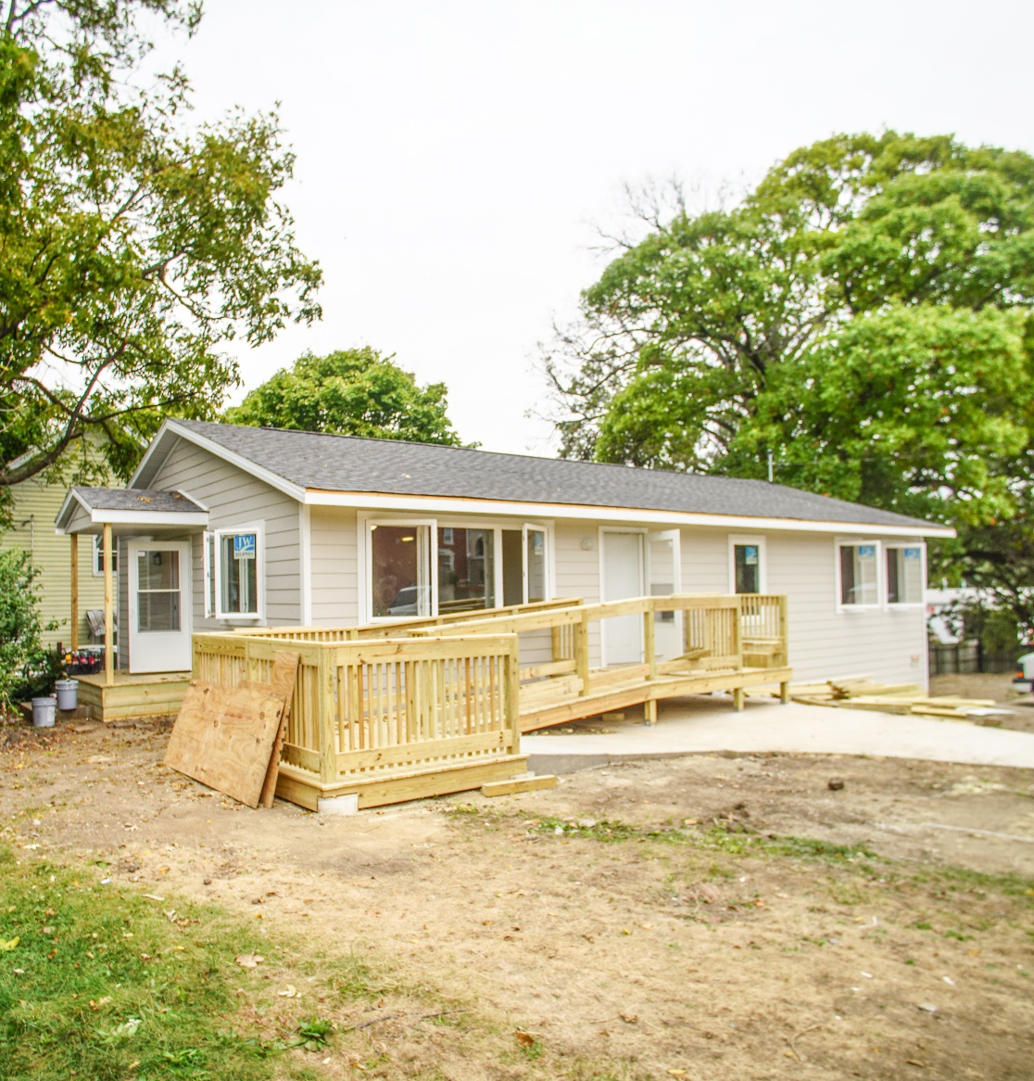
Community Revitalization & Planning
IHDA provides grants that help Illinois homeowners make health- and safety-related repairs and accessibility modifications.
IHDA provides grants that help local governments acquire, renovate, or demolish vacant residential properties.
IHDA engages in long-term planning partnerships to help communities understand local housing needs and plan for future development.
Home Repair & Accessibility Program, Bloomington

Slide 10
Community-Level Planning
with IHDA
www.ihda.org/developers/market-research/community-revitalization
“Community Revitalization” for IHDA is the implementation of intentional efforts that are likely to lead to measurable increases in access to employment, living wage jobs, healthcare, supportive services, community amenities, transportation, and quality affordable housing stock.
IHDA offers technical assistance and customized planning assistance to feed local revitalization efforts with data, housing needs analysis, targeting, and funding advice.

Slide 11
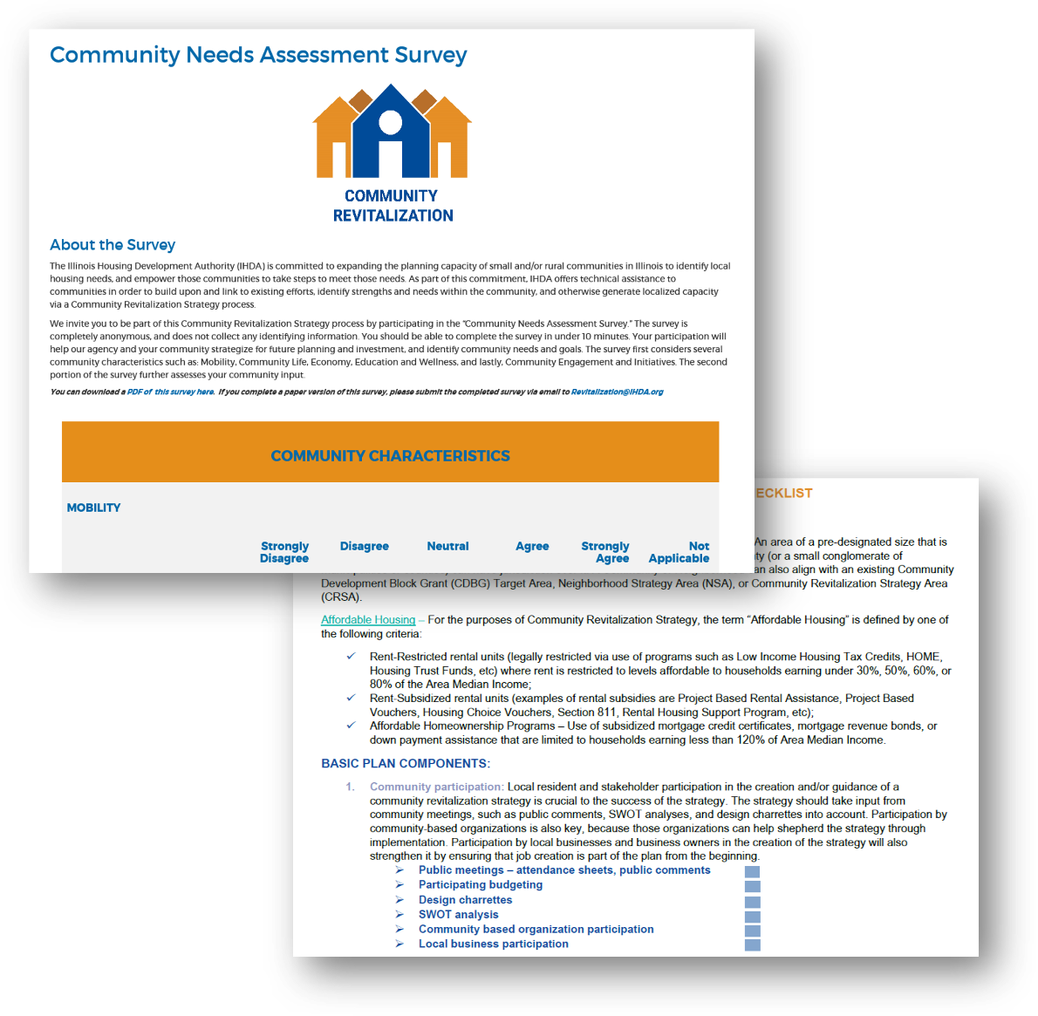
Community Revitalization Planning Services
The following services are available to communities through IHDA’s Community Revitalization Technical Assistance program:
  Community Outreach
  Development Resources
  Housing Stock Survey
  Housing Needs Assessment
  Community Needs Assessment
  Community Planning Documentation

Slide 12
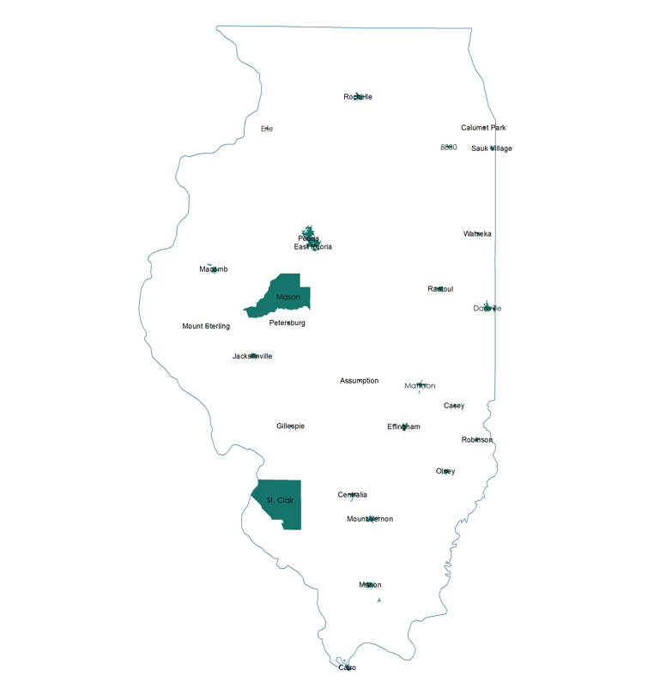
Community Revitalization Utilization Across Illinois
Community Revitalization and the LIHTC Program since 2016:
232 9% LIHTC applications submitted with Community Revitalization documentation (52% of 434 total).
78 9% LIHTC awards made to projects with Community Revitalization documentation (38% of 205 total).
25% increase in annual 9% LIHTC applications with Community Revitalization.

Slide 13
Community Revitalization Utilization Across Illinois (continued)
Proactive planning results since 2018:
35 proactive planning partnerships.
12 completed Housing Needs Assessments, 2 resulting in tax credit awards.
3 developments utilizing completed assessments in 2024 9% round.
Services expanded to Chicagoland area.

Slide 14
Community Revitalization Utilization Across Illinois (continued)
Community Revitalization Success Stories:
Bristol Place (Champaign) – Local planning effort, utilized TA to link with State requirements. Result: competitive and funded applications for family subdivision / senior housing in a previously disinvested area.
City of Peoria – Utilized proactive Community Revitalization Planning services to plan three neighborhoods. Result: Successful LIHTC applications resulted from this planning with projects approved in two of three neighborhoods prioritized and Land Bank resources serving the third.

Slide 15
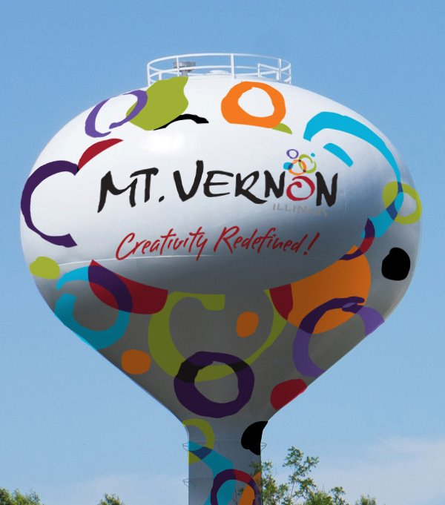
Case Study - Mt. Vernon, IL
Community Revitalization Plan
Parts of a Housing Needs Assessment:
Housing Stock Survey: A comprehensive look at housing condition in a neighborhood in Mt. Vernon.
Community Needs Assessment: 301 responses over 5 months.
Asset Mapping: Maps of existing Mt. Vernon amenities
Market Analysis: Look at market trends in the Mt. Vernon
Goals and Recommendations: Community input leading to recommendations on how to make Mt. Vernon better for the residents.

Slide 16
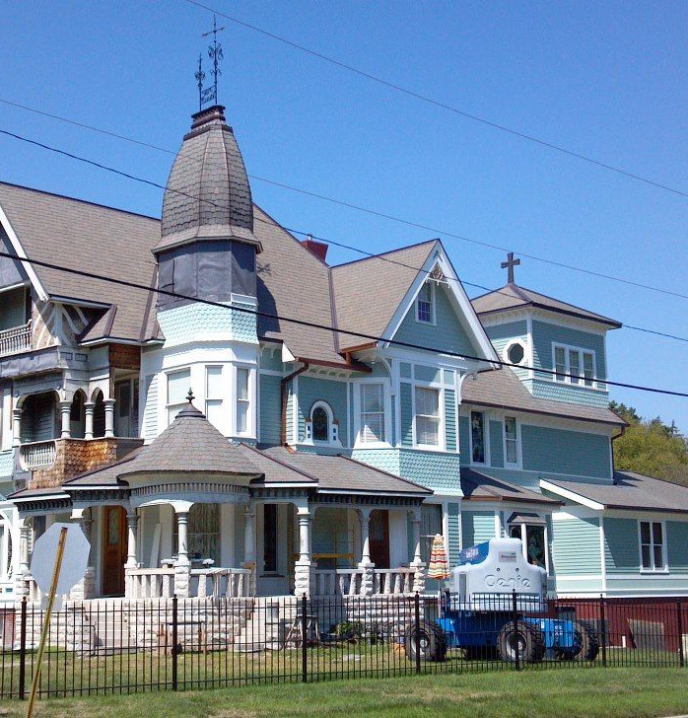
Housing Stock in Mt. Vernon
A comprehensive community-led look at the housing conditions in Census Tracts 509 and 510 in Mt. Vernon:
Utilization
Residential Building Type
Occupancy Status
Exterior Building Condition
Roof Condition
Yard Condition
Paint Condition

Slide 17
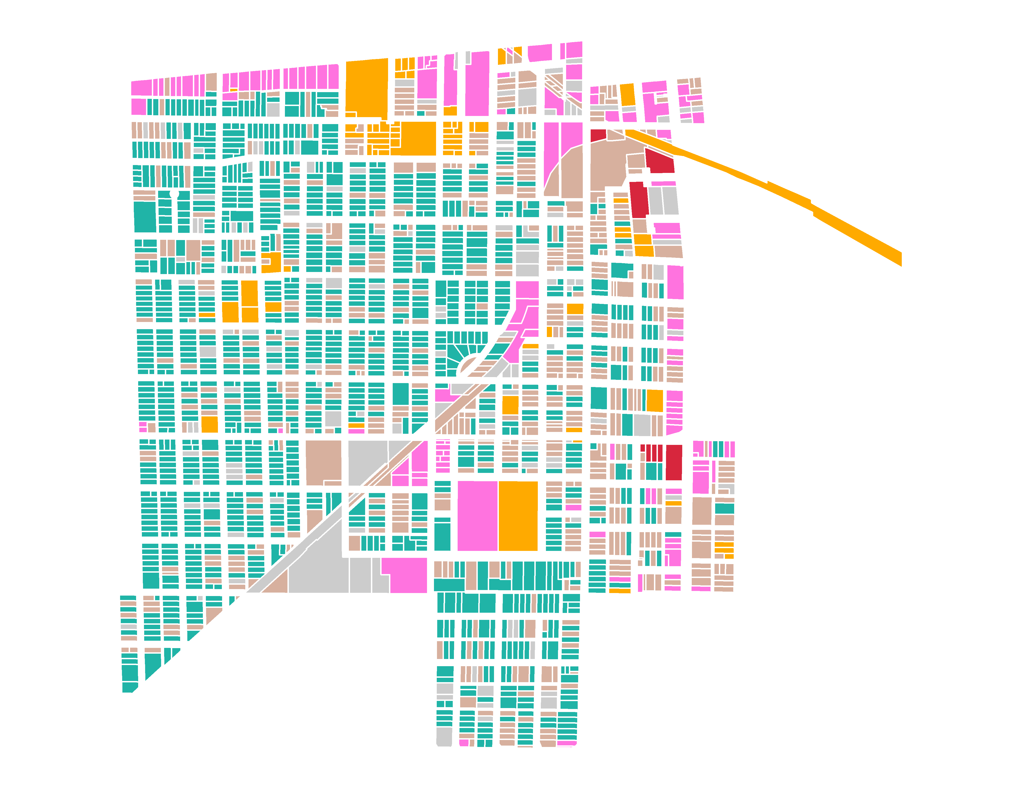
Utilization in Mt. Vernon
Notes:
Building utilization is used to create a type of land use map that is important to get a sense of how much a community is made up of different uses. It helps us to accurately analyze what is residential and what is not for a more accurate account of the housing stock.

Slide 18
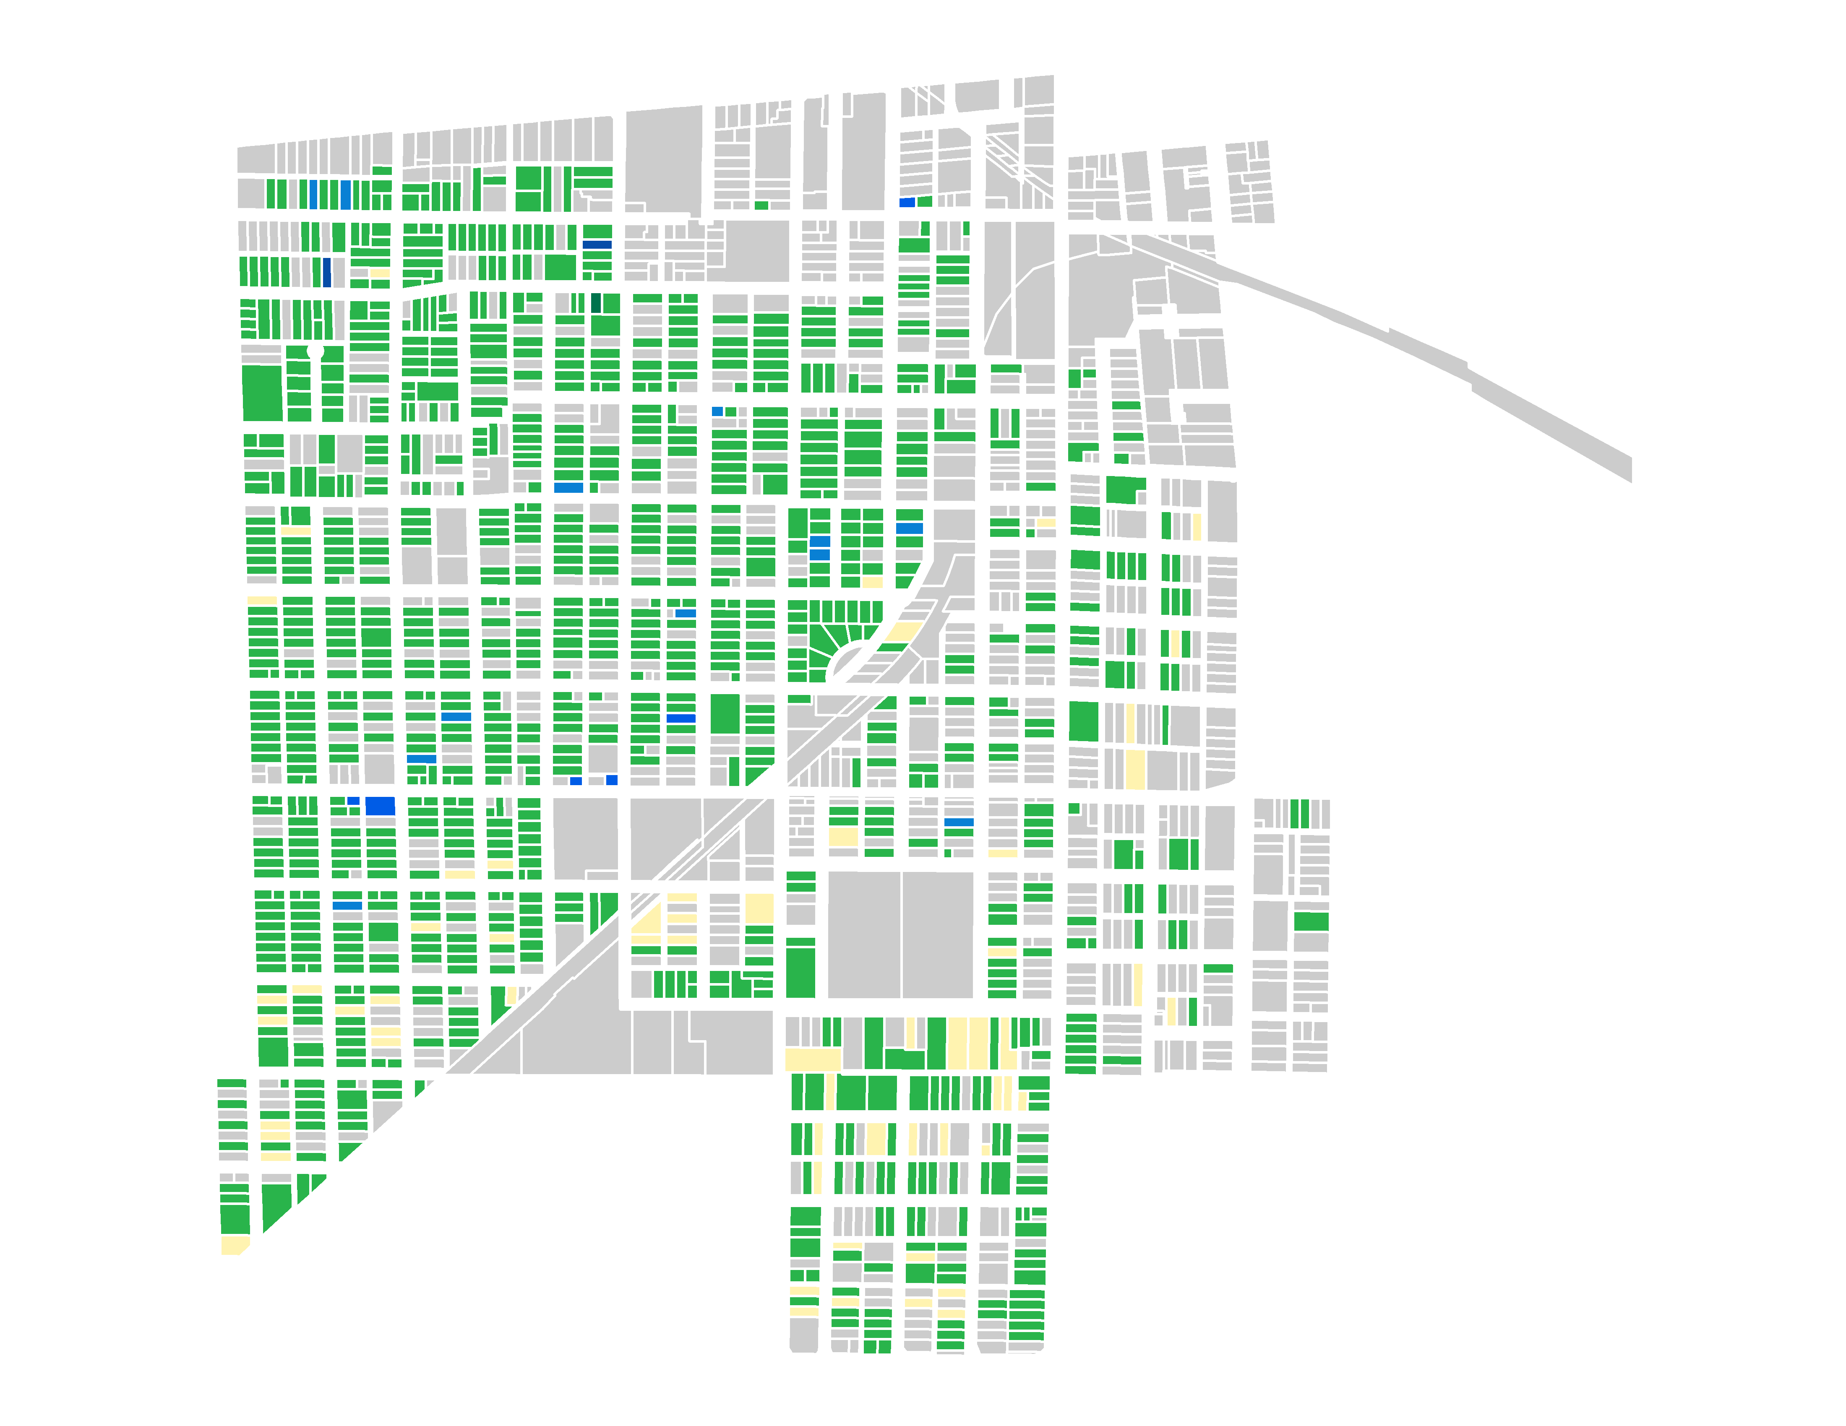
Residential Utilization in Mt. Vernon
Notes:
We look at what type of residential property occupies the parcel to get an idea of what type of housing exists in communities. IF there is room for more Single Family or Multifamily units, this map can help partner communities make that determination.

Slide 19
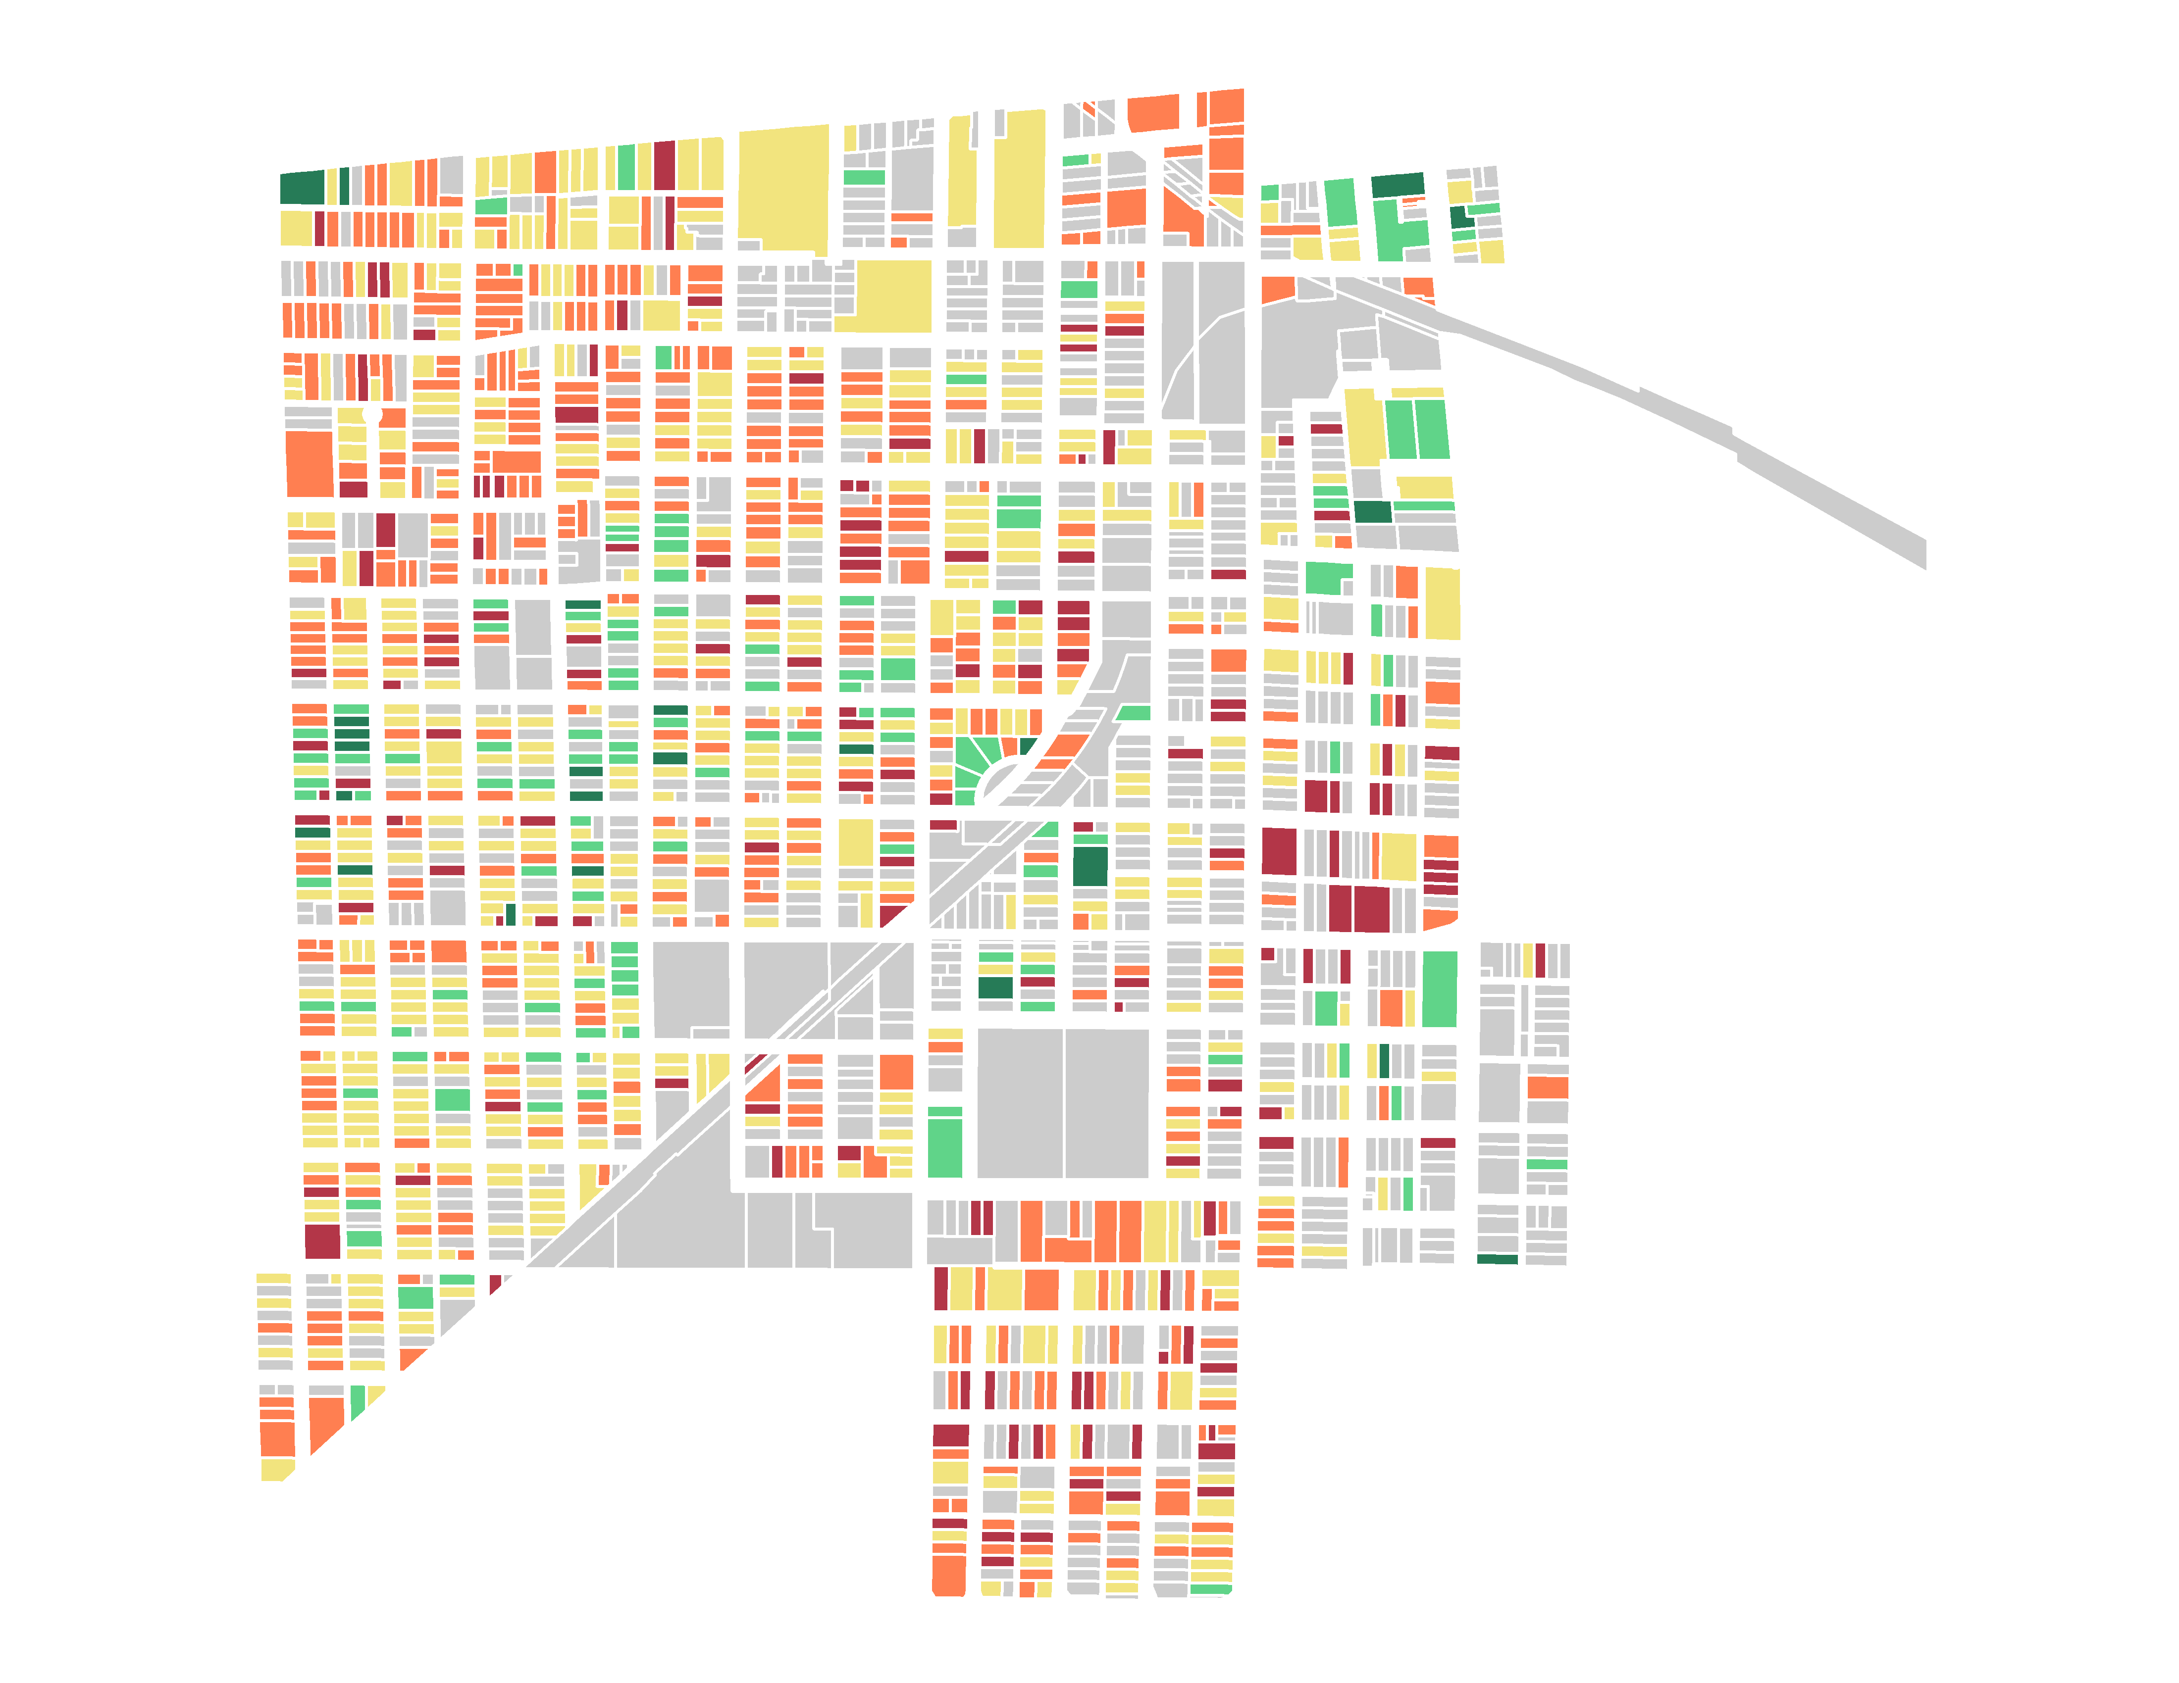
Exterior Building Condition in
Mt. Vernon
Notes:
Quality of the housing in the community is judged by this map. There are guidelines on how we rank the exterior condition of a property that is shared with volunteers who do the Housing Stock Survey. Those guidelines are detailed both at a training that IHDA planners conduct as well as in the field maps app itself.

Slide 20
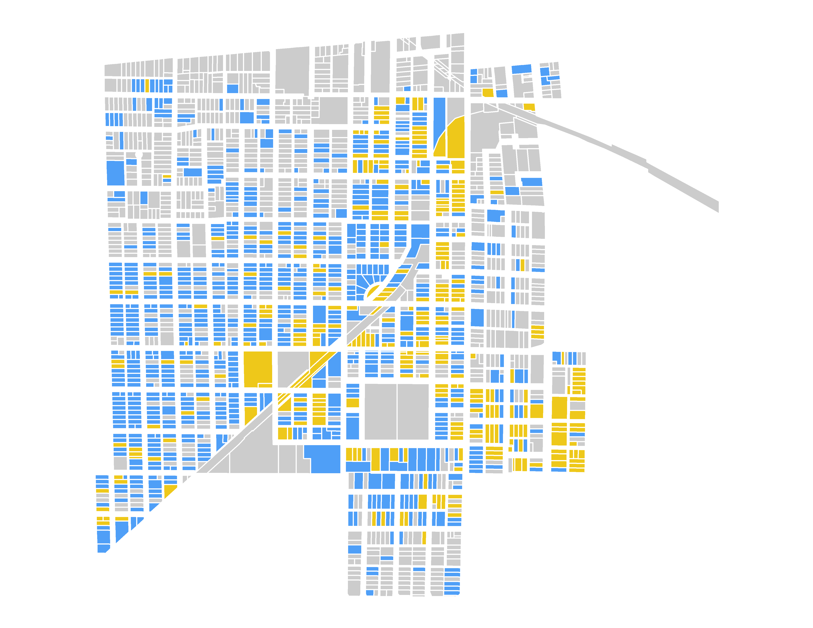
Occupancy Status in Mt. Vernon
Notes:
Occupancy status is determined strictly based on if there is or is not evidence of occupancy. This map is not meant to be a definitive occupancy map but just the perception of the building in question.

Slide 21
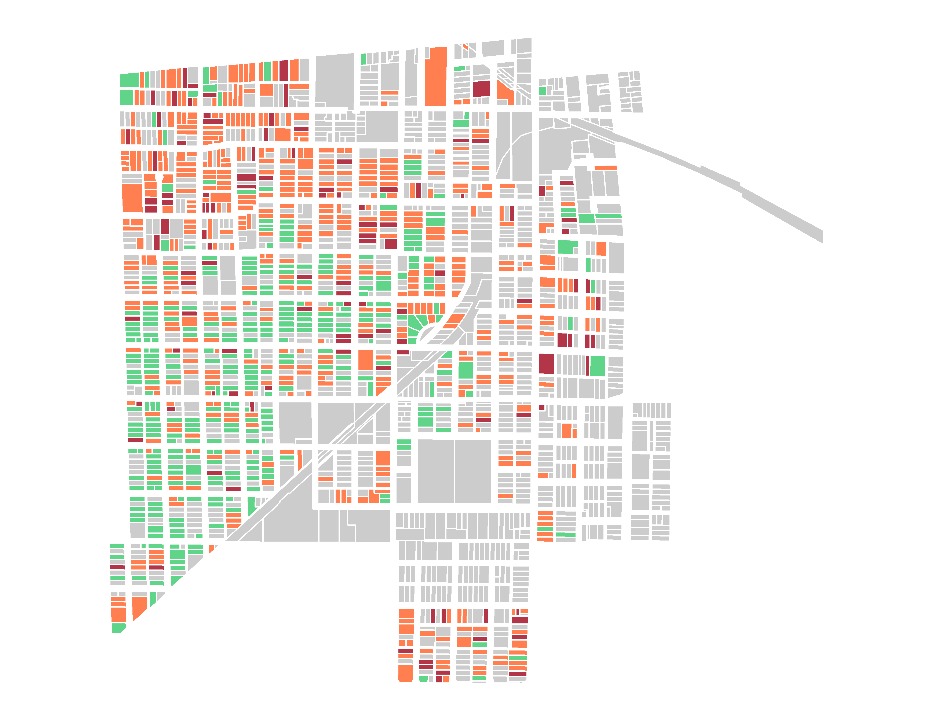
Roof Condition in Mt. Vernon
Notes:
Roof condition is determined based on if there is any damage at all, loose gutters, missing shingles, etc. Even if a roof looks good with just minor repairs, it is marked as fair. This helps communities apply for grants that can be awarded out to individuals to assist with roof repair.

Slide 22
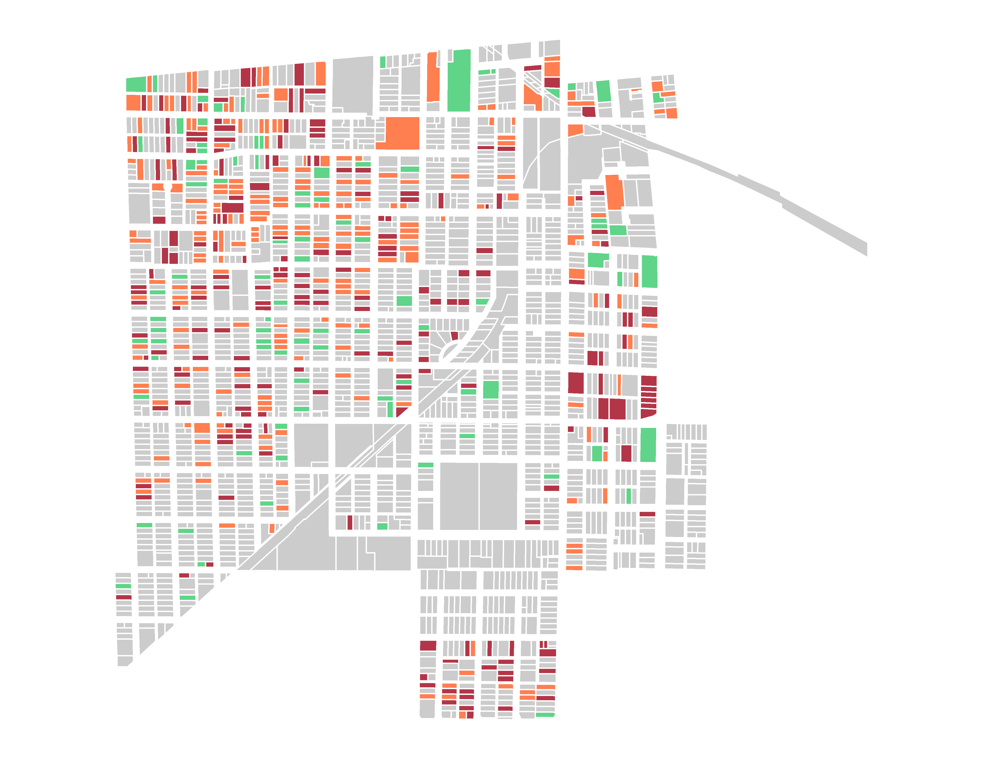
Paint Condition in Mt. Vernon
Notes:
Paint condition includes siding condition as well. This, again, helps with grants that can go to individuals to assist with home repairs.

Slide 23
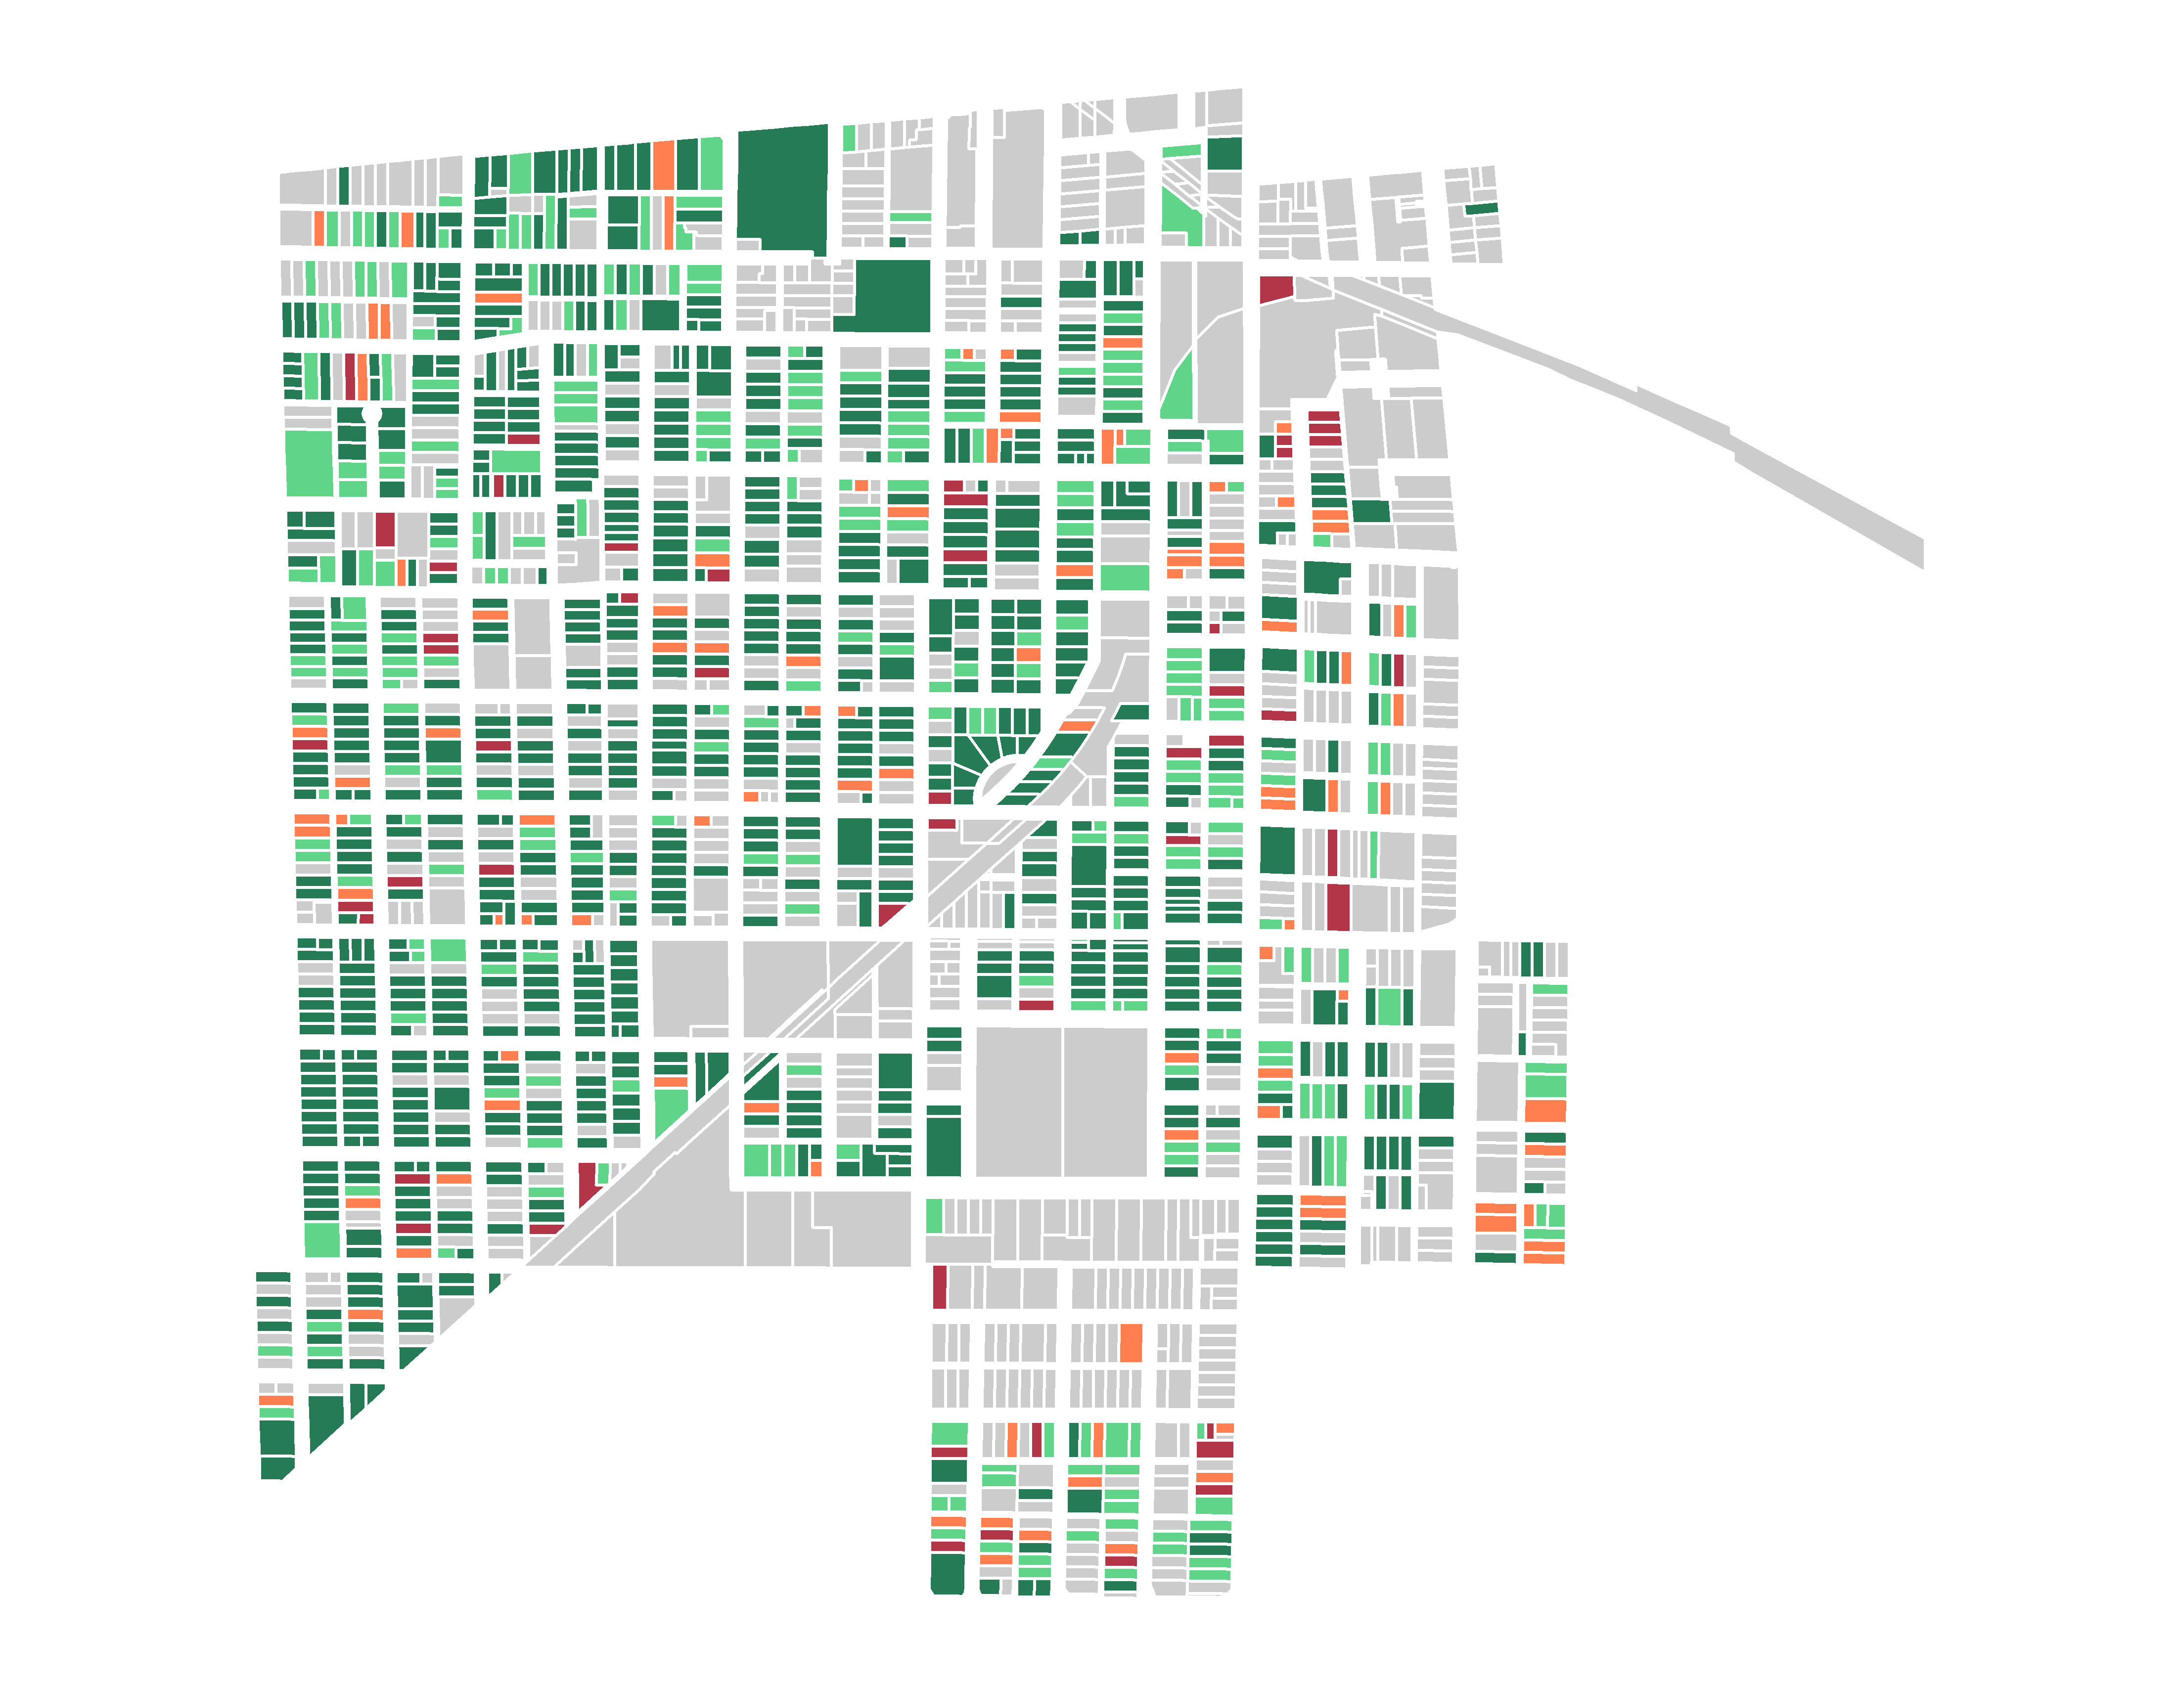
Yard Condition in Mt. Vernon
Notes:
Many partner communities like to see yard condition to compare and overlay any parcels where there is a vacant building and the city can identify which parcels need service to the yard.

Slide 24
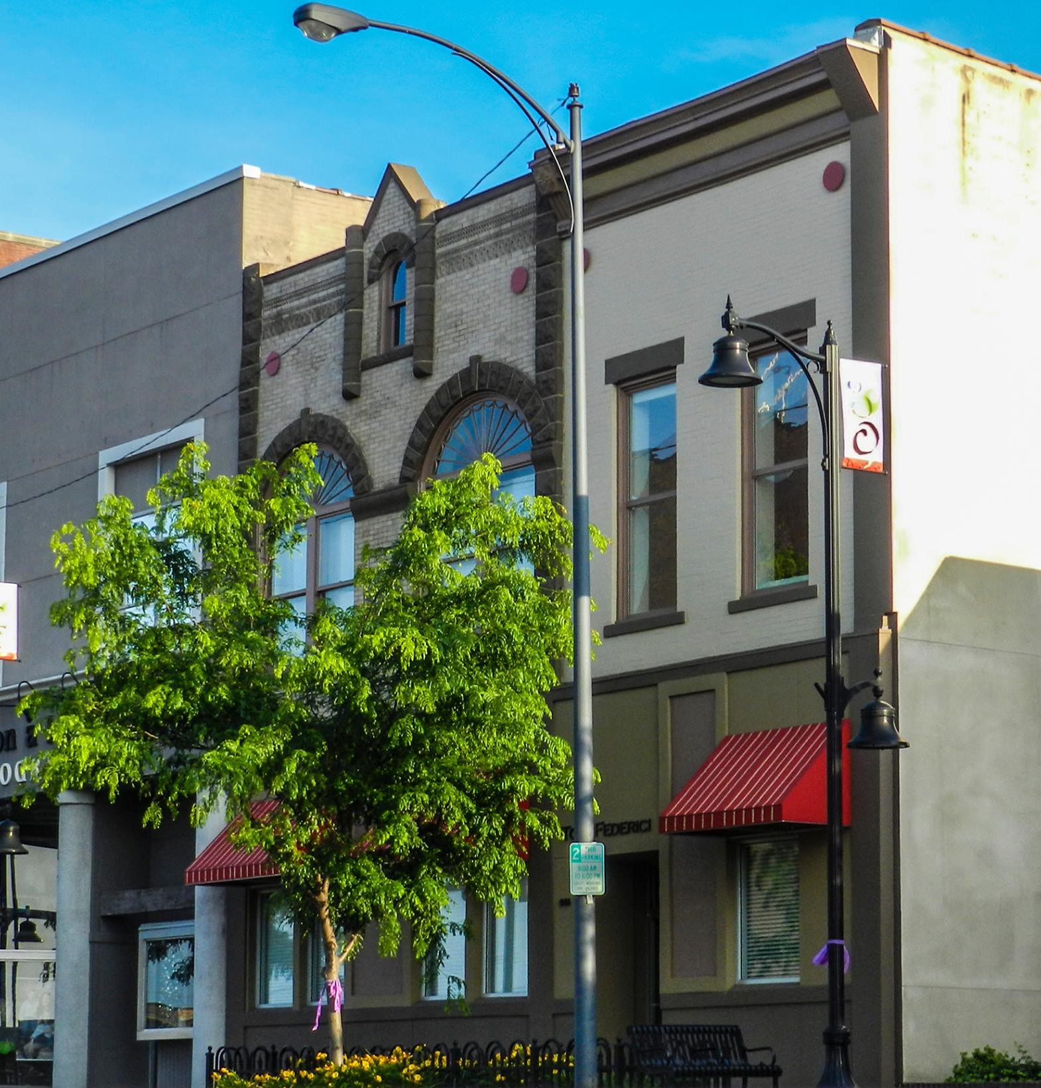
Community Needs in Mt. Vernon
A survey that garnered 301 responses over the course of 5 months that asked questions based on these categories:
Mobility
Community Life
Education
Wellness
Economy
Housing
Community Engagement
City Initiatives

Slide 25
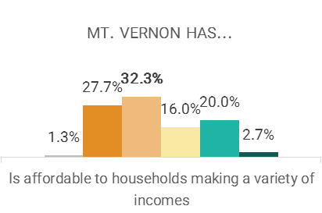
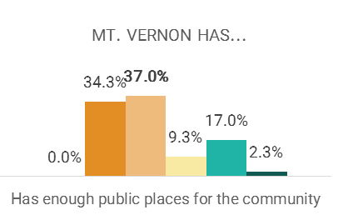
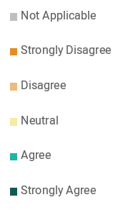
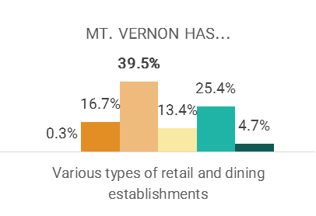
Mt. Vernon Community Needs
COMMUNITY LIFE
64.6% of Mt. Vernon respondents disagree or strongly disagree that housing in their community is in good condition. Only 10.3% of respondents agree or strongly agree.
22.7% of respondents in Mt. Vernon agree or strongly agree that housing in their community is affordable to households making a variety of incomes, but 60% of respondents disagree or strongly disagree.

Slide 26
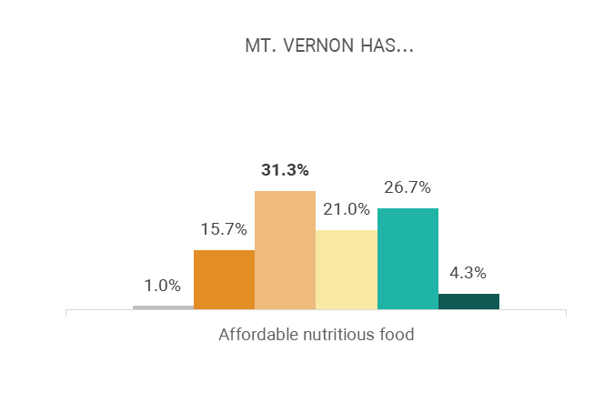
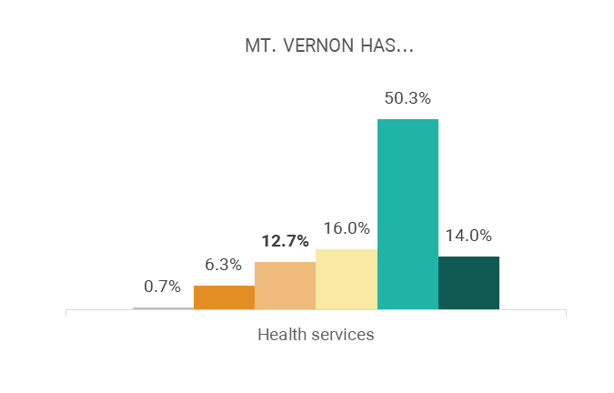

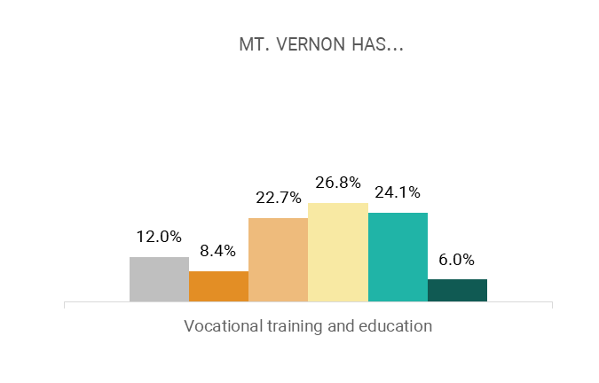
Mt. Vernon Community Needs
EDUCATION AND WELLNESS
Respondents most strongly agree that their community has the following opportunities and services that meet its needs:
Banking Services (83%)
K-12 education (58%)
Health Services (64.4%)

Slide 27
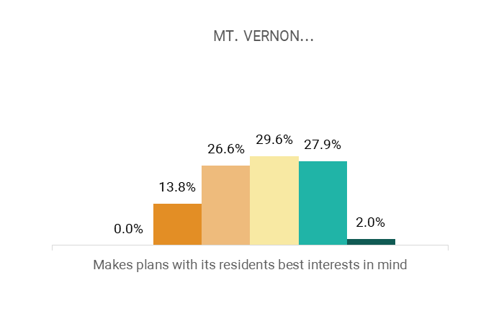
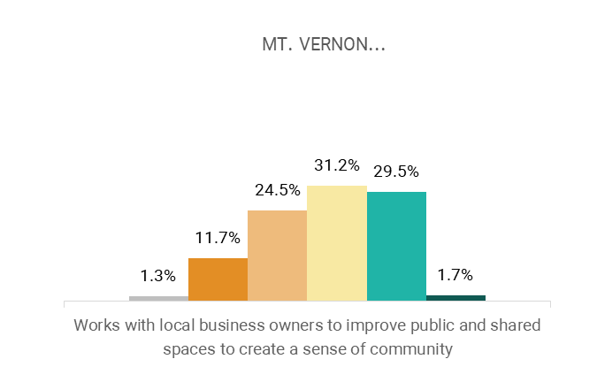
Mt. Vernon Community Needs
Mobility
39.3% of respondents agree that their neighborhood is walkable, but nearly 53.3% of respondents disagree that their neighborhood is pedestrian friendly.
COMMUNITY ENGAGEMENT AND INITIATIVES
47.7% of respondents are interested in the opportunity to provide feedback to leaders.

Slide 28
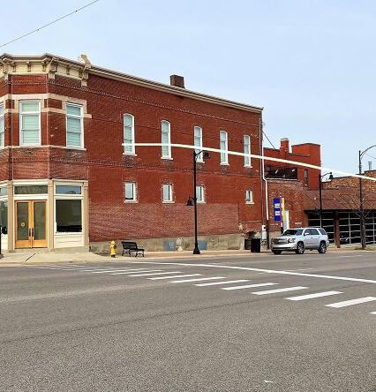
Assets in Mt. Vernon
A list of assets and amenities were provided to IHDA CR planners to map out:
Mobility
Community Life
Education
Wellness
Economy
Housing
Community Engagement
City Initiatives

Slide 29
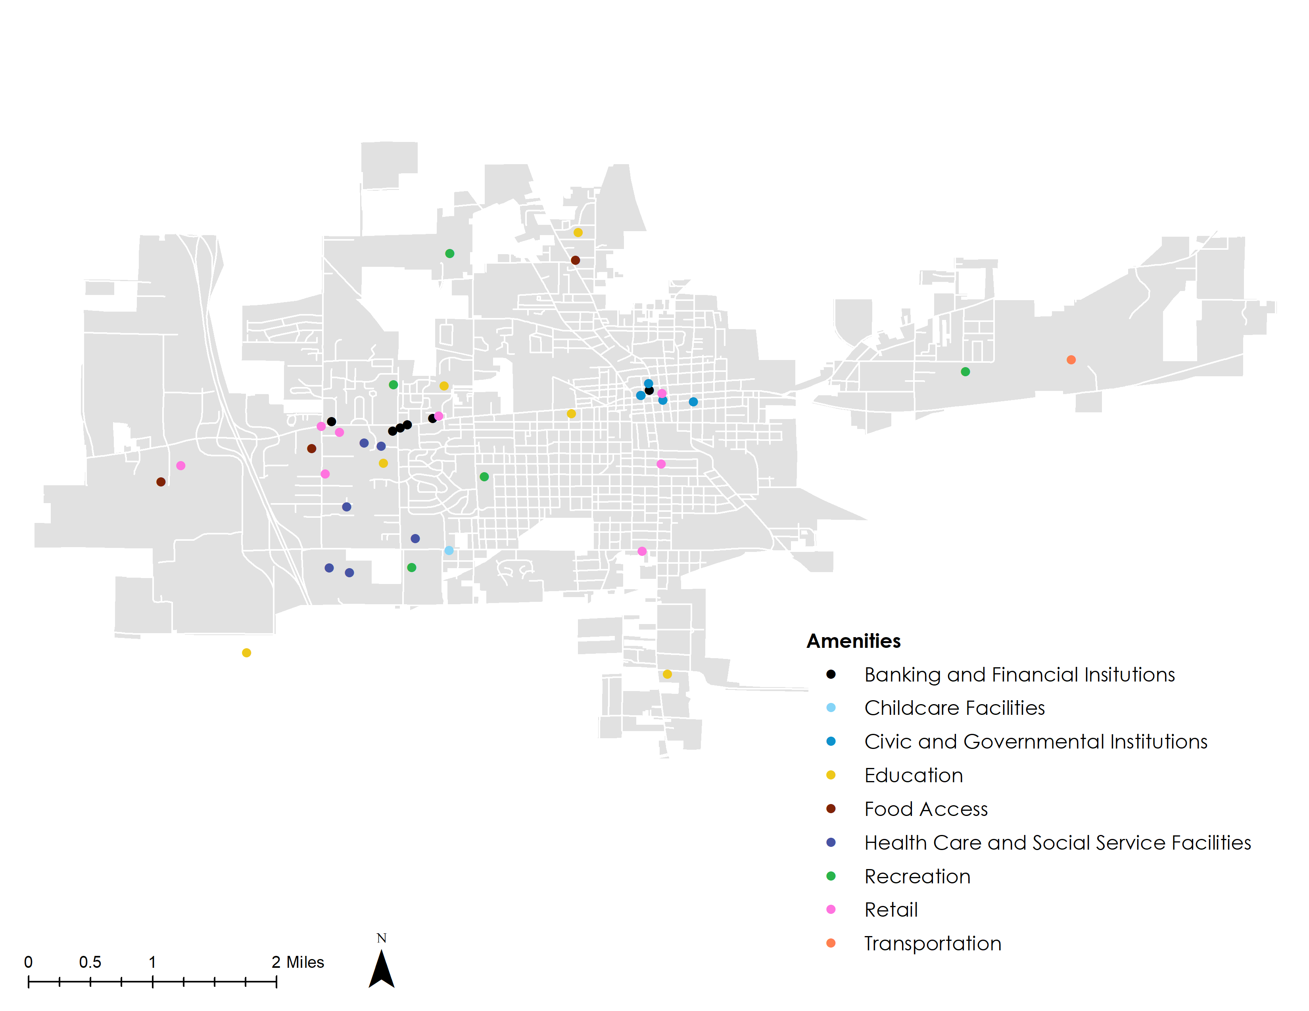
Mt. Vernon Asset Map

Slide 30
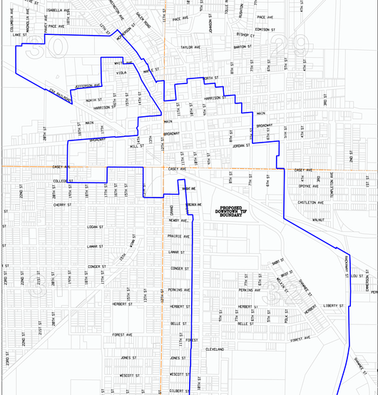
Market in Mt. Vernon
Market tools used to help monitor the market trends in Mt. Vernon:
Area Median Income
Quality of Life Index
Affordability Risk Index
Revitalization Impact Areas

Slide 31
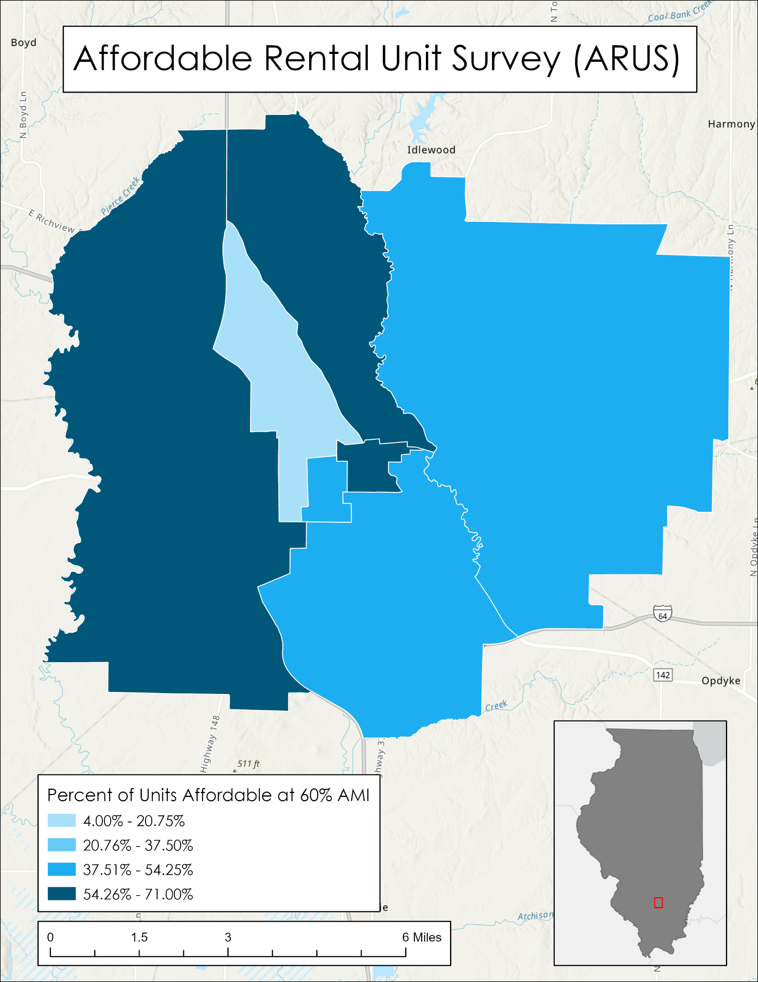
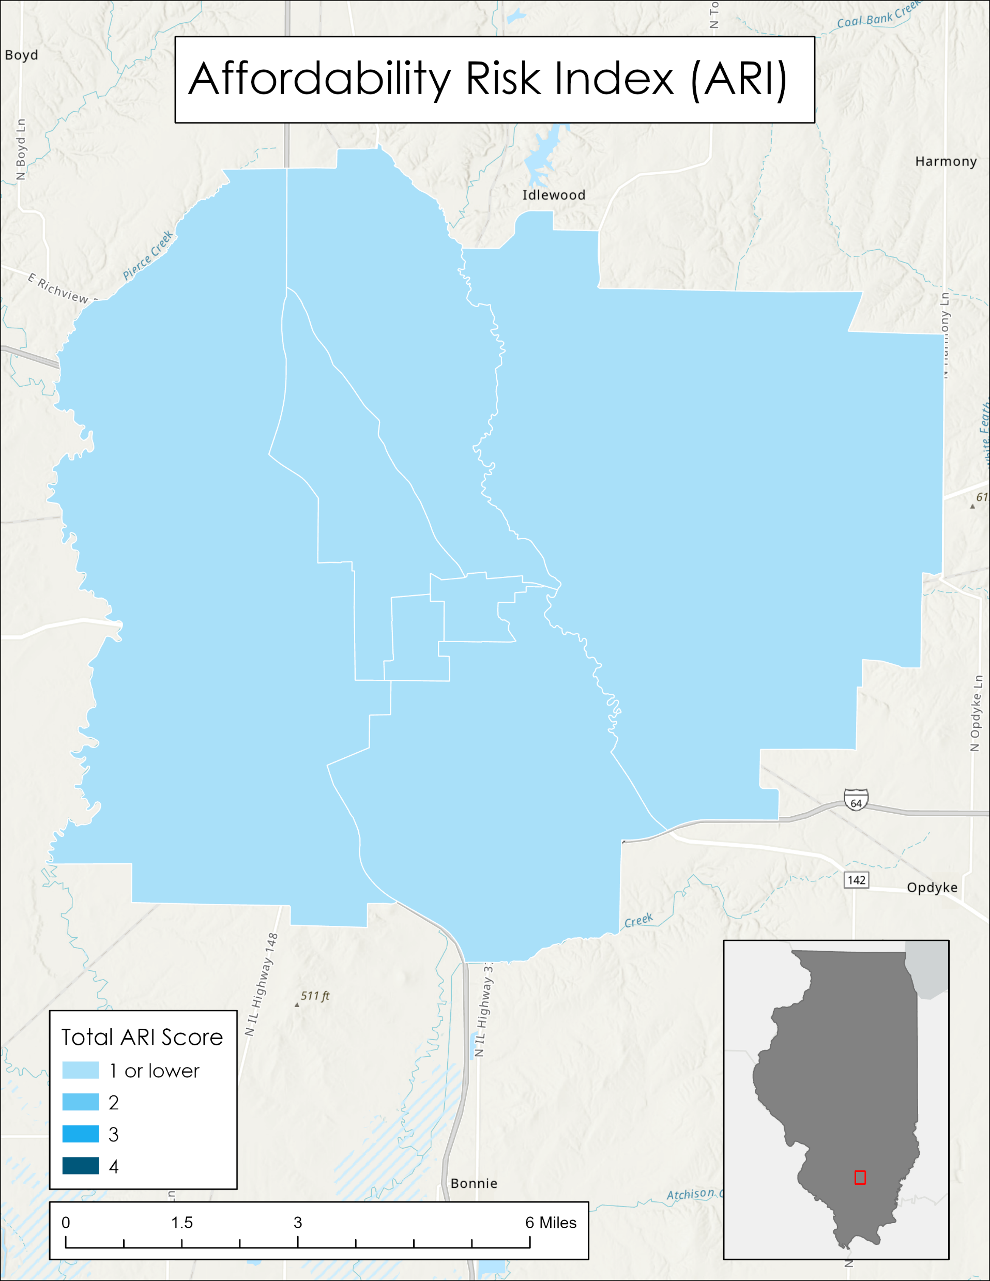
Notes:
ARUS – Looks at the percentage of currently available affordable rental units. Lower percentages means lower amounts of affordable units. ARUS maps also come in 30%, 50%, 80%, and 120%
ARI – Looks are the over all risk to affordability in a census tract. A lower score means low risk to affordability

Slide 32
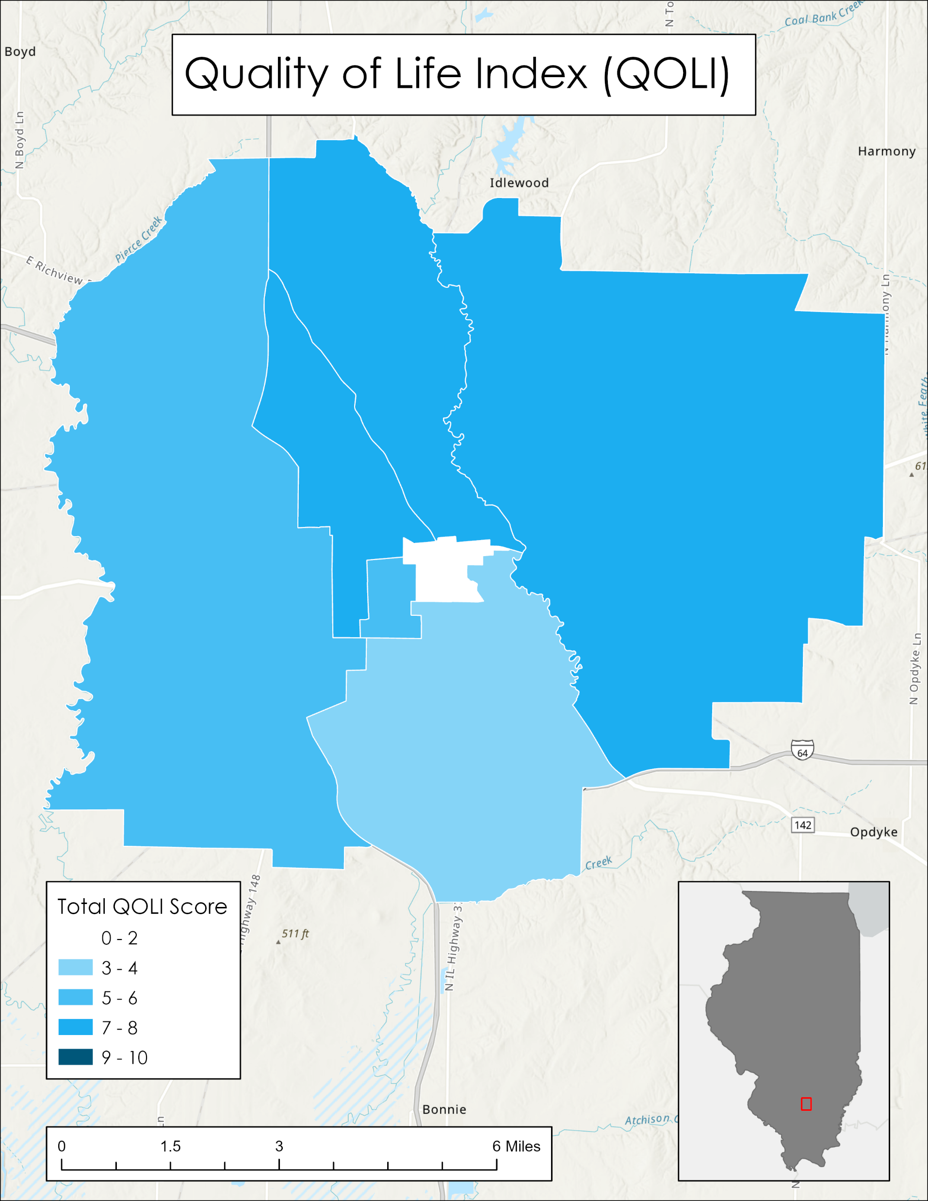
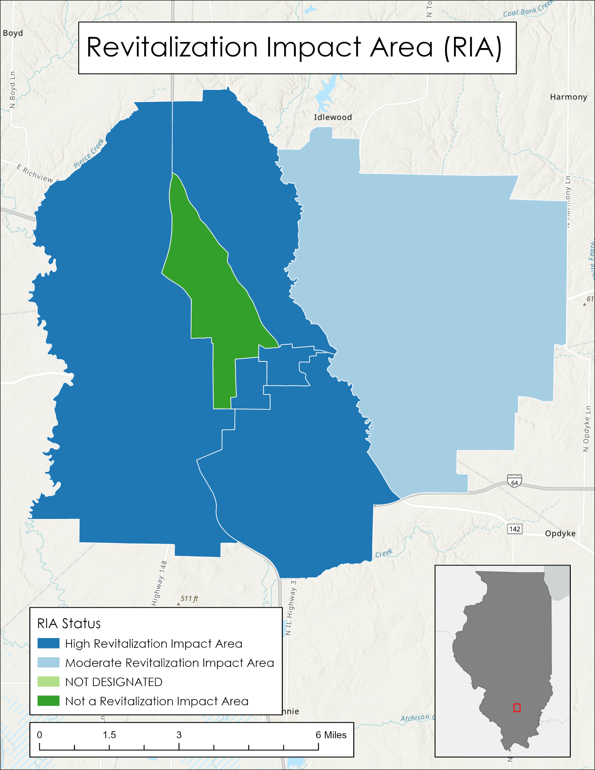
Notes:
QOLI takes a wholistic look at census tract using five categories: Health, Prosperity, Connectivity, Education, and Housing. There are 2 points assigned to each category based on census data and market factors for a total of 10 points.
RIA uses a similar equation to determine the impact of revitalization efforts. A high impact implies need for revitalization where “not a RIA” implies there is no need for revitalization efforts.

Slide 33
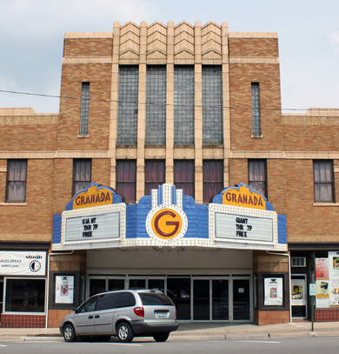
Goals for Mt. Vernon
Goals and Recommendations were decided upon by the community via two community meetings attended by over 70 people. A third community conversation was held to update goals in 2024:
Economic Development
Affordable Housing
Community Improvements
Community Development
Recreation
Infrastructure

Slide 34
Goals for Mt. Vernon
Notes:
An example of what goals look like for a CR plan and how there is room for updates and further partnership even after the plan is completed.

Slide 35
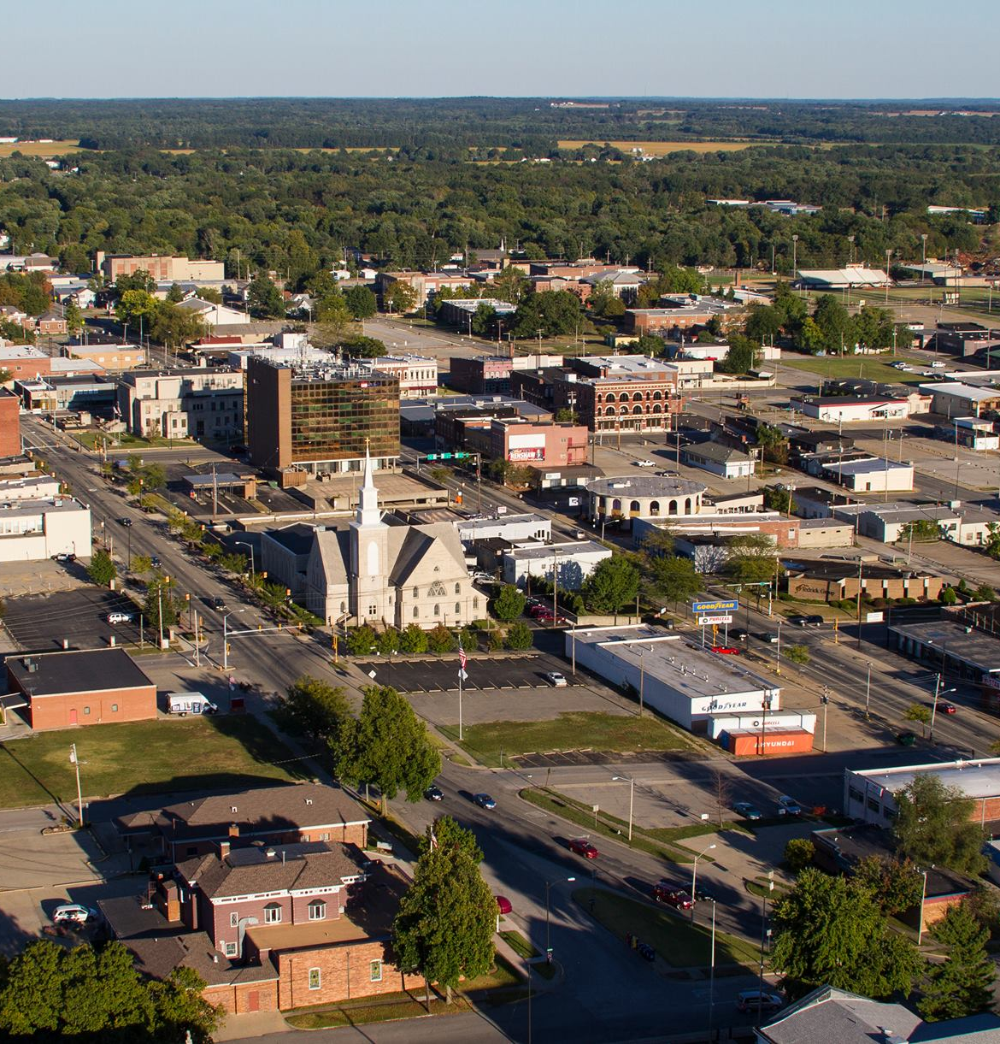
How Does a Community Revitalization Plan Impact a Community?
Housing Needs Assessments (CR Plan) can be used by communities to achieve many different goals:
Grant Applications
Community Building
Improvements to Infrastructure
LIHTC Applications
Attracting Developers

Slide 36
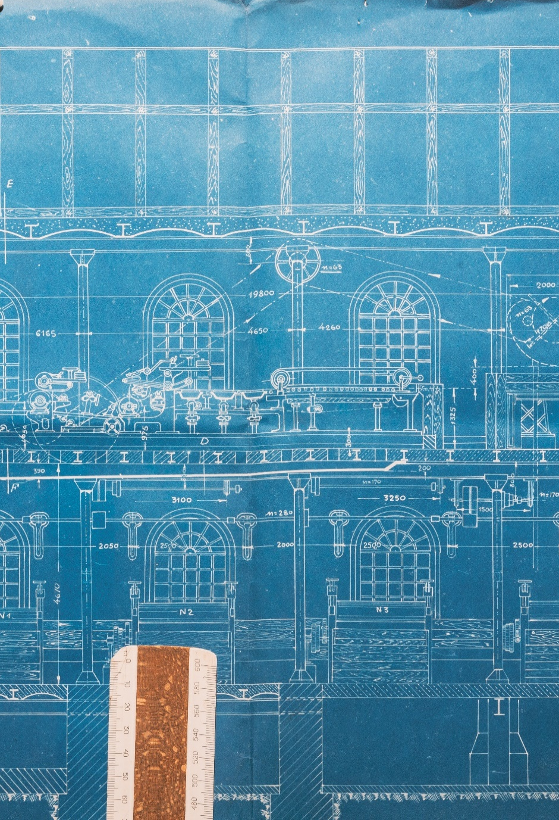








Connect With Us
Website:
Biennial Report:
www.IHDA.org
ihdacy22-23.com
Social Media:
@IllinoisHousingDevelopmentAuthority
@ILHousing
@ILHousing
@ilhousing.bsky.social
@Illinois-Housing-Development-Authority
@IHDAIllinois

