Slide 1


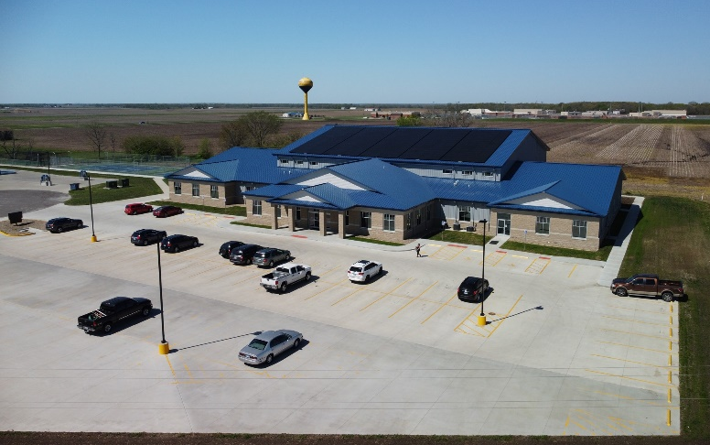
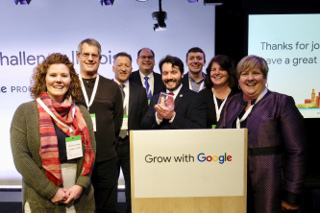
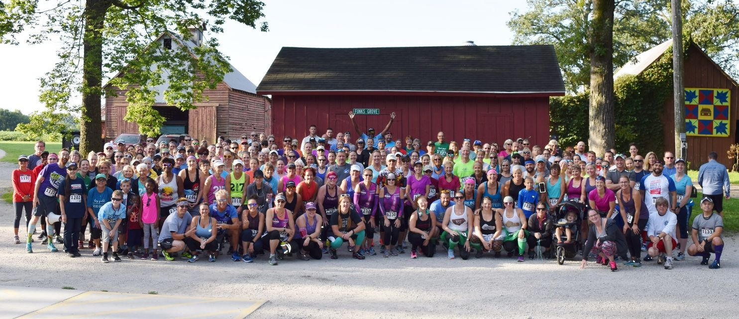
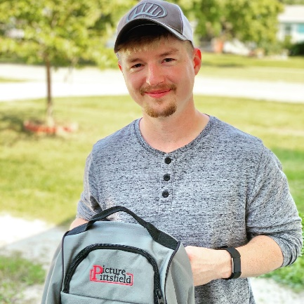
MAPPING the Future of
Your Community
Strategic Visioning for Rural Development
Gisele Hamm, MAPPING Manager
Illinois Institute for Rural Affairs
Western Illinois University
Illinois Institute for Rural Affairs

Slide 2
“The best way to predict the future is to create it.”
Peter Drucker
Notes:
The need for "planned abandonment". Businesses and governments have a natural human tendency to cling to "yesterday's successes" rather than seeing when they are no longer useful. A belief that taking action without thinking is the cause of every failure.^{[19]}

Slide 3
Brief History Of MAPPING
Management and Planning Programs…
Created in 1991
150+ communities in 65+ counties
Average MAPPING community population = ~3,000 [ranges from ~300 – 18,000+]

Slide 4
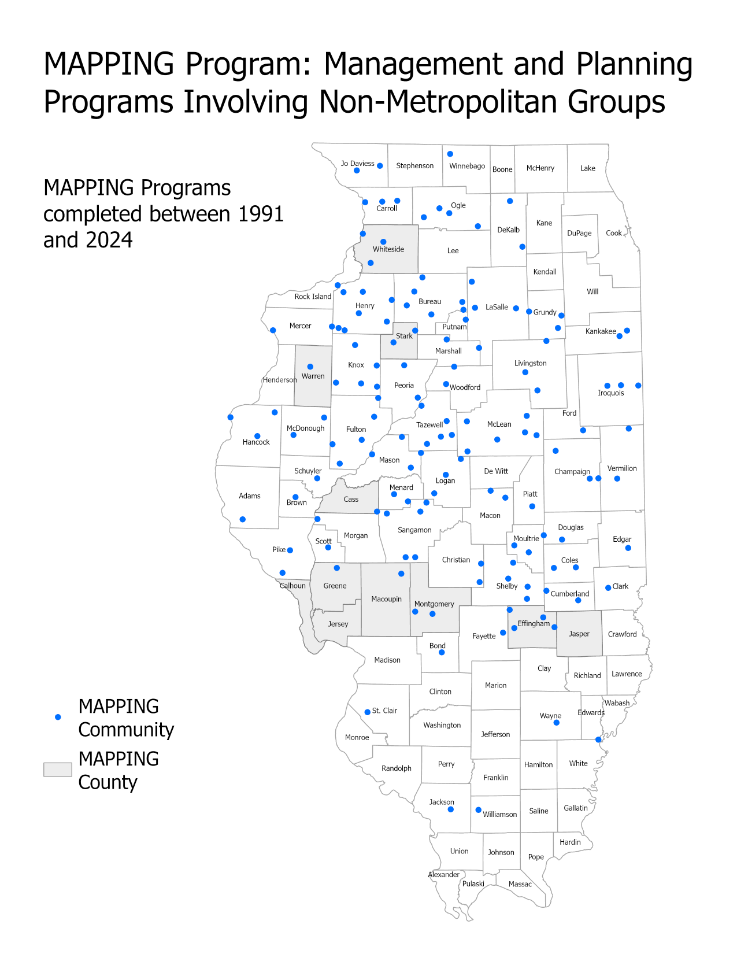
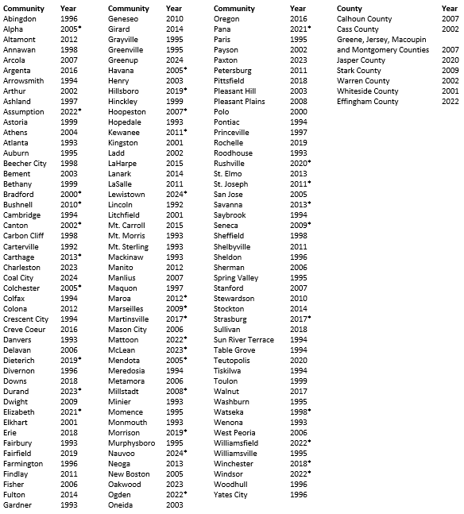
*Communities have participated in MAPPING update programs. Year listed is most recent MAPPING program.

Slide 5
Challenges Facing Small Communities
Increased competition for retail & declining downtowns
Shift from manufacturing to service jobs at lower pay
Youth outmigration and aging population
Difficulties recruiting and maintaining strong leadership
Inadequate financing for development efforts
Aging/inadequate infrastructure

Slide 6
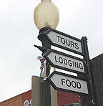
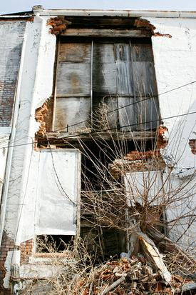
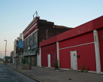
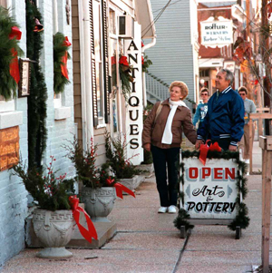
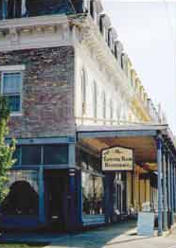
Why Plan?
Viability of community
Limited/dwindling resources
Build local capacity
Starting point and creates a roadmap for success
Notes:
State and federal funding sources are more difficult to obtain
-Cmmunities need to LOOK FROM WITHIN the community for resources
-Mobilize human talents and community resources
-ENGAGE community residents in community and economic development efforts
-Build local capacity so that community is less dependent on outside help

Slide 7
Community Life Cycle Model
Revitalization
Economic
Vitality
Phase
III
Stagnation
Phase I
Growth
Phase II
Development
Stability
Phase
IV
Retrenchment
Phase V
TIME
Darling (1994)
Decline

Slide 8
Role of Proactive
Visioning and Planning
Gather diverse set of community ideas and talents
Explore innovative approaches
Identify local & external resources to implement solutions
Develop local capacity for decision-making
Build community consensus
Set a course for the future
Make vision a reality and achieve community goals

Slide 9
Three Guiding Principles
Volunteers are the HEART of Positive Community Change
  Commitment
  Inclusion
  Follow-through
  Strength in Numbers
  Fostering Leadership
Structured Planning is Essential
  Continuity of Sessions
  Commitment to Entire Process
Building on Assets is Better Than Focusing on Problems

Slide 10

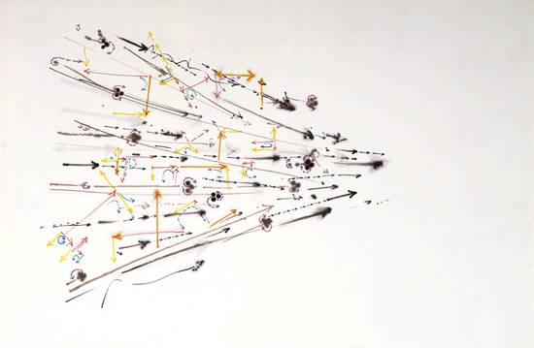
Is your community strategic?
Is everyone working towards different visions?
Or towards a shared community vision?

Slide 11
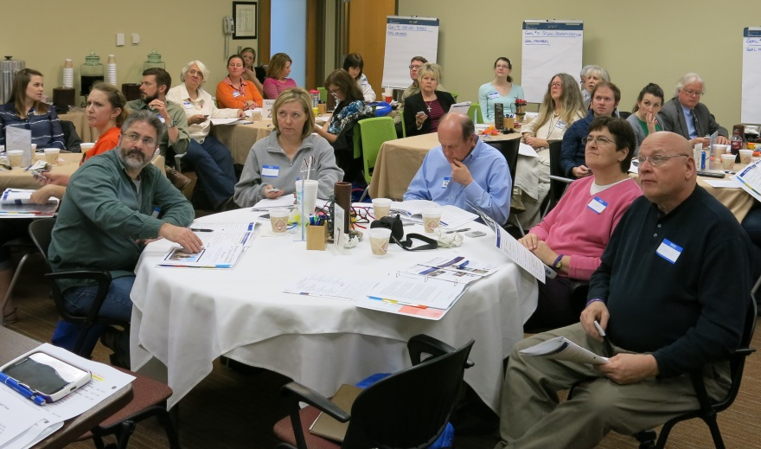
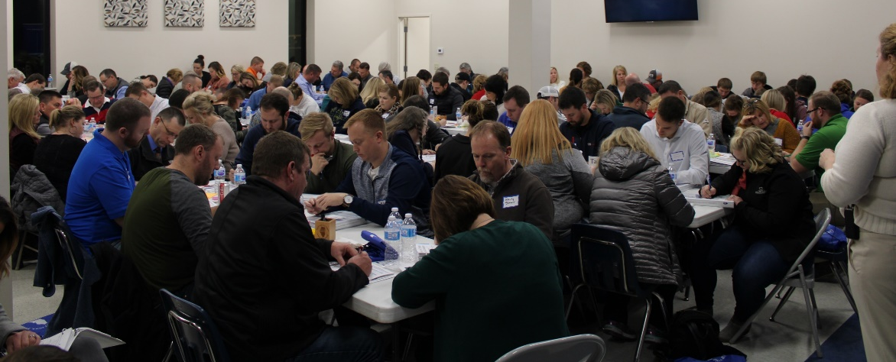
What to Expect from MAPPING…
The MAPPING process:
Brings the community together under a common vision
Develops an action plan to assist in making the vision a reality
Promotes and encourages volunteerism
DOES NOT provide grants, nor guarantee the receipt of grants

Slide 12
Roadmap to Success
Meet with Local Steering Committee
Where do we want to be?
How do we get there?
Making it Happen!
Where are we now?
Community-Led Town Meeting
To the Future!

Slide 13
From Vision to Action
Components of a visioning and planning process:
MAPPING Approach
Where Are We Now?
  Review community data, historical timeline, discuss what makes the community special
Where Do We Want To Be?
  Build consensus for vision, brainstorm & prioritize high priority goals, brainstorm strategies
How Do We Get There?
    Prioritize strategies, brainstorm projects, form action teams
Making It Happen/Keeping It Going
  Transition from planning to implementation, plan for town meeting, develop organizational structure

Slide 14
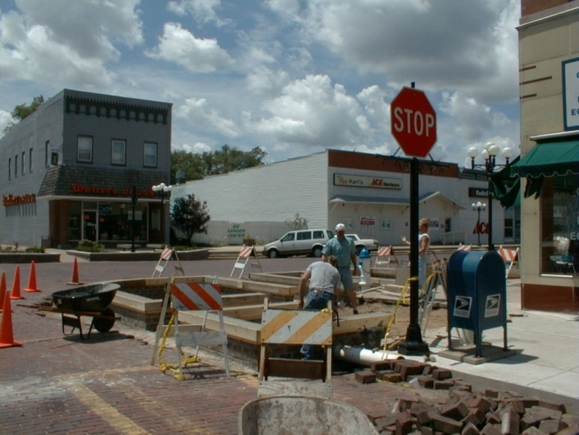
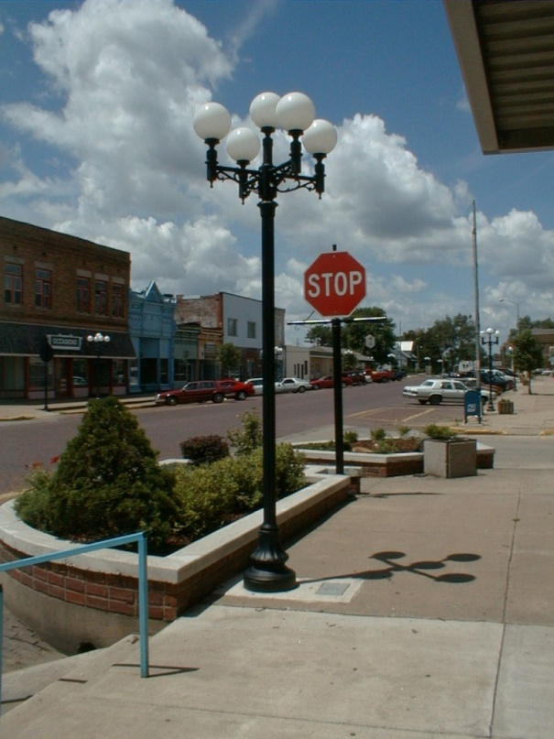
Implementation
Action teams work on projects
Community organization oversees implementation
IIRA:
  Technical assistance
  Peace Corps Fellow
  Resources
External resource partners

Slide 15
Action Plan Components
Projects
VISION
BHAG 1
BHAG 2
Strategy
Strategy

Slide 16
Common Goal Areas
Business Retention, Expansion, and Attraction
Downtown Revitalization
Entrepreneurship
Infrastructure Maintenance and Improvement
Community Marketing
Tourism & Recreation
Housing
Workforce Development
Education
Childcare

Slide 17
MAPPING Action Plan

Slide 18
MAPPING the Future
Community Examples
Strasburg (2007, 2017)
Hillsboro (2015, 2019)
Mattoon (1994, 2017, 2022)

Slide 19
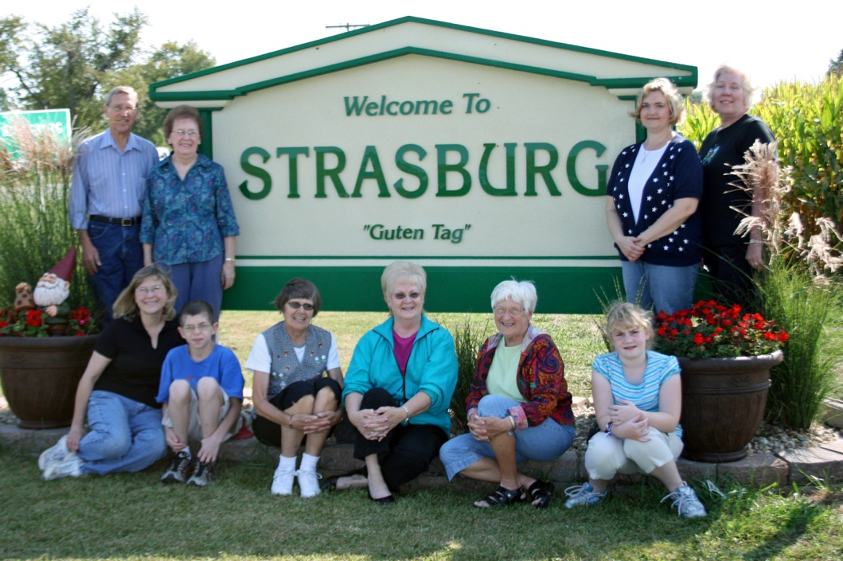
Strasburg

Slide 20

Strasburg (Pop: 467)
Completed MAPPING in 2007, 2017
Between Shelbyville and Effingham
Engaged, hard working volunteers
Close-knit community
Challenges:
  No downtown center
  Bedroom community
  Limited attractions/amenities

Slide 21
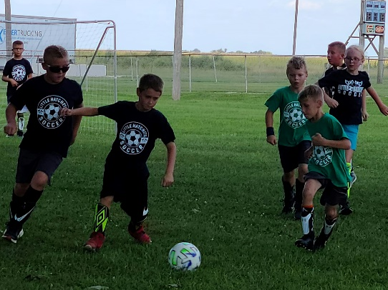

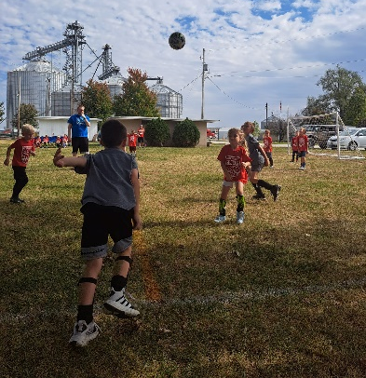
Accomplishments
  Formation of community organization—Strasburg CAN!
  Fundraising
    Community Endowment Fund: $80,000+ with grants being distributed for projects
    Various fundraisers including Hog Roast, Gnome Fest, Annual Plant Sale, Quarter Auction, and Basket Bingo
  Community Branding and Marketing
    Website, newsletter, Facebook, Brochure, Gnome banners, gnome awards
    Adoption of Garden Gnome as community mascot
  Coordination of TIF District
    Recruitment of convenience store/Subway
    24-hour fitness center, daycare
  Park renovations
    Received an Illinois Department of Natural Resources (IDNR) Open Spaces Lands Acquisition and Development (OSLAD) grant of $318,000 for park improvements
    Added a 4-hole disc golf course to the park with plans for expansion
  New community signage and landscape
  Worked with IL Dept. of Corrections to create winter decorations
  Two-time Governor’s Hometown Award winner!

Slide 22

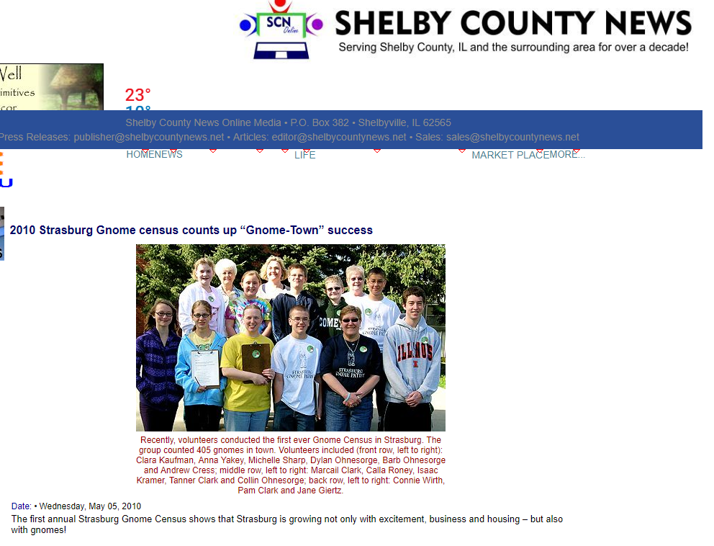
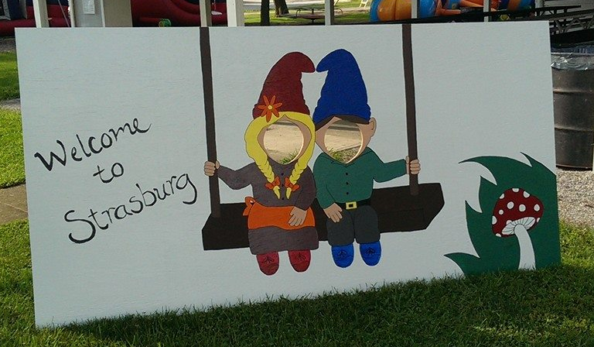
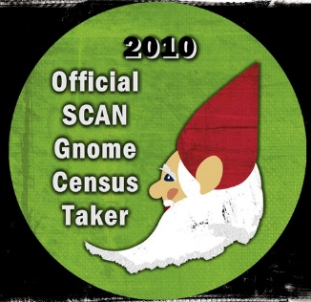
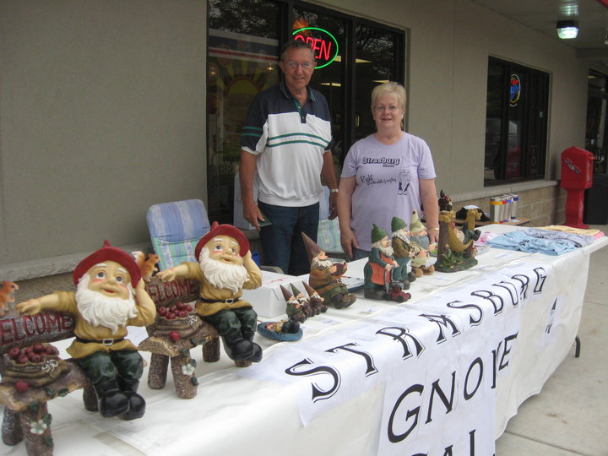

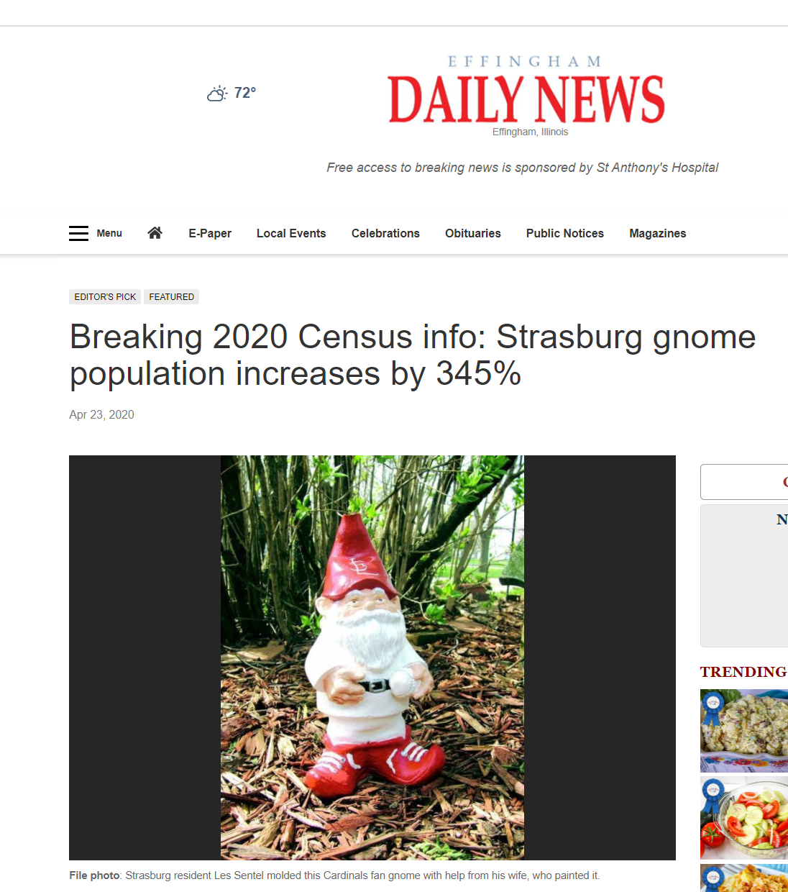
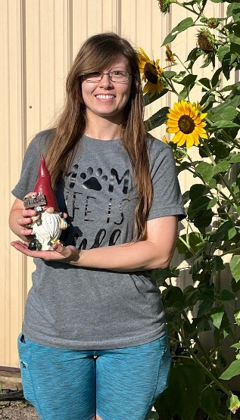
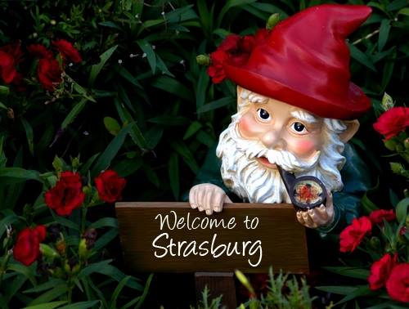
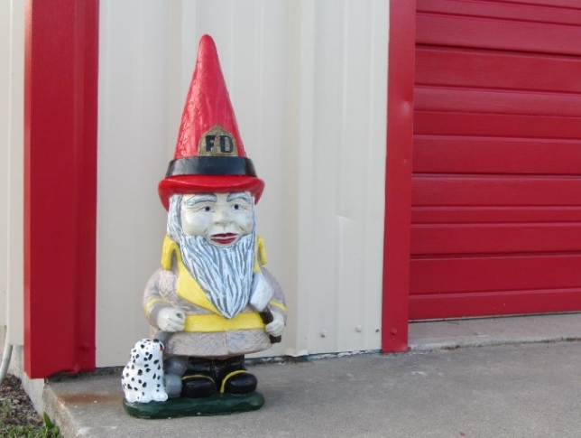
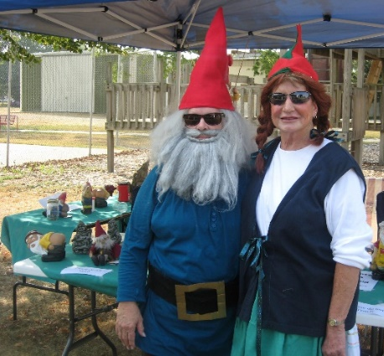
Strasburg Gnomes

Slide 23
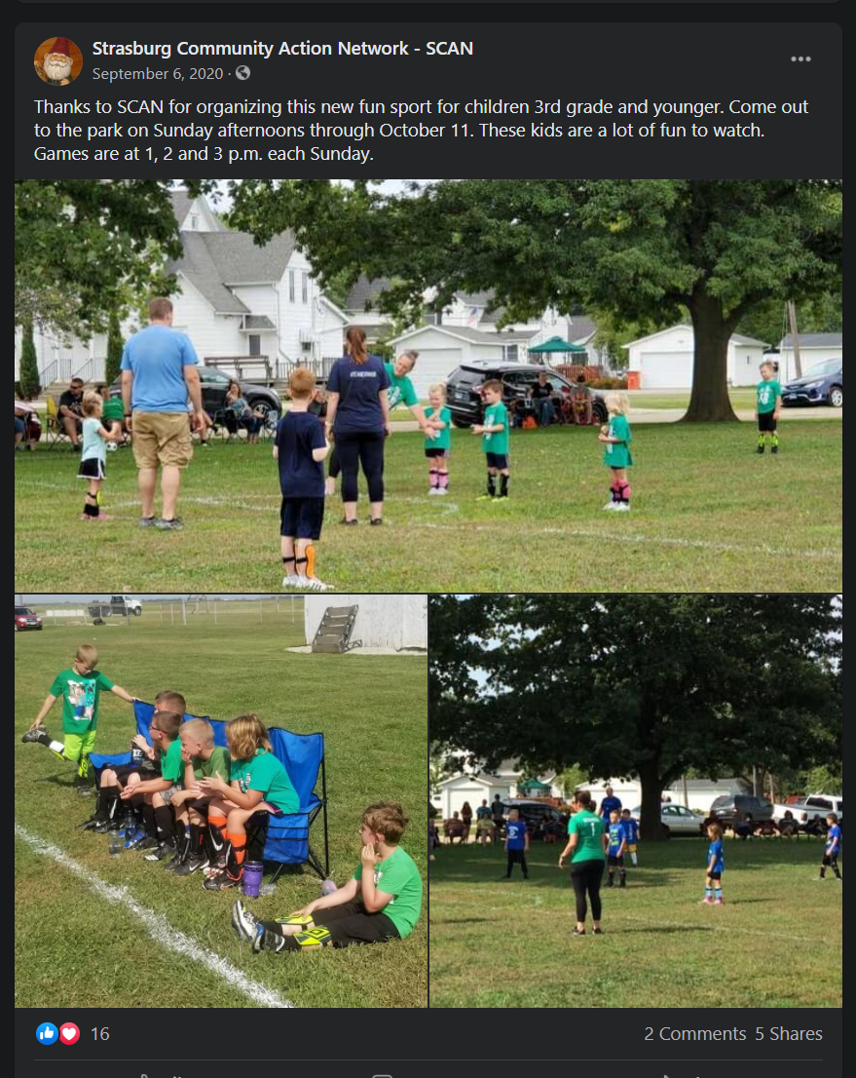
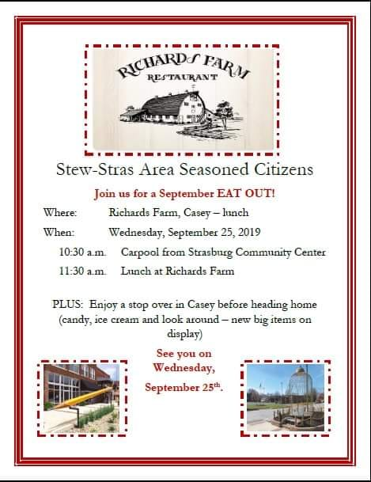
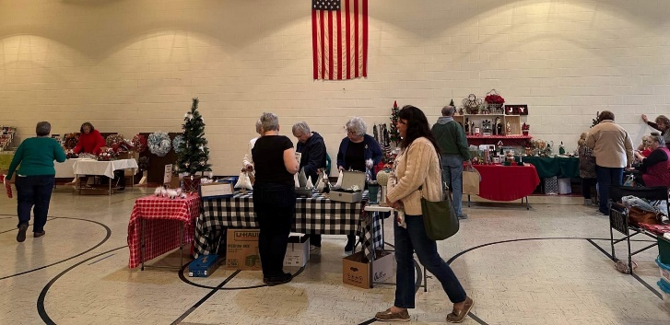
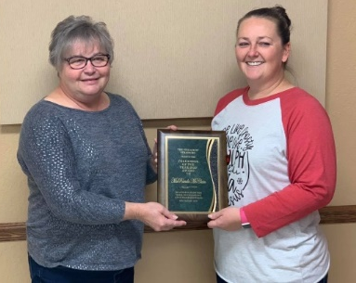

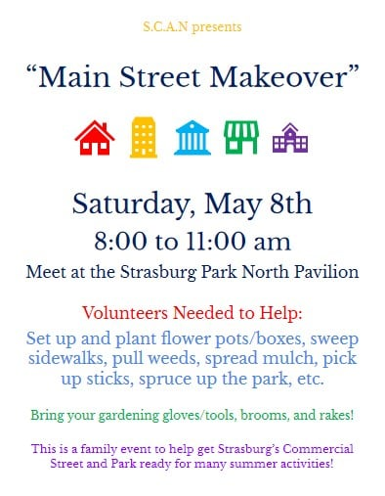
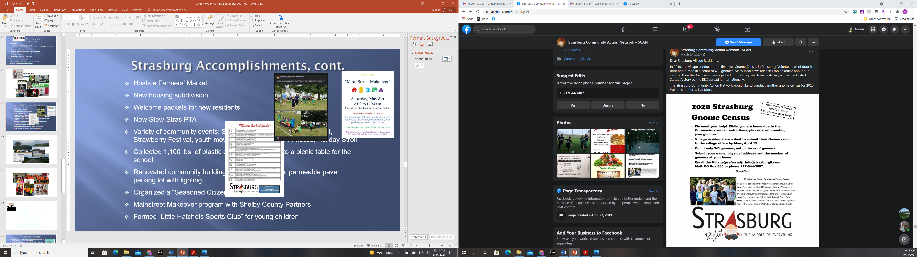
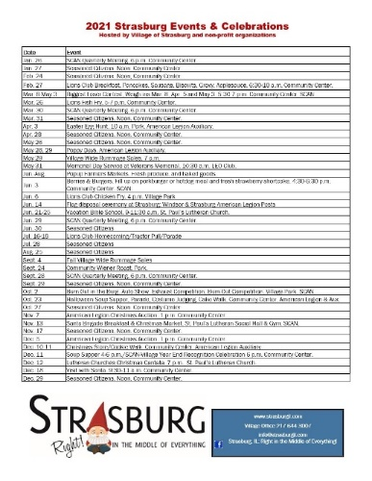
Strasburg Accomplishments, cont.
  Hosts a Farmers’ Market
  New housing subdivision
  Welcome packets for new residents
  New Stew-Stras PTA
  Variety of community events: Santa Brigade Breakfast and Market, Strawberry Festival, youth movie nights, Tea with a Princess, Holiday Stroll
  Collected 1,100 lbs. of plastic caps for recycling into a picnic table for the school
  Renovated community building, added new façade, permeable paver parking lot with lighting
  Organized a “Seasoned Citizens” group
  Mainstreet Makeover program with Shelby County Partners
  “Light Up Strasburg” holiday lighting competition
  Village-wide rummage sales
  Formed “Little Hatchets Sports Club” for young children

Slide 24
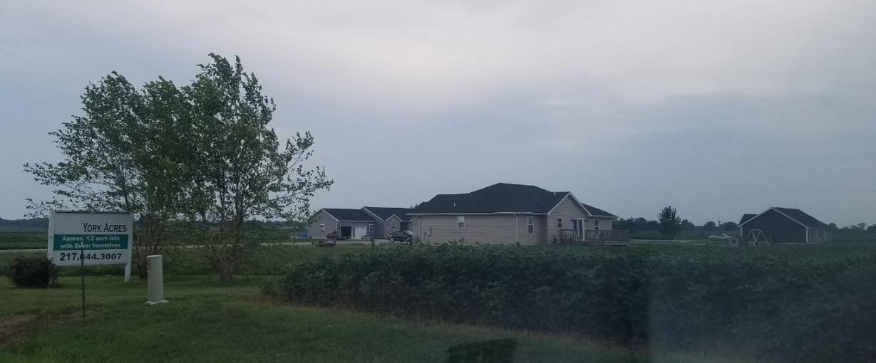
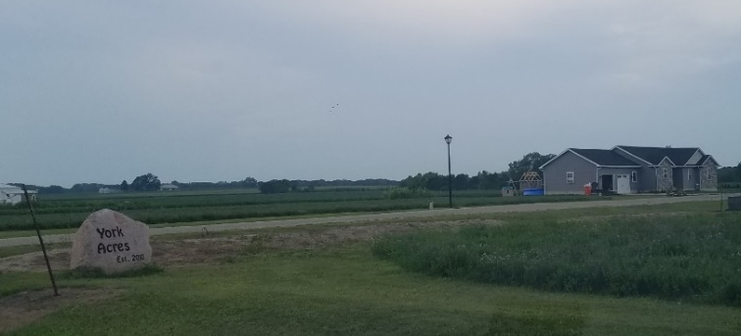
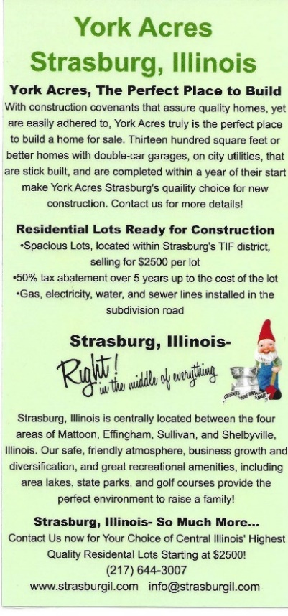
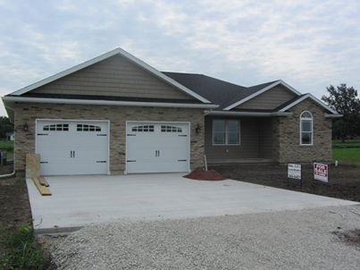

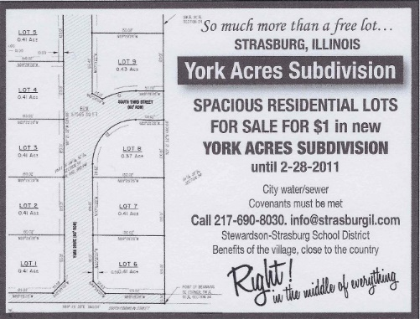
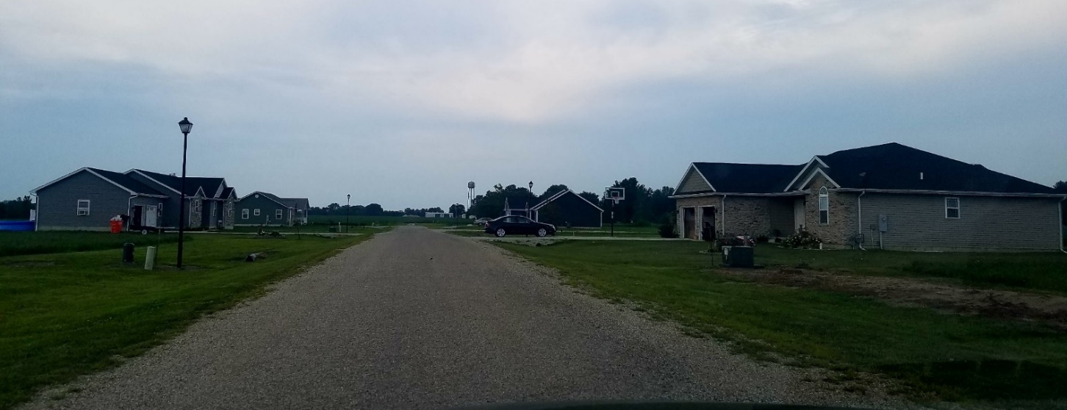
York Acres Subdivision

Slide 25
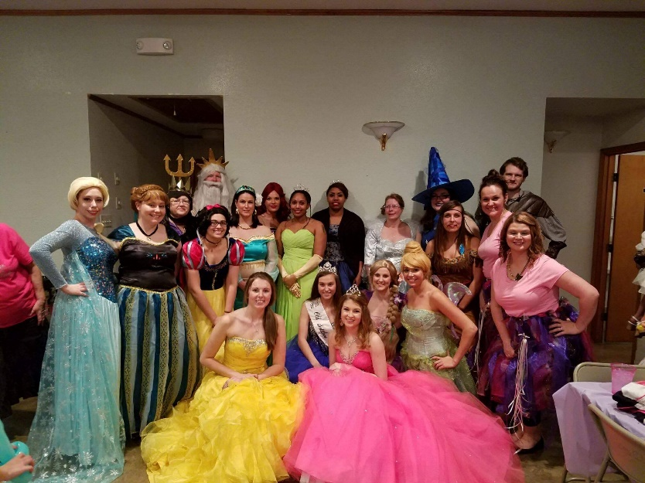
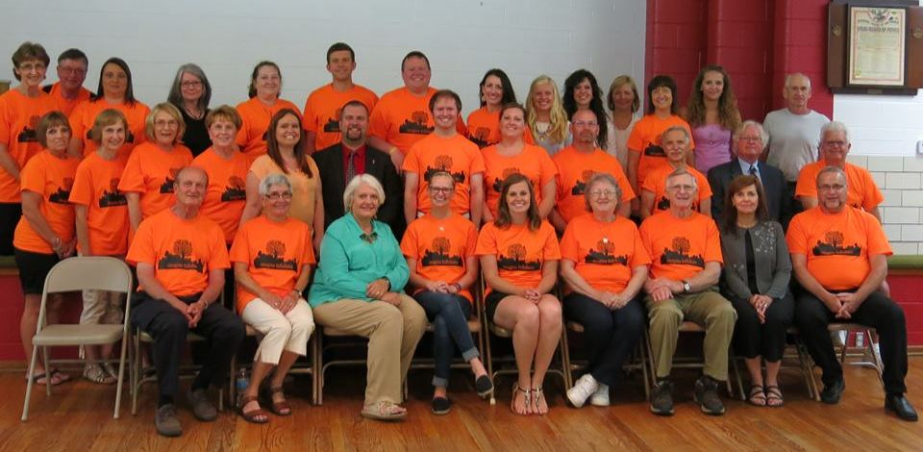

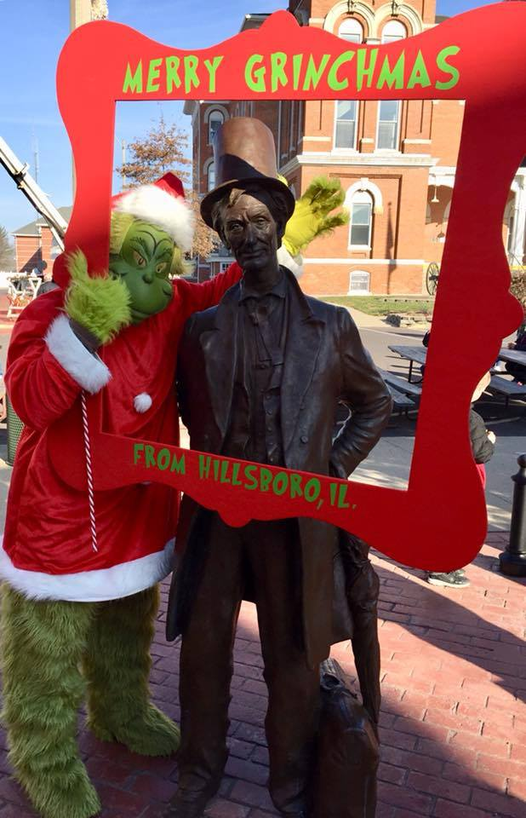
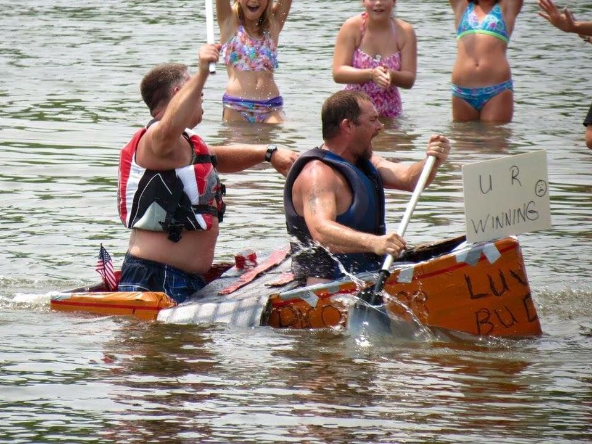
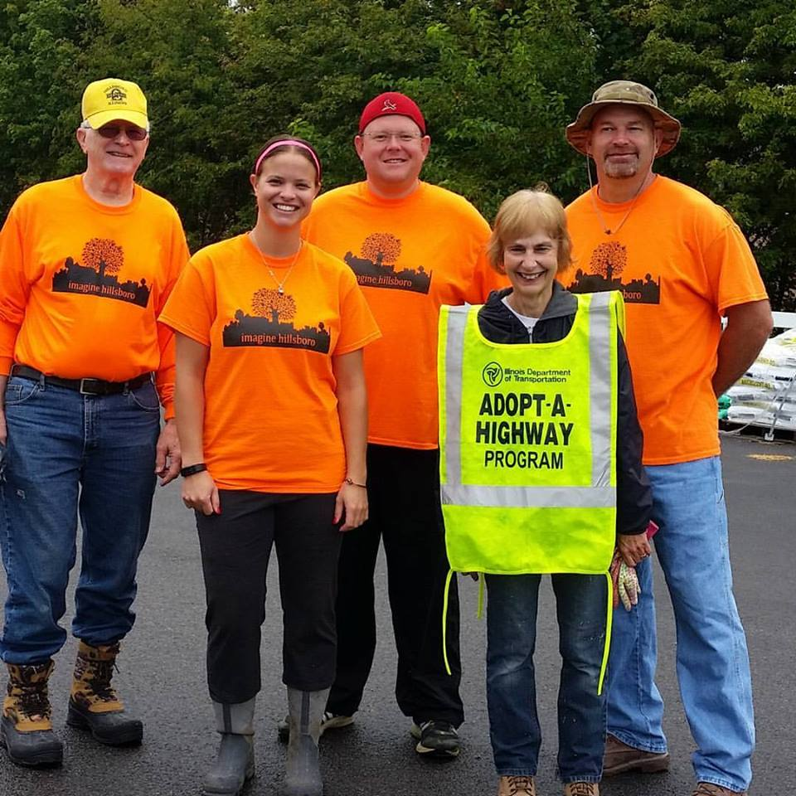
Hillsboro

Slide 26

Hillsboro (Pop: 4,500)
Completed MAPPING in 2015, 2019
Southern Illinois
Outstanding, community-minded hospital
Excellent school district
Passionate, caring community
Challenges:
  Empty downtown storefronts, deteriorating buildings/infrastructure
  Inadequate housing stock for middle income families

Slide 27

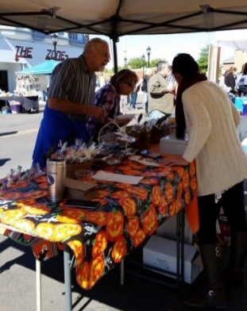
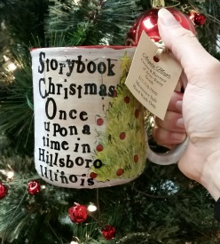
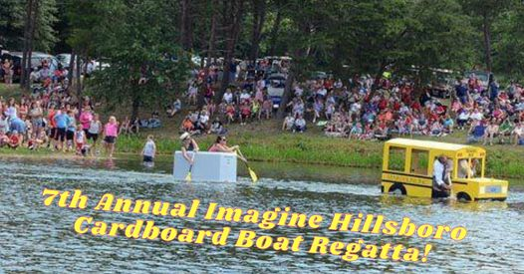
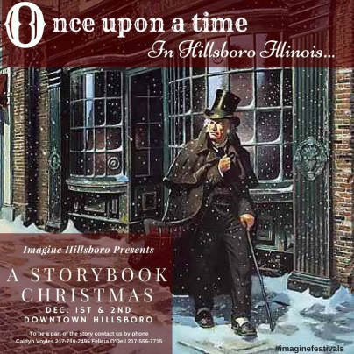
Accomplishments
Worked with the City and the County EDC to bring fiber connectivity direct to homes in Hillsboro and WiFi throughout downtown
Host annual fall European Style Harvest Market with variety of vendors and entertainment
Hosted pop-up coffee shop that spurred the development of a bricks and mortar coffee shop opening in 2018
Established “awww yeah!” campaign to highlight the positive things happening at Hillsboro Schools in newspaper, on radio and on Facebook page
Created adopt-a-pot program and decorate the flower pots for each season
Developed educational video on Common Core being implemented at area schools
Established program to connect elementary school teachers with regular, in-class, community volunteers
Hosted a Peace Corps Fellow
Holds a very popular annual pop-up art show
Organizes a cardboard boat regatta each summer
Awards grants to teachers for special projects

Slide 28





Hillsboro Accomplishments, cont.
Cleaned and remodeled a local stage and are holding annual summer concert series
Designed a promotional website at imagine-hillsboro.com
Organized a very popular holiday celebration ‘A Storybook Christmas’ featuring a new holiday book each year. Event attracts over 1,000 participants annually
Hosts annual events including bed races, Spooktacular Golf Outing, Shake the Lakes 5K, snow pageant, Rake and Run, Father/Daughter Dance, Mother/Son Crazy Bowl, back-to-school Luau and pool party
Volunteers planted 22 trees in Challacombe Park, installed new playground equipment at Central Park, and launched the Ooo-de-lally bike trail
Initiated the Hillsboro Community Development Corporation, a for-profit group focused on housing development
Working with area schools to provide training for teachers and students in computer coding
Organized a chili cook-off with a grand prize of $1,000 for the Harvest Market
Developed a community garden
Created a dog park (“Pawsboro”)
Created theater group, “Blended Artists Imaginarium”
Received a $370k grant to rehabilitate low value housing
Coordinates a farmers market held from June to September each year
Hillsboro was chosen to be featured in the Smithsonian Institution’s traveling exhibit, “Spark! Places of Innovation” in 2023
Developed a co-working space—originally a nonprofit known as The Hilltop Coop, now privately owned—The Annex at Lincoln Plaza (https://www.facebook.com/profile.php?id=61557412267479)

Slide 29







Hillsboro’s Growing Entrepreneurial Culture
“Searching out the small town cool, creative, and inspiring stuff from around this small town and others like it!”
Young “Boomerangs” re-located back to their hometown
Renovated old downtown building for living and working
Pop-up coffee shop, art studio, night market
Refinery (vintage goods store), record store/music recording studio, coffee shop (Black Rabbit Coffee Roasting)
Promoting an “entrepreneurial culture” in the community (and region) https://www.facebook.com/smalltowncool/
Opera House Brewery (opened in 2018)

Slide 30




Hillsboro’s Focus on Technology
Expanded broadband across community and added WiFi to downtown
Recruiting and supporting technology businesses (housing, quality of schools, property taxes are challenges, however)
Providing computer technology education
Creating a tech center in library
Holding tech meet and greet events
Providing Chromebooks to students in need

Slide 31




Mattoon

Slide 32


Mattoon: (Pop.: 18,555)
Completed MAPPING in 1994, 2017, 2022
Southeastern Illinois
Robust industry
Healthcare, education, transportation
Challenges:
  Inadequate workforce/skills gap
  Organizational/collaboration challenges

Slide 33
Accomplishments
Developed bike plan with Ride Illinois
Created a new community website
Housing needs assessment with IHDA, database, painting/repair initiative
Held groundbreaking for $80 million Emerald Acres Sports Complex, a public-private collaboration
Youth engagement, mentoring initiatives
Developed a business incubator/coworking space, Elevate
  6,000 sq. ft. building donated by Rural King
  $75,000 and $250,000 Google Impact Grant winner!

Slide 34











Elevate Cross County Innovation Center

Slide 35
Mattoon Accomplishments, cont.
Certified “Better City for Pets” by Mars Petcare
Launched "Move to Mattoon" campaign to attract remote high income workers with $11,703 in incentives
Won a $50,000 T-Mobile Hometown Grant to develop a pocket park downtown
Hosted two Peace Corps Fellows and retained both in the community
Launched “Our Town Mattoon” event and website to promote the community and all they have to offer
Inventoried all 909 businesses in Mattoon and Charleston
City of Mattoon received a $600,000 Illinois Department of Natural Resources Open Space Land Acquisition and Development (OSLAD) grant for improvements to Lake Mattoon campground, marina, and pavilion
A team of AmeriCorps members assisted with building trails at Lake Paradise
Creating a pickleball court in a former tennis court
Host AmeriCorps VISTAs at several Mattoon sites
Created a dog park (https://www.facebook.com/mattooncommunitydogpark/)

Slide 36
Keys to Success
Recognition of need for action and sense of responsibility
Willingness to accept change
Strong local leadership
Clearly communicated vision and goals
Widespread support and collaboration within community
Follow-through with documented results
Perseverance
Regional view of community

Slide 37
Questions?
For more info:
Gisele Hamm, Program Director
MAPPING the Future of Your Community
Illinois Institute for Rural Affairs
Western Illinois University
GF-Hamm@wiu.edu / 309.298.4019

