Slide 1

Regional Summit

Slide 2
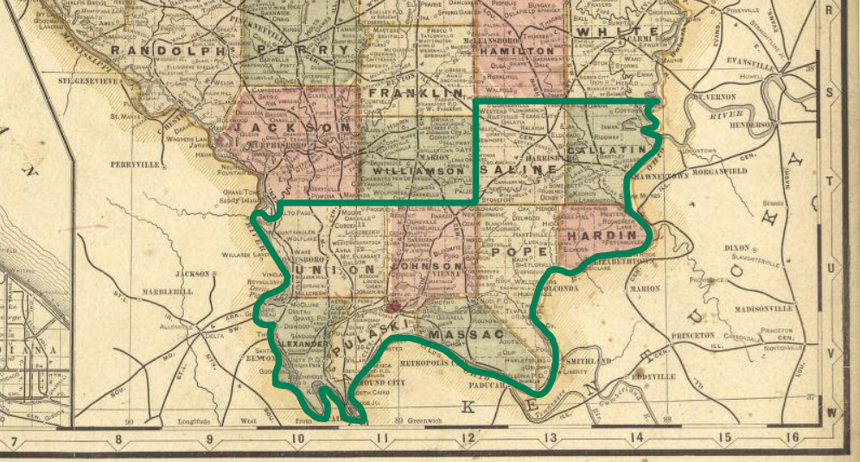
One Shawnee Region

Slide 3
One Shawnee
Board of Directors
Patrick Windhorst | Sherrie Crabb | Martin Rowe
Nicholas Mott | Dale Fowler | Deborah Barnett
Joshua Stafford | Kristy Stephenson | Angie Hampton
Vernon Stubblefield | Melissa Presser | Jody Johnson
Trish Steckenrider | Larry Mizell | Beth Montfort
Rhonda Belford | Deborah Johnson

Slide 4
Mission Statement
One Shawnee will generate planned action that culturally and economically rebuilds the Ohio River and Shawnee National Forest regions of southernmost Illinois on a shared vision of the future using a focused alliance of community groups, leaders, resource partners, and stakeholders.
“Build Stronger Communities”

Slide 5
Why a Regional Summit?
Community Capacity Building
Increase the ability of community members to work together effectively to solve problems, set goals, and get things done.

Slide 6

Website:
oneshawnee.com
Facebook:
facebook.com/oneshawnee
Email:
OneShawneeRegion@gmail.com

Slide 7
Regional Summit

Slide 8


Data for Decision Makers
One Shawnee Regional Summit
Zach Kennedy
Extension Specialist, Community and Economic Development
State Lead, Illinois State Census Data Center
University of Illinois Extension
10/11/2024

Slide 9
State Population Change
Top 5 and Bottom 5 States in Population Growth 2010-2020
State | 2010 Population | 2020 Population | Change | Rank
Texas | 25,145,561 | 29,145,505 | 3,999,944 | 1
Florida | 18,801,310 | 21,538,187 | 2,736,877 | 2
California | 37,253,956 | 39,538,223 | 2,284,267 | 3
Georgia | 9,687,653 | 10,711,908 | 1,024,255 | 4
Washington | 6,724,540 | 7,705,281 | 980,741 | 5
Vermont | 625,741 | 643,077 | 17,336 | 46
Wyoming | 563,626 | 576,851 | 13,225 | 47
Mississippi | 2,967,297 | 2,961,279 | (6,018) | 48
Illinois | 12,830,632 | 12,812,508 | (18,124) | 49
West Virginia | 1,852,994 | 1,793,716 | (59,278) | 50
Source: U.S. Census Bureau, 2010 & 2020 Decennial Census
Illinois Population Change 2010-2020: -18,124 Rank: 49th 2020 Population: 12,812,508

Slide 10
State Population Change
Top 5 and Bottom 5 States in Population Growth Percentage 2010-2020
State | 2010 Population | 2020 Population | Pct Change | Rank
Utah | 2,763,885 | 3,271,616 | 18.4% | 1
Idaho | 1,567,582 | 1,839,106 | 17.3% | 2
Texas | 25,145,561 | 29,145,505 | 15.9% | 3
North Dakota | 672,591 | 779,094 | 15.8% | 4
Nevada | 2,700,551 | 3,104,614 | 15.0% | 5
Michigan | 9,883,640 | 10,077,331 | 2.0% | 46
Connecticut | 3,574,097 | 3,605,944 | 0.9% | 47
Illinois | 12,830,632 | 12,812,508 | -0.1% | 48
Mississippi | 2,967,297 | 2,961,279 | -0.2% | 49
West Virginia | 1,852,994 | 1,793,716 | -3.2% | 50
Source: U.S. Census Bureau, 2010 & 2020 Decennial Census
Illinois Percent Population Change 2010-2020: -0.1%
Rank: 48th

Slide 11
State Population Change
What has happened since the 2020 Census?
Top 5 and Bottom 5 States in Population Growth 2020-2023
State | 2020 Population | 2023 Population | Change | Rank
Texas | 29,145,428 | 30,503,301 | 1,357,842 | 1
Florida | 21,538,226 | 22,610,726 | 1,072,510 | 2
North Carolina | 10,439,414 | 10,835,491 | 396,032 | 3
Georgia | 10,711,937 | 11,029,227 | 315,456 | 4
Arizona | 7,151,507 | 7,431,344 | 273,442 | 5
Pennsylvania | 7,029,949 | 6,981,974 | (41,105) | 46
Louisiana | 4,657,749 | 4,590,241 | (84,036) | 47
Illinois | 12,812,545 | 12,582,032 | (263,780) | 48
California | 39,538,245 | 39,029,342 | (573,019) | 49
New York | 20,201,230 | 19,677,151 | (631,104) | 50
Source: U.S. Census Bureau, 2020 Decennial Census & 2023 Population Estimate Series

Slide 12
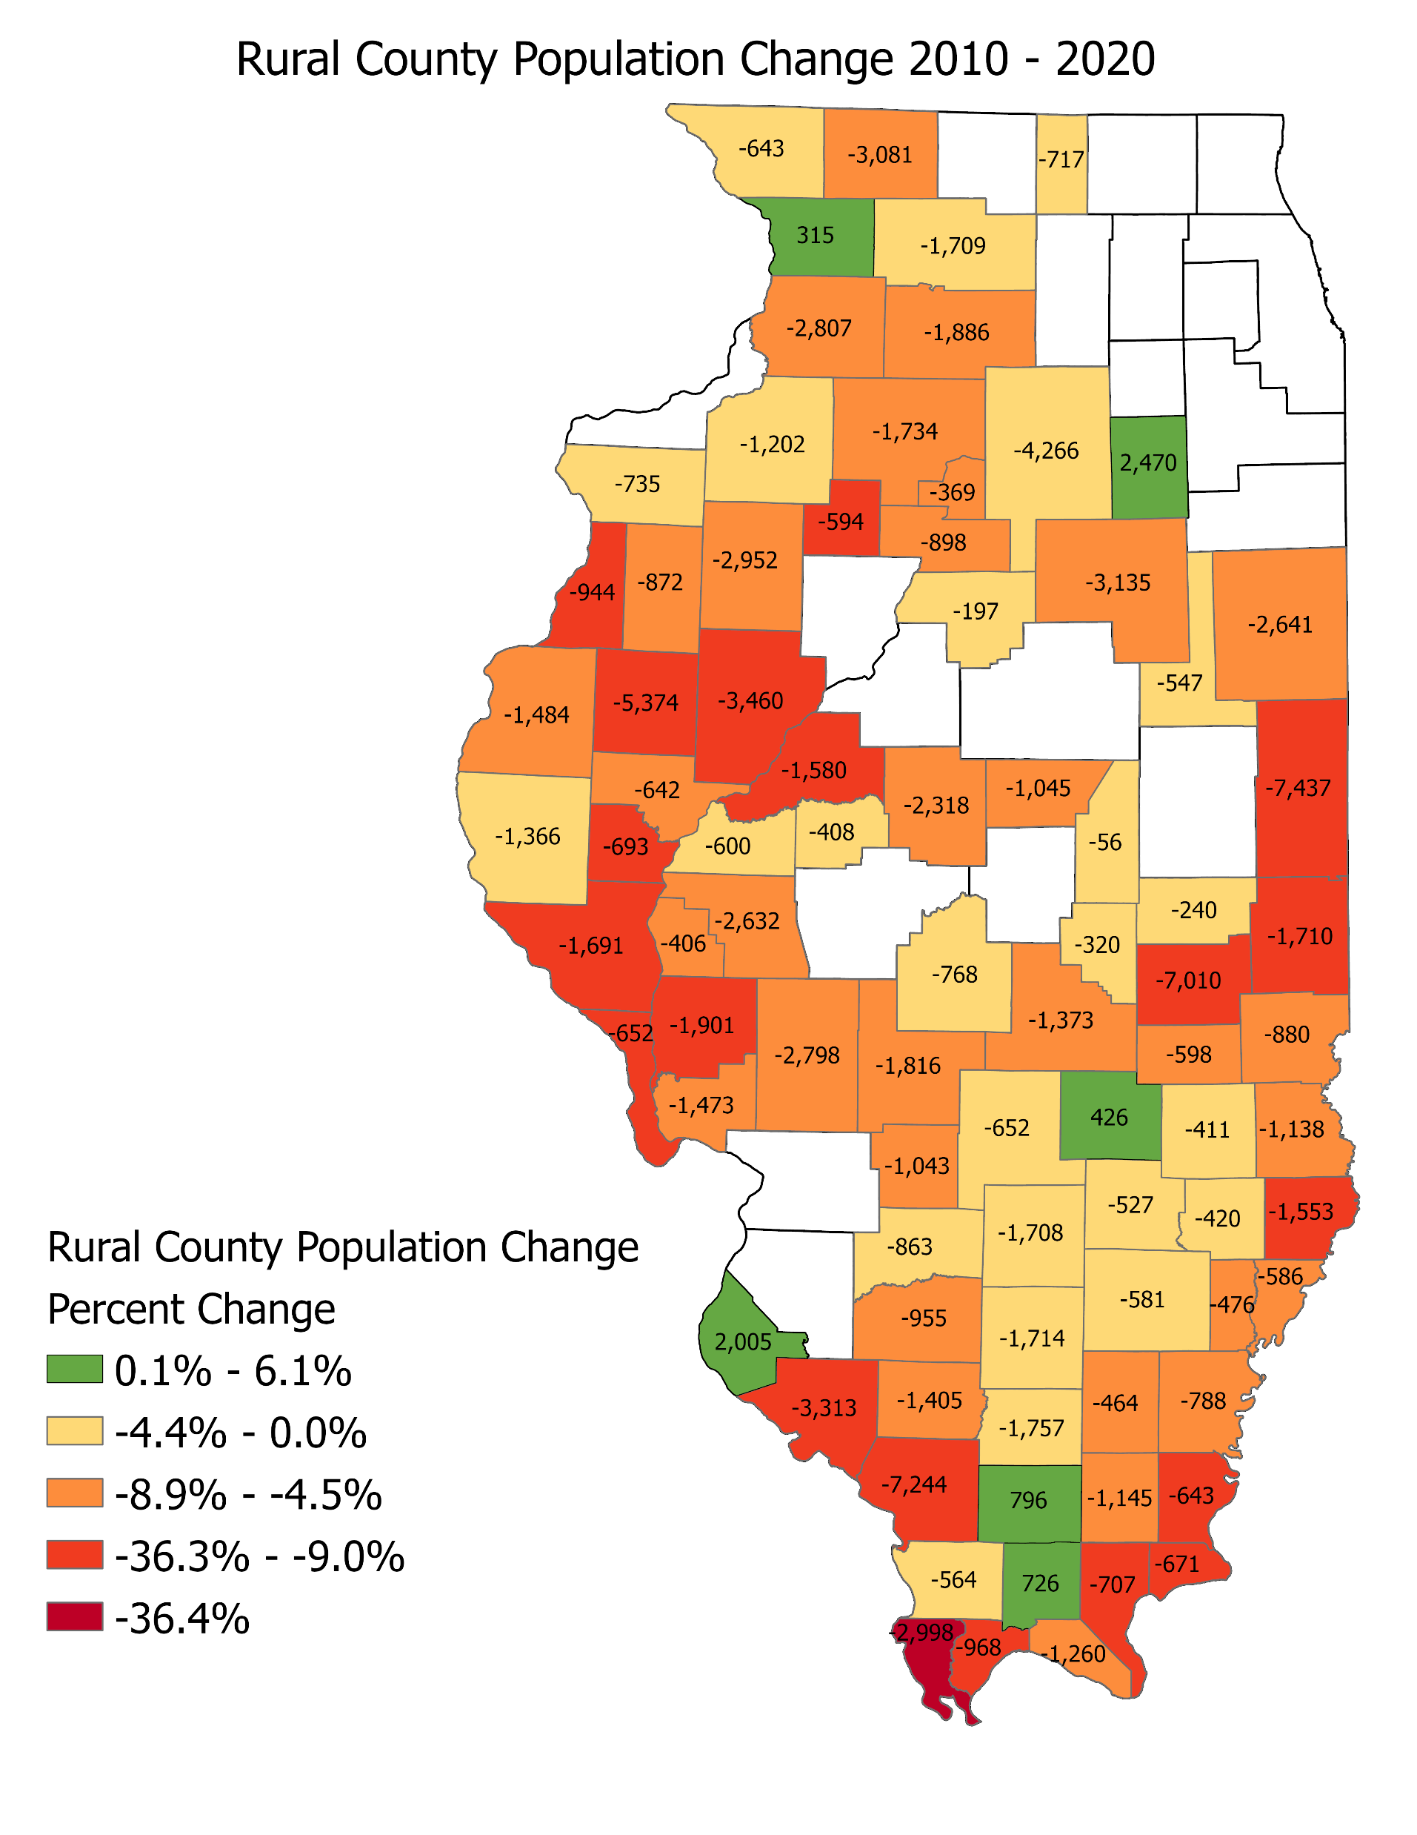
Rural County Population Change
Top and Bottom 5 Counties in Percent Growth 2010 - 2020
County | 2010 | 2020 | Change | Percent Change | Rank
Monroe Co. | 32,957 | 34,962 | 2,005 | 6.1% | 1
Johnson Co. | 12,582 | 13,308 | 726 | 5.8% | 2
Grundy Co. | 50,063 | 52,533 | 2,470 | 4.9% | 3
Carroll Co. | 15,387 | 15,702 | 315 | 2.0% | 4
Effingham Co. | 34,242 | 34,668 | 426 | 1.2% | 5
Hardin Co. | 4,320 | 3,649 | (671) | -15.5% | 79
Pulaski Co. | 6,161 | 5,193 | (968) | -15.7% | 80
Pope Co. | 4,470 | 3,763 | (707) | -15.8% | 81
McDonough Co. | 32,612 | 27,238 | (5,374) | -16.5% | 82
Alexander Co. | 8,238 | 5,240 | (2,998) | -36.4% | 83
Source: U.S. Census Bureau, 2010 & 2020 Decennial Census

Slide 13
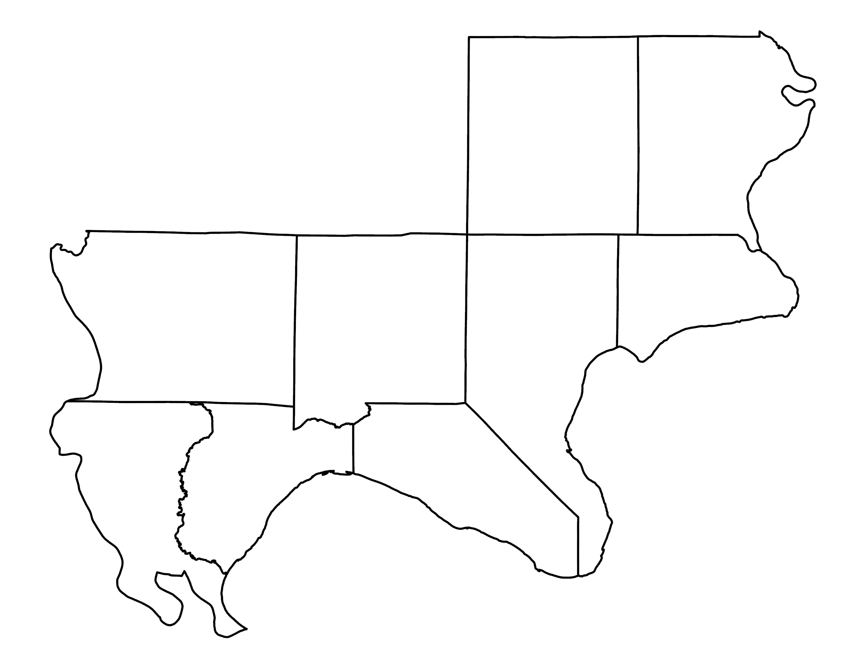
Regional Population - Total Change
Saline Co.
2022 Pop: 3,799
2010 Pop: 4,426
Change: -627
Pct. Chg.: -14.2%
Gallatin Co.
2022 Pop: 4,967
2010 Pop: 5,773
Change: -806
Pct. Chg.: -14.0%
One Shawnee Region
2022 Pop: 91,101
2010 Pop: 100,577
Change: -9,476
Pct. Chg.: -9.4%
United States
2022 Pop: 331,097,593
2010 Pop: 303,965,272
Change: 27,132,321
Pct. Chg.: 8.9%
Hardin Co.
2022 Pop: 3,665
2010 Pop: 4,402
Change: -737
Pct. Chg.: -16.7%
Union Co.
2022 Pop: 17,122
2010 Pop: 17,959
Change: -837
Pct. Chg.: -4.7%
Johnson Co.
2022 Pop: 13,313
2010 Pop: 12,710
Change: 603
Pct. Chg.: 4.7%
Pope Co.
2022 Pop: 3,799
2010 Pop: 4,426
Change: -627
Pct. Chg.: -14.2%
Alexander Co.
2022 Pop: 5,261
2010 Pop: 8,449
Change: -3,188
Pct. Chg.: -37.7%
Massac Co.
2022 Pop: 14,135
2010 Pop: 15,425
Change: -1,290
Pct. Chg.: -8.4%
Pulaski Co.
2022 Pop: 5,177
2010 Pop: 6,262
Change: -1,085
Pct. Chg.:
-17.3%
Source: U.S. Census Bureau, 2010 & 2022 American Community Survey 5-yr Estimates

Slide 14
Regional Population - Age
Saline Co.
2022 <18: 20.6%
2010 <18: 23.1%
2022 >65: 20.6%
2010 >65: 18.4%
Gallatin Co.
2022 <18: 21.9%
2010 <18: 21.8%
2022 >65: 24.7%
2010 >65: 20.0%
One Shawnee Region
2022 <18: 20.3%
2010 <18: 22.2%
2022 >65: 22.0%
2010 >65: 18.2%
United States
2022 <18: 22.1%
2010 <18: 24.4%
2022 >65: 16.5%
2010 >65: 12.7%
Hardin Co.
2022 <18: 22.0%
2010 <18: 21.6%
2022 >65: 23.5%
2010 >65: 21.7%
Union Co.
2022 <18: 20.8%
2010 <18: 22.0%
2022 >65: 20.6%
2010 >65: 22.8%
Johnson Co.
2022 <18: 20.3%
2010 <18: 19.4%
2022 >65: 19.6%
2010 >65: 16.3%
Pope Co.
2022 <18: 16.2%
2010 <18: 20.7%
2022 >65: 24.9%
2010 >65: 18.4%
Alexander Co.
2022 <18: 22.0%
2010 <18: 23.3%
2022 >65: 23.5%
2010 >65: 18.3%
Massac Co.
2022 <18: 21.6%
2010 <18: 23.0%
2022 >65: 20.7%
2010 >65: 18.2%
Pulaski Co.
2022 <18: 20.5%
2010 <18: 24.0%
2022 >65: 22.6%
2010 >65:
17.4%
Source: U.S. Census Bureau, 2010 & 2022 American Community Survey 5-yr Estimates

Slide 15
Regional Population - Race
Source: U.S. Census Bureau, 2022 American Community Survey 5-yr Estimates

Slide 16
Regional Population - Ethnicity
Source: U.S. Census Bureau, 2022 American Community Survey 5-yr Estimates

Slide 17
One Shawnee Region
Regional Economy -
Industrial Employment
Saline Co.
Edu & Health.. 29.4%
Manufacturing.. 11.4%
Retail.. 11.3%
Gallatin Co.
Edu & Health.. 20.8%
Retail.. 16.3%
Ag, Mining.. 13.4%
Industry | Emp | Pct Emp
Ag. Forestry, Fishing, Hunting, Mining | 1,918 | 5.4%
Construction | 2,297 | 6.5%
Manufacturing | 3,308 | 9.4%
Wholesale Trade | 726 | 2.1%
Retail Trade | 4,427 | 12.5%
Transportation, warehousing and utilities | 2,608 | 7.4%
Information | 253 | 0.7%
Finance and ins, and real estate | 1,295 | 3.7%
Prof, mgmt, admin & waste mgmt. | 1,721 | 4.9%
Edu, health care & social assistance | 10,129 | 28.7%
Arts, entertainment, rec, accomod & food | 2,481 | 7.0%
Other services, except public admin | 1,613 | 4.6%
Public administration | 2,521 | 7.1%
Hardin Co.
Edu & Health.. 38.9%
Retail.. 11.8%
Manufacturing.. 7.9%
Union Co.
Edu & Health.. 31.7%
Retail.. 11.2%
Arts & Ent.. 8.6%
Johnson Co.
Edu & Health.. 31.4%
Retail.. 10.6%
Public Admin.. 10.6%
Pope Co.
Edu & Health.. 34.7%
Retail.. 15.4%
Transp.. 9.0%
Alexander Co.
Edu & Health.. 26.5%
Manufacturing..
15.0%
Retail.. 12.8%
Massac Co.
Edu & Health.. 19.8%
Retail.. 15.6%
Transportation.. 12.2%
Pulaski Co.
Edu & Health.. 35.2%
Retail.. 13.2%
Manufacturing..
9.2%
Source: U.S. Census Bureau, 2010 & 2022 American Community Survey 5-yr Estimates

Slide 18
Regional vs National Employment by Industry
One Shawnee Region
United States
Industry | Emp | Pct Emp | Emp | Pct Emp | Region vs U.S. Difference
Ag. Forestry, Fishing, Hunting, Mining | 1,918 | 5.4% | 2,605,614 | 1.6% | +3.8%
Construction | 2,297 | 6.5% | 10,927,582 | 6.9% | -0.4%
Manufacturing | 3,308 | 9.4% | 15,876,915 | 10.0% | -0.6%
Wholesale Trade | 726 | 2.1% | 3,816,197 | 2.4% | -0.3%
Retail Trade | 4,427 | 12.5% | 17,463,378 | 11.0% | +1.5%
Transportation, warehousing and utilities | 2,608 | 7.4% | 9,190,548 | 5.8% | +1.6%
Information | 253 | 0.7% | 3,016,820 | 1.9% | -1.2%
Finance and ins, and real estate | 1,295 | 3.7% | 10,582,227 | 6.7% | -3.0%
Prof, mgmt, admin & waste mgmt. | 1,721 | 4.9% | 19,285,652 | 12.1% | -7.2%
Edu, health care & social assistance | 10,129 | 28.7% | 36,948,956 | 23.3% | +5.4%
Arts, entertainment, rec, accomod & food | 2,481 | 7.0% | 14,244,205 | 9.0% | -2.0%
Other services, except public admin | 1,613 | 4.6% | 7,509,732 | 4.7% | -0.1%
Public administration | 2,521 | 7.1% | 7,445,378 | 4.7% | +2.4%
Source: U.S. Census Bureau, 2022 American Community Survey 5-yr Estimates

Slide 19
Regional Economy -
Occupational Employment
Saline Co.
Management.. 34.5%
Service.. 21.0%
Sales.. 19.0%
Gallatin Co.
Management.. 29.1%
Production.. 20.9%
Sales.. 15.8%
One Shawnee Region
Occupation | Emp | Pct Emp
Management, professional, & related | 10,840 | 30.7%
Service | 7,750 | 22.0%
Sales and office | 6,823 | 19.3%
Farming, fishing, and forestry | 445 | 1.3%
Construction, extract, maint, & repair | 2,408 | 6.8%
Production, transportation | 5,768 | 16.3%
Johnson Co.
Management.. 32.4%
Service.. 25.0%
Sales.. 20.0%
Pope Co.
Management.. 38.6%
Service.. 21.7%
Production.. 16.4%
Hardin Co.
Management.. 38.0%
Production.. 22.5%
Service.. 18.2%
Union Co.
Management.. 30.1%
Service.. 26.0%
Production.. 17.6%
Alexander Co.
Production.. 29.3%
Management..
23.3%
Sales.. 20.8%
Massac Co.
Sales.. 27.3%
Management.. 24.9%
Service.. 20.0%
Pulaski Co.
Management.. 24.7%
Service.. 24.3%
Sales.. 21.5%
Source: U.S. Census Bureau, 2010 & 2022 American Community Survey 5-yr Estimates
Notes:
Examples of Occupations

Slide 20
Regional vs National Employment by Occupation
One Shawnee Region
United States
Occupation | Emp | Pct Emp | Emp | Pct Emp | Region vs U.S. Difference
Management, professional, & related | 10,840 | 30.7% | 65,164,340 | 41.0% | -10.3%
Service | 7,750 | 22.0% | 26,632,838 | 16.8% | +5.2%
Sales and office | 6,823 | 19.3% | 32,500,088 | 20.5% | -1.2%
Farming, fishing, and forestry | 445 | 1.3% | 962,303 | 0.6% | +0.7%
Construction, extract, maint, & repair | 2,408 | 6.8% | 7,936,170 | 5.0% | +1.8%
Production, transportation | 5,768 | 16.3% | 20,842,673 | 13.1% | +3.2%
Source: U.S. Census Bureau, 2022 American Community Survey 5-yr Estimates

Slide 21
Commuting
Saline Co.
Work in County.. 69.1%
Work out of County.. 30.9%
Avg. Commute.. 22.2 mins
Gallatin Co.
Work in County.. 33.8%
Work out of County.. 66.2%
Avg. Commute..
25.8 mins
Pope Co.
Work in County.. 29.1%
Work out of County..
70.9%
Avg. Commute.. 29 mins
Hardin Co.
Work in County.. 42.2%
Work out of County.. 57.8%
Avg. Commute.. 32 mins
Union Co.
Work in County.. 62.9%
Work out of County.. 37.1%
Avg. Commute.. 24.4 mins
Johnson Co.
Work in County.. 40.1%
Work out of County.. 59.9%
Avg. Commute.. 24.9 mins
Alexander Co.
Work in County.. 35.6%
Work out of County..
64.4%
Avg. Commute..
26.7 mins
Massac Co.
Work in County.. 52.4%
Work out of County..
47.6%
Avg. Commute..
21.4 mins
Pulaski Co.
Work in County.. 38.0%
Work out of County..
62.0%
Avg. Commute
26.3 mins
Source: U.S. Census Bureau, 2010 & 2022 American Community Survey 5-yr Estimates

Slide 22
Household Incomes
Saline Co.
Median HH Income:
$51,710
Gallatin Co.
Median HH Income:
$51,868
Household Income | One Shawnee Region | United States
Less than $10,000 | 5.9% | 4.9%
$10,000 to $14,999 | 7.5% | 3.8%
$15,000 to $24,999 | 10.0% | 7.0%
$25,000 to $34,999 | 10.7% | 7.4%
$35,000 to $49,999 | 12.7% | 10.7%
$50,000 to $74,999 | 17.9% | 16.1%
$75,000 to $99,999 | 12.2% | 12.8%
$100,000 to $149,999 | 13.8% | 17.1%
$150,000 to $199,999 | 5.5% | 8.8%
$200,000 or more | 4.0% | 11.4%
Union Co.
Median HH Income:
$54,090
Johnson Co.
Median HH Income:
$63,295
Pope Co.
Median HH Income:
$57,582
Hardin Co.
Median HH Income:
$53,026
Alexander Co.
Median HH Income:
$40,365
Pulaski Co.
Median HH Income:
$41,038
Massac Co.
Median HH Income:
$57,365
U.S. Median
HH Income:
$75,149
Source: U.S. Census Bureau, 2010 & 2022 American Community Survey 5-yr Estimates

Slide 23
Poverty Prevalence
Saline Co.
People in Poverty.. 18.0%
Families in Poverty.. 14.2%
Gallatin Co.
People in Poverty.. 19.2%
Families in Poverty.. 13.4%
Union Co.
People in Poverty.. 20.1%
Families in Poverty.. 13.5%
Johnson Co.
People in Poverty.. 16.5%
Families in Poverty.. 10.4%
Pope Co.
People in Poverty.. 18.7%
Families in Poverty..
9.6%
Hardin Co.
People in Poverty.. 11.5%
Families in Poverty.. 6.3%
Poverty Prevalence | One Shawnee Region | United States
People below poverty | 18.0% | 12.5%
Families below poverty | 12.2% | 8.8%
Alexander Co.
People in Poverty.. 21.4%
Families in
Poverty.. 15.1%
Massac Co.
People in Poverty.. 13.8%
Families in Poverty.. 8.7%
Pulaski Co.
People in Poverty.. 25.0%
Families in
Poverty..
15.2%
Source: U.S. Census Bureau, 2010 & 2022 American Community Survey 5-yr Estimates

Slide 24
Household Earnings Sources
Saline Co.
Labor Earnings.. 67.1%
Social Security.. 39.9%
Retirement Income.. 25.6%
Gallatin Co.
Labor Earnings.. 63.5%
Social Security.. 43.0%
Retirement Income..
24.7%
Household Earnings Sources | One Shawnee Region | United States
Labor Earnings | 63.0% | 77.6%
Social Security | 44.0% | 31.2%
Retirement Income | 29.8% | 23.1%
Supplemental Security Income (SSI) | 7.6% | 5.1%
Cash Public Assistance | 4.4% | 2.7%
SNAP | 19.1% | 11.5%
Hardin Co.
Labor Earnings.. 53.7%
Social Security.. 48.7%
Retirement Income.. 36.8%
Union Co.
Labor Earnings.. 60.6%
Social Security.. 44.2%
Retirement Income.. 31.1%
Johnson Co.
Labor Earnings.. 62.4%
Social Security.. 44.5%
Retirement Income.. 36.3%
Pope Co.
Labor Earnings.. 56.6%
Social Security.. 47.8%
Retirement Income.. 38.5%
Alexander Co.
Labor Earnings.. 58.4%
Social Security..
52.8%
Retirement
Income.. 27.3%
Massac Co.
Labor Earnings.. 67.7%
Social Security.. 45.2%
Retirement
Income.. 30.0%
Pulaski Co.
Labor Earnings.. 53.1%
Social Security..
47.5%
Retirement
Income..
28.8%
Source: U.S. Census Bureau, 2010 & 2022 American Community Survey 5-yr Estimates

Slide 25
Educational Attainment
Saline Co.
No H.S. Grad.. 11.8%
Associate’s.. 13.8%
Bachelor’s or higher.. 20.2%
Gallatin Co.
No H.S. Grad.. 12.8%
Associate’s.. 10.7%
Bachelor’s or higher..
12.4%
Hardin Co.
No H.S. Grad.. 12.7%
Associate’s.. 13.9%
Bachelor’s or higher.. 12.0%
Educational Attainment | One Shawnee Region | United States
No High School Degree | 12.6% | 10.9%
Associate’s Degree | 11.1% | 8.7%
Bachelor’s Degree or Higher | 17.3% | 34.3%
Union Co.
No H.S. Grad.. 12.0%
Associate’s.. 8.9%
Bachelor’s or higher.. 21.7%
Johnson Co.
No H.S. Grad.. 15.4%
Associate’s.. 10.6%
Bachelor’s or higher.. 16.6%
Pope Co.
No H.S. Grad.. 11.8%
Associate’s.. 9.0%
Bachelor’s or higher.. 15.4%
Alexander Co.
No H.S. Grad.. 13.6%
Associate’s.. 7.5%
Bachelor’s or
higher.. 10.3%
Pulaski Co.
No H.S. Grad.. 11.9%
Associate’s.. 8.2%
Bachelor’s or
higher.. 14.5%
Massac Co.
No H.S. Grad.. 12.3%
Associate’s.. 11.7%
Bachelor’s or
higher.. 14.7%
Source: U.S. Census Bureau, 2010 & 2022 American Community Survey 5-yr Estimates
Notes:
Examples of Occupations

Slide 26
Declining Birth Rates
Illinois, like much of the U.S., has seen declining birth rates, leading to a smaller youth population.
This affects school enrollments and future workforce numbers. In the past decade, Illinois has experienced a 7% decrease in public school enrollments, mirroring birth rate trends.
There are implications of fewer young workers entering the labor market and balancing the needs of an aging population.
Source: U.S. Center for Disease Control, National Health Statistics

Slide 27
Family Composition – Household Structures
Family structures are diversifying: more single-parent households, childless couples, and multigenerational homes.
Shifts in housing demand, social services, and economic behavior.
Source: U.S. Census Bureau, Decennial Census 1990 and 2020

Slide 28
Impacts on Workforce – Labor Force Participation
Illinois’ workforce is aging; more people are retiring, shrinking the pool of active workers.
Sectors like healthcare, construction, and education are feeling the impacts as experienced workers leave.
Source: U.S. Bureau of Labor Statistics

Slide 29
Economic Implications – Slowing Economic Growth?
With fewer young workers entering the workforce and an aging population, economic growth may slow unless offset by productivity gains.
Older populations tend to consume less and need more healthcare service shifting economic priorities.
U.S. GDP grew on average 2.3% per year between 2010 and 2020, while Illinois GDP only grew 1.3%.
Source: U.S. Bureau of Economic Analysis

Slide 30
Economic Implications – Changing Consumer Behavior
Young diverse populations may shift consumption patterns towards technology, experiences, and education while older populations focus on healthcare and retirement services.
Regional differences in consumer behavior including urban vs. rural will shape how businesses market their products and services.
What role can we play to make sure all communities are prepared to meet new consumer preferences while also providing for an aging population? (E.g. continued growth of online shopping, the convenience economy, and increasing demand for sustainability and ethical consumption).

Slide 31
Economic Implications – Strain on Social Services
From 2010 to 2020, Illinois saw a 45% increase in Medicaid enrollment, with over 3.3 million residents (nearly 26% of the state's population) enrolled in the program by 2020.
Illinois’ aging population will place pressure on healthcare, social security and pension system.
The state will need to invest in healthcare infrastructure, eldercare and housing suitable for older residents.
Workforce policies that support childcare, education and skills training for both young and older populations will be crucial to maintaining economic productivity.
Source: Illinois Department of Health and Family Services
Illinois has a shortage of 8,500 home health aides and workers in long-term care facilities.
Source: Illinois Department of Public Health
Notes:
3

Slide 32
Good News!
Growing renewable energy sector
Tourism and outdoor recreation growth
Agricultural innovation
Higher education as an economic driver
Affordable cost of living

Slide 33
Questions?

Slide 34
Zach Kennedy
Extension Specialist, Community and Economic Development
zkenned2@illinois.edu

Slide 35
Website:
oneshawnee.com
Facebook:
facebook.com/oneshawnee
Email:
OneShawneeRegion@gmail.com

Slide 36
Regional Summit

